Slide 1
Moving Traffic Enforcement
A Local Authority Story So Far……..
Helen Taverner

Slide 2
Contents
Introduction
Rules of the road – organising traffic
What the Government said
What we decided to do
How we did it
What is in progress
What is left to do
Summary

Slide 3
Introduction
Welcome
Why am I here?
Civil Enforcement – TMA 2004
Part 6 – Moving Traffic
Local Authority perspective

Slide 4
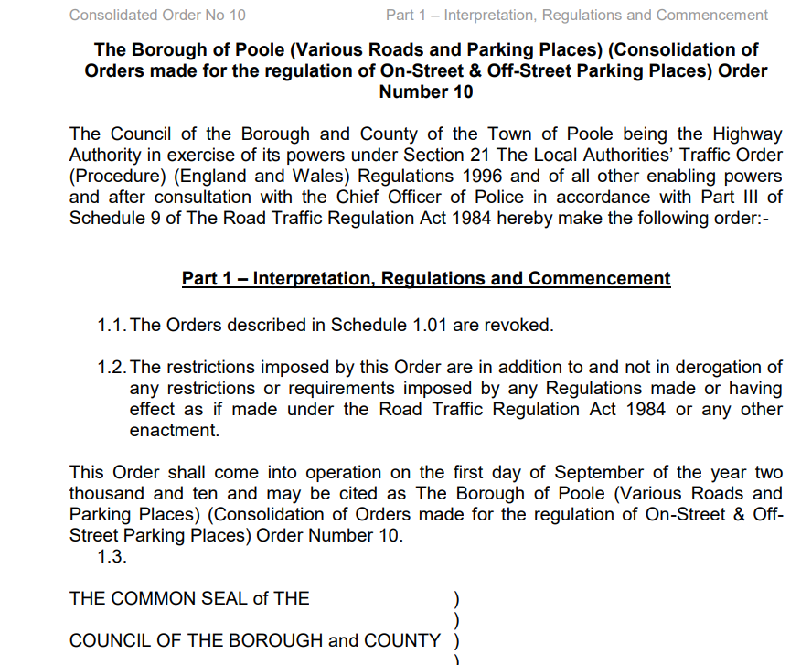
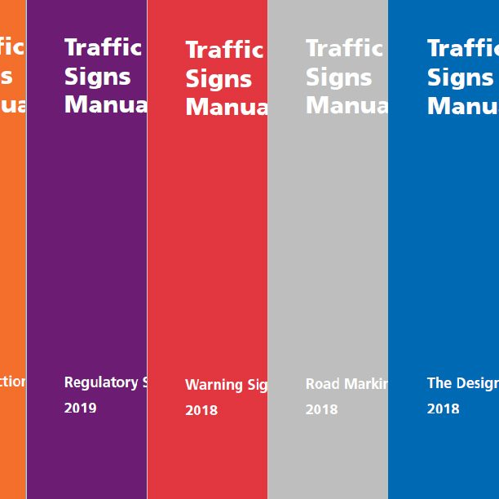
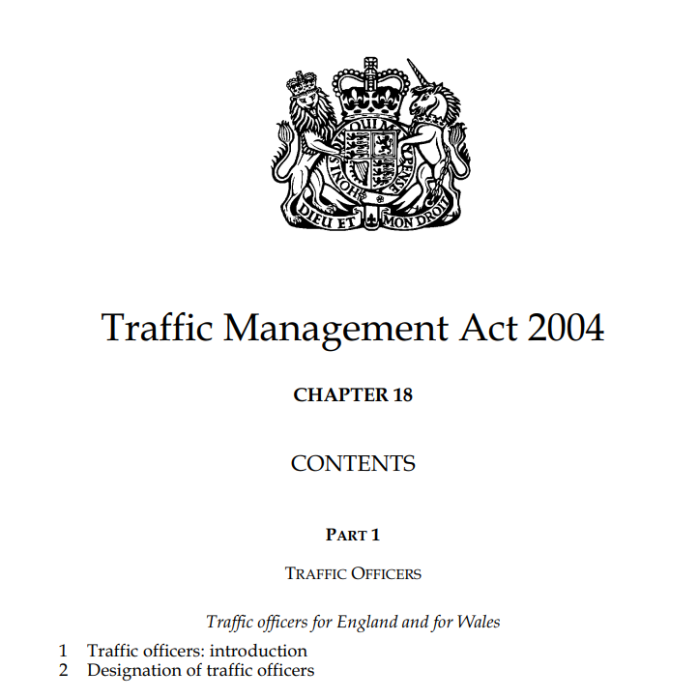
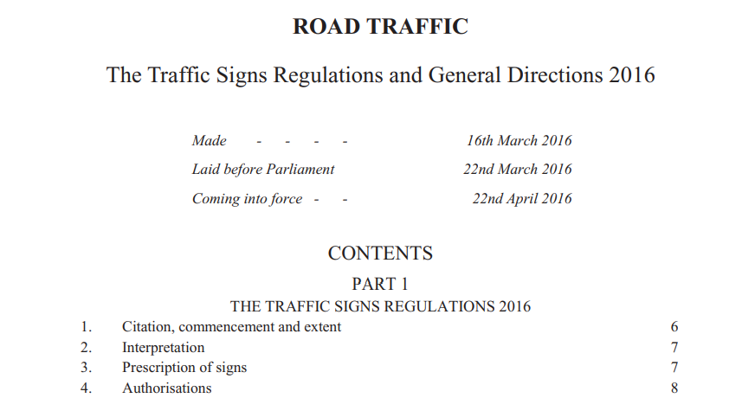
Rules of the road – organising traffic
Highways Act 1980 – the right to pass and repass
TMA 2004 – Network Management Duty (expeditious movement of traffic)
TSRGD
Traffic Signs Manuals
Traffic Orders
Highway Code
Notes:
Traffic on roads consists of road users including pedestrians, ridden or herded animals, vehicles, cars, buses and other conveyances, either singly or together, while using the public way for purposes of travel. Traffic laws are the laws which govern traffic and regulate vehicles, while rules of the road are both the laws and the informal rules that may have developed over time to facilitate the orderly and timely flow of traffic.

Slide 5
What the Government said….
Civil Enforcement of Parking, Bus Lane, and Moving Traffic Contraventions –Advice Note
Legisltaion changes and instructions on how to apply for Moving Traffic Enforcement Powers
LA Part 6 Q&A (britishparking.co.uk)
Bus lane and moving traffic enforcement outside London - GOV.UK (www.gov.uk)
The first tranche deadline will be 20th May 2022

Slide 6
What we decided to do…..
Strong political desire to be early adopters
Review of funding opportunities – clear link with BSIP and other key projects
Selection of appropriate sites – 15 yellow boxes

Slide 7
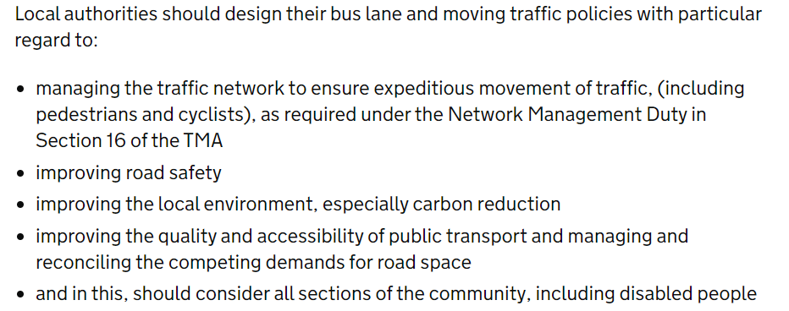
How we did it…..
Review of Policies as per DfT guidance
Consultation – public, police and stakeholders
Application Letter
Physical review of all sites

Slide 8
What is still in Progress….
Governance reporting
Device and Software procurement
Staff Training
Further publicity/comms
Signing and lining refresh

Slide 9
What is left to do….
Review of all sites effectiveness
New sites to consider
Resourcing
Reporting

Slide 10
Summary…It’s all about SUPPORT
BPA
Peers
Suppliers
Contractors
Team
Finance
Political

