Slide 1





Imperial User Group
21st October 2021

Slide 2
Application Support
Mandy Watson

Slide 3
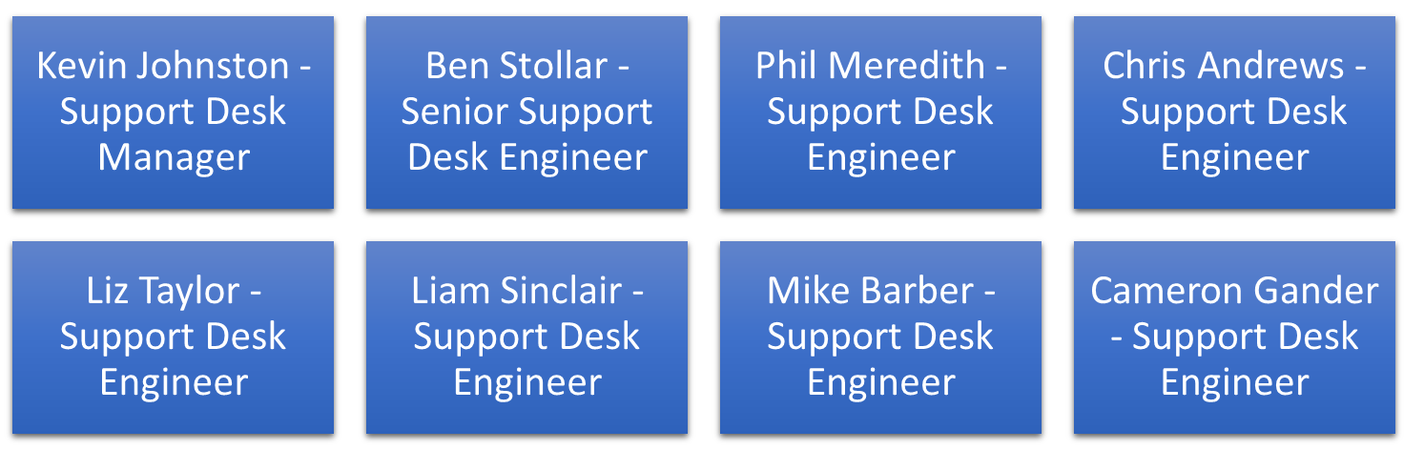
Support Desk Team
Cameron Gander joined the Help Desk on the 05/07/2021

Slide 4




Logging calls with The Support Desk
By Web
https://support.imperial.co.uk
By Email
Support@imperial.co.uk
By Phone
0117 311 6688

Slide 5
Modaxo
Mandy Watson

Slide 6

What is Modaxo?
A global collective of technology companies passionate about changing the face of public transportation
  2000 people, 35 offices, 21 countries
  Sharing industry knowledge and market understandings to help drive new product innovation and services

Slide 7
What does this mean for Imperial customers?
  No change in day to day business
  Product Roadmaps continue
  Future transport initiatives
    Working to improve the local transport experience.
    March and April 2021, Imperial and Trapeze Group hosted two roundtables with a variety of subject matter experts on the topic of post-Covid-19 air quality.

Slide 8

White Paper
  Download: www.imperial.co.uk

Slide 9
Mandy Watson
Software Update
3sixty product Suite

Slide 10
3sixty Web
Liz Smart retired end of August
Helen Clements now the product owner
  Worked at Imperial for 19 years.
    12 years on the support desk
    7 years in development as an Analyst

Slide 11
Where are we now
Latest version V2.4
  Full end to end processing

Slide 12
Extra functionality
TEC interface validity
Email attachments
Adding storage costs for impounded vehicles automatically
Can “recreate” the one-time reports
Direct link to GeoSmarti
Assign incoming email & Batch scanning – Can now update existing names with the email address rather than add a new name record

Slide 13
Road Map
V2.5 & V2.6 – Improve performance and resilience to cope with ever increasing cases in the system.

Slide 14
Road Map highlights
6-9 months
  Ability to auto create a VQ4 – Will reduce the need for human intervention
  London tribunals integration – phase 1 – Automatically creating the case pack and all docs
  Multi factor authentication – to offer an extra layer of security when using 3ixty Web

Slide 15
GoSmarti
Manages incidents recorded in 3sixty
API for 3rd parties
  e.g. Smart Bay sensor overstay, CCTV spotter cars, Fault reporting
  Next release:
  Real time clamping/removals

Slide 16
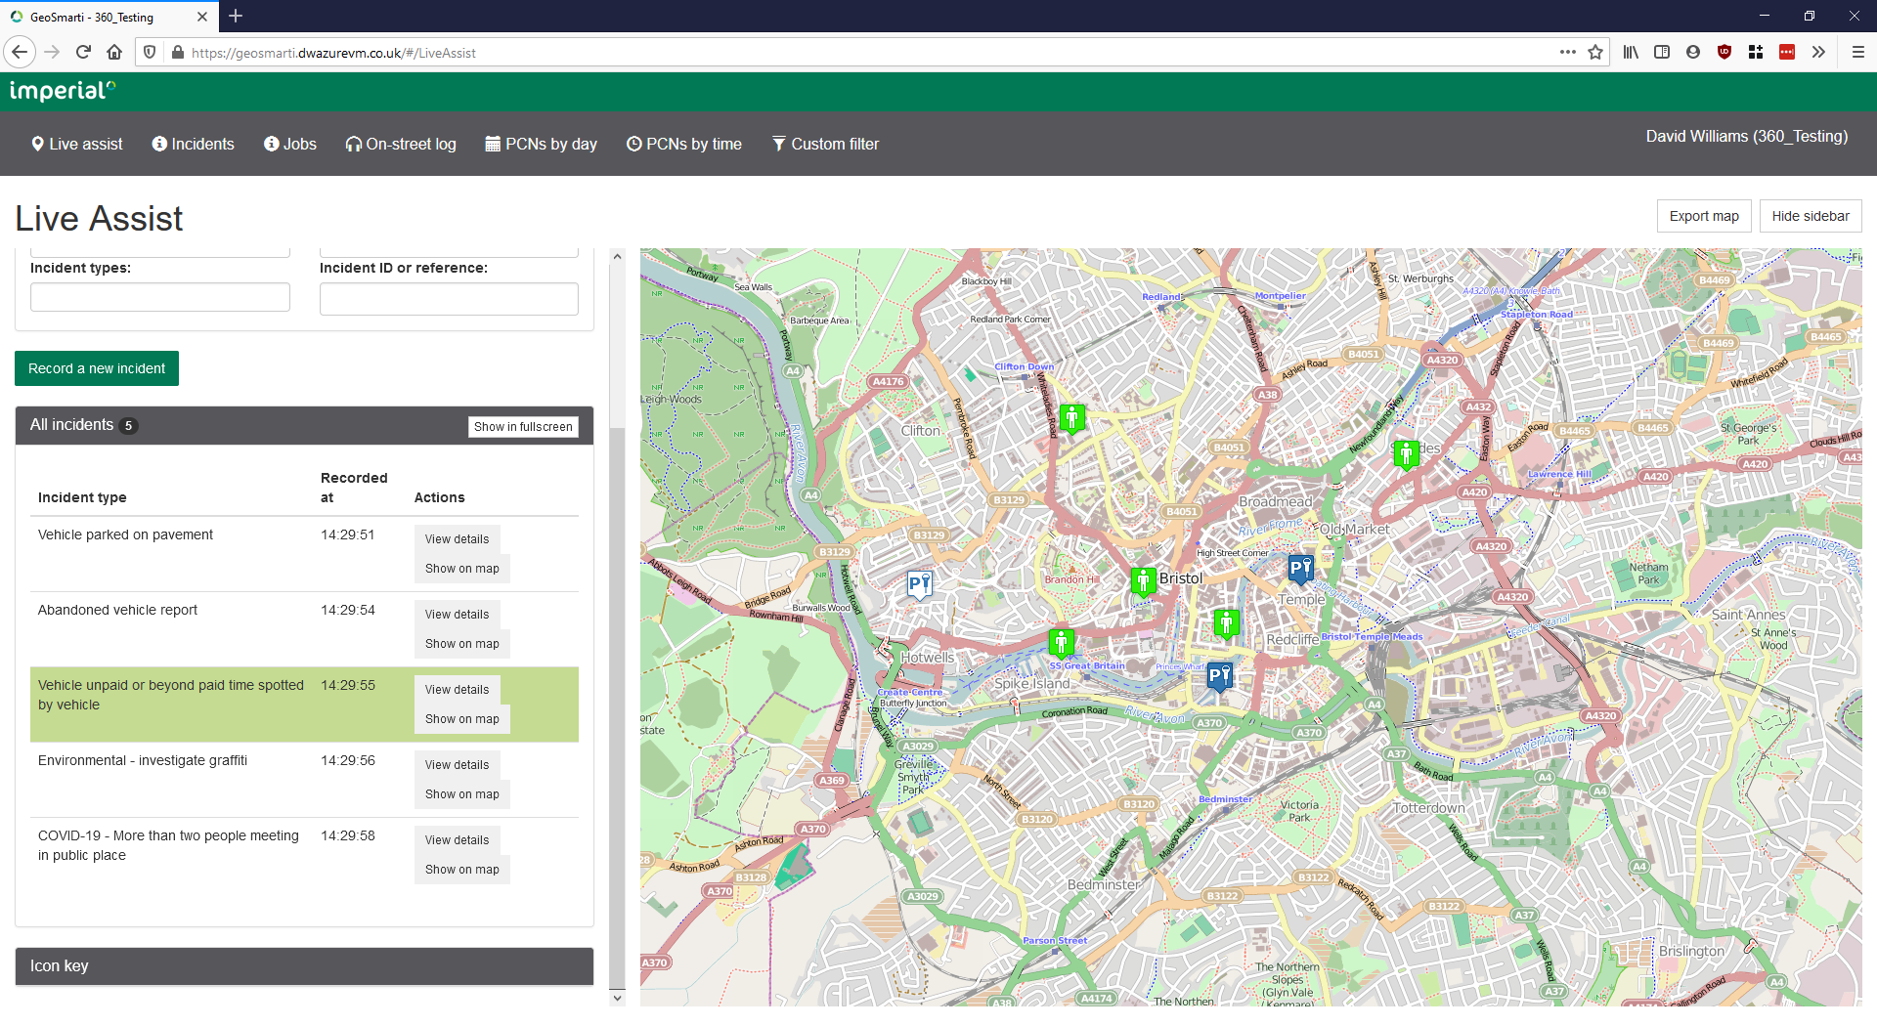

Slide 17
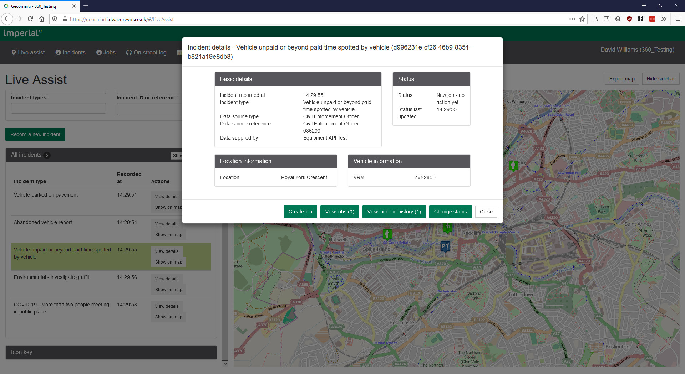

Slide 18
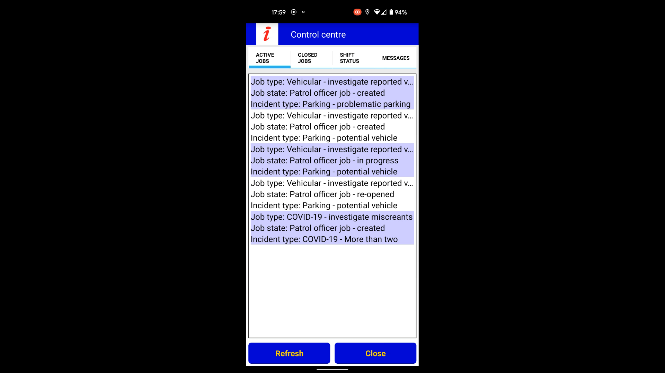
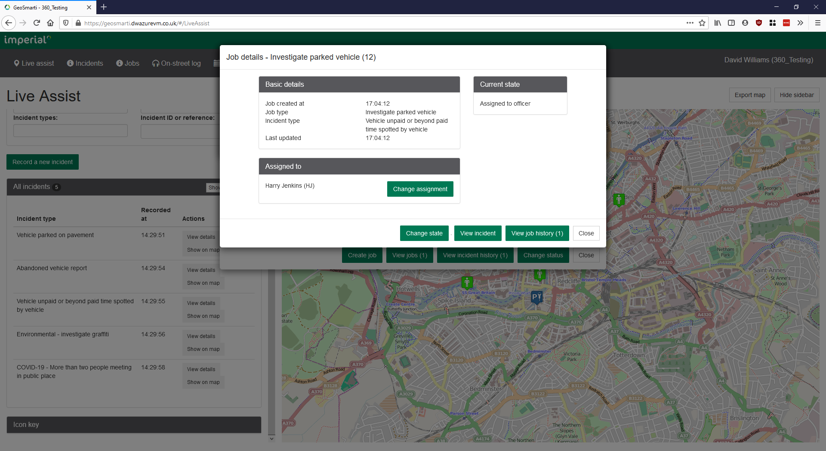


Slide 19
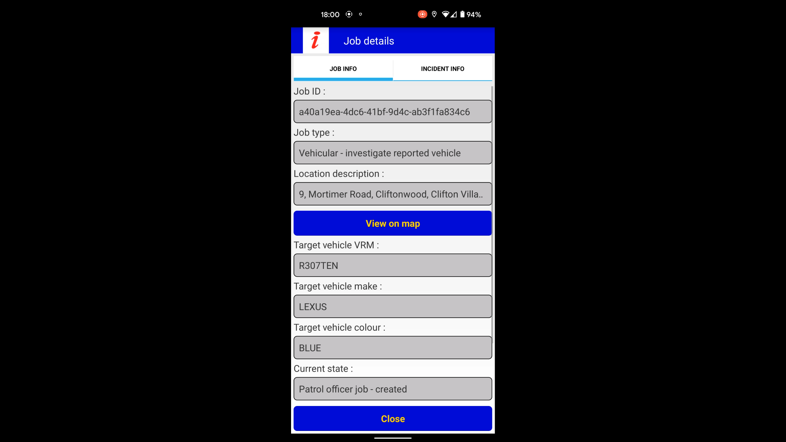

Slide 20
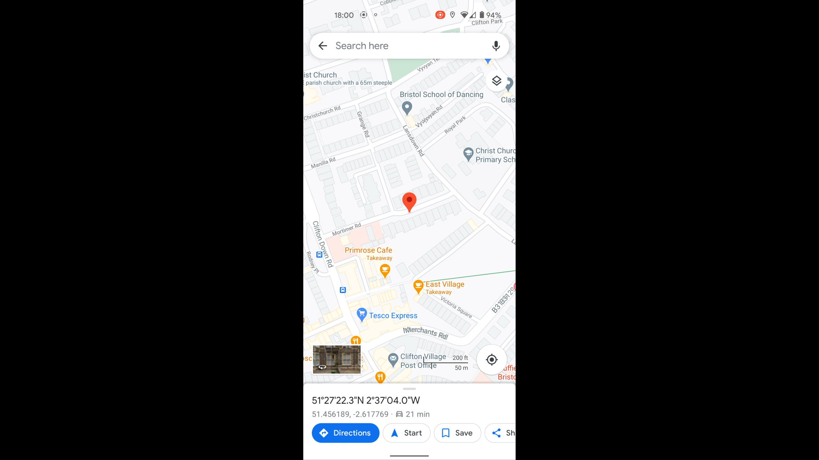

Slide 21
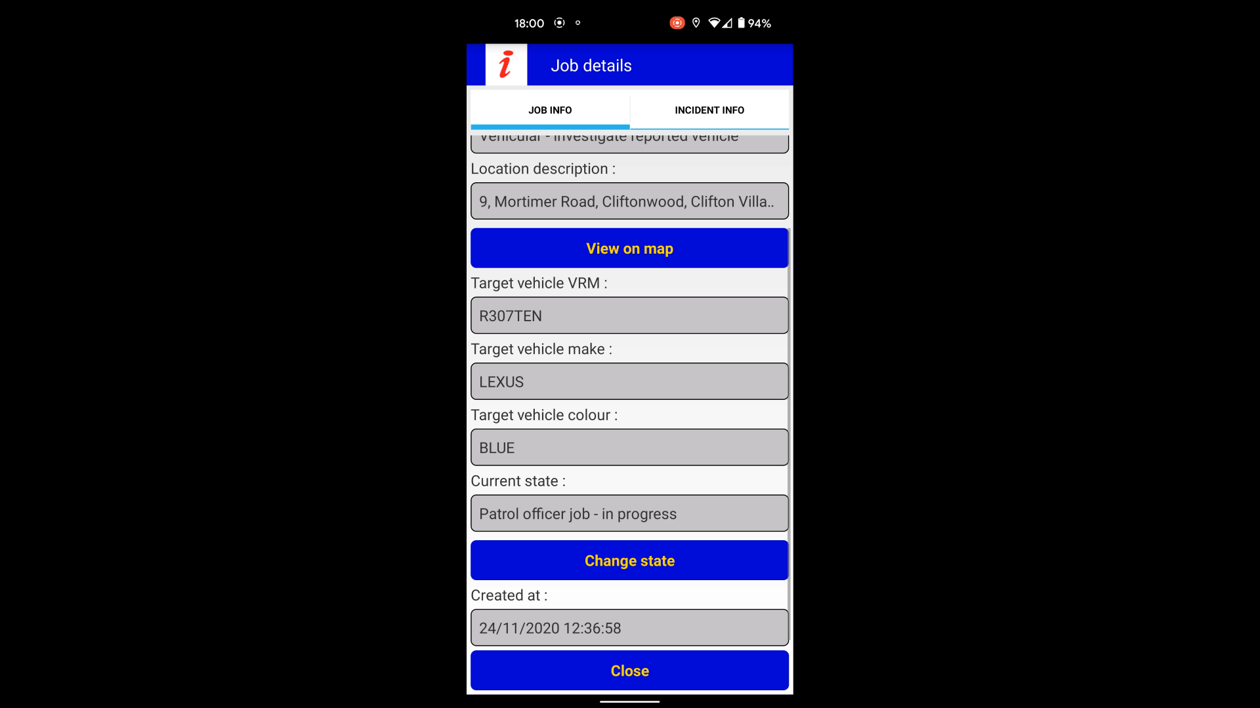

Slide 22
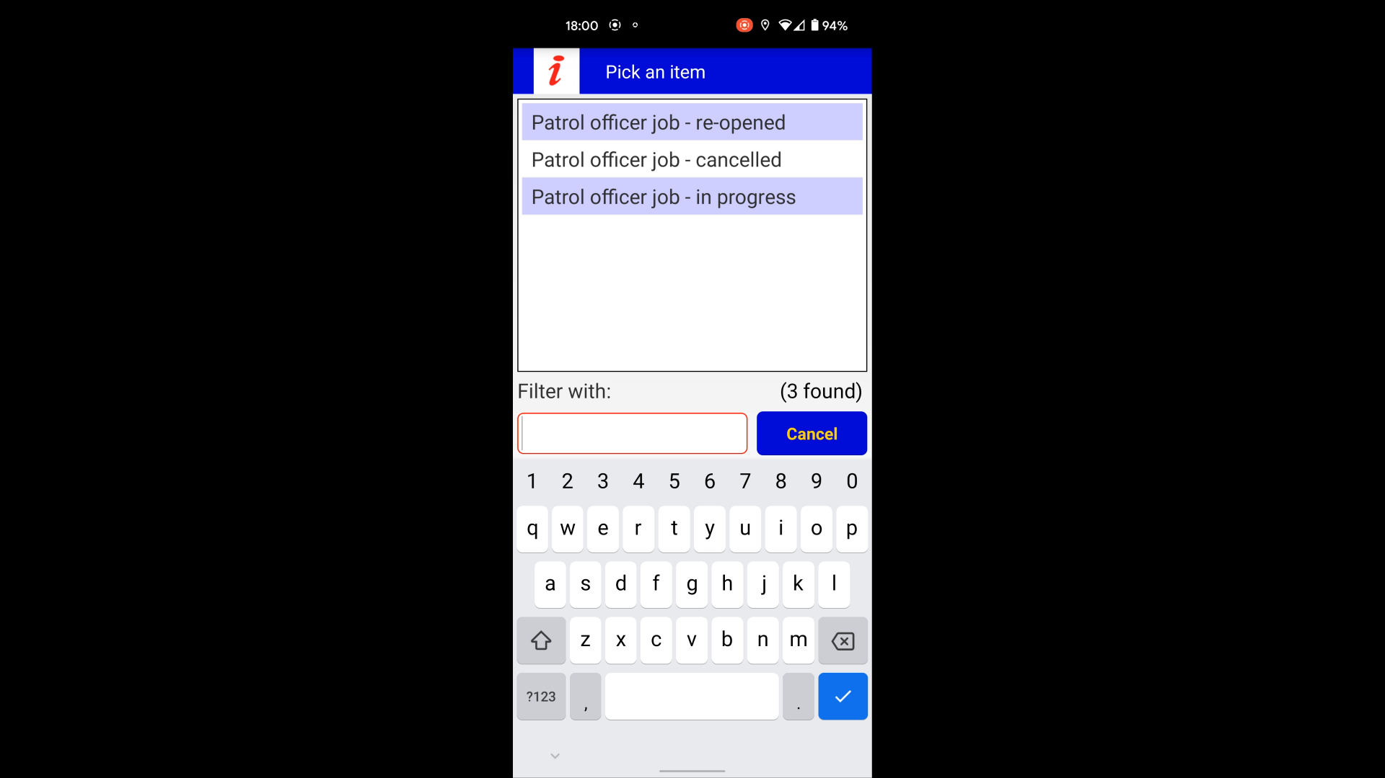

Slide 23
Strong Customer Authentication
Mandy Watson

Slide 24
Upgrade to facilitate changes
Systems must be compliant by 14th March 22
Development changes made to 3sixty Citizen and PermitSmarti.
  VoucherSmarti changes planned November 21
  Quotes going out to all customers effected
  New Merchant IDs (MIDs) will be required

Slide 25
Chris Tubby
Software Update
PermitSmarti

Slide 26
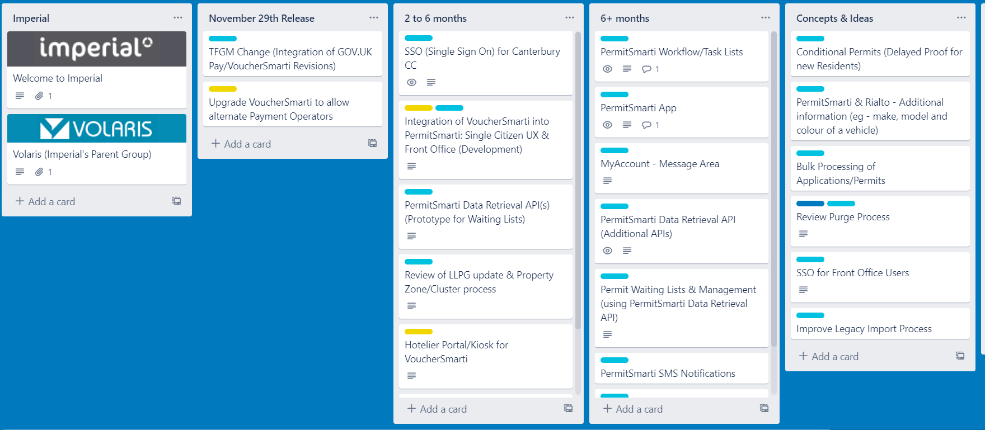
PermitSmarti Road Map

Slide 27
Roadmap – Key Items
Vouchers into PermitSmarti
Feedback indicated that this is considered to be the primary improvement by a number of Operators…so we’ve made a start!
Citizen will no longer be taken to a separate site (VoucherSmarti) to book voucher sessions
VoucherSmarti functionality will be consolidated into the citizen’s ‘MyAccount’ which sits in PermitSmarti
Notes:
Roadmap – Key Items – A summary of each principal item in the Roadmap (for consideration) will be identified and a limited summary of the proposed functionality. This will lead to the Roadmap being screen shared at the end of the presentation as a starting point for discussion, and I’ll literally move the items around the Trello board based on a balanced view of the feedback received. I’ll also add any significant issue that are raised if there is a merit in adding it into the Roadmap.
Vouchers into PermitSmarti – As we’ve already completed the initial design step for the merge, I’ll then proceed to work through the principal screens indicating where we have consolidated functionality.

Slide 28
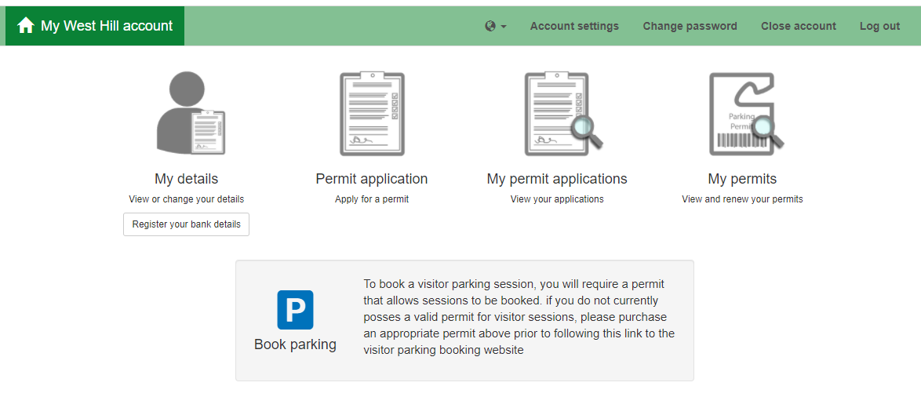
Vouchers into PermitSmarti

Slide 29
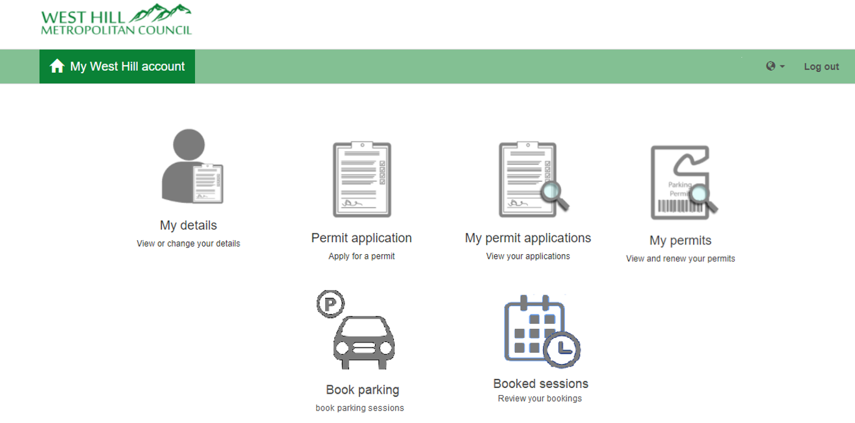
Consolidated MyAccount

Slide 30
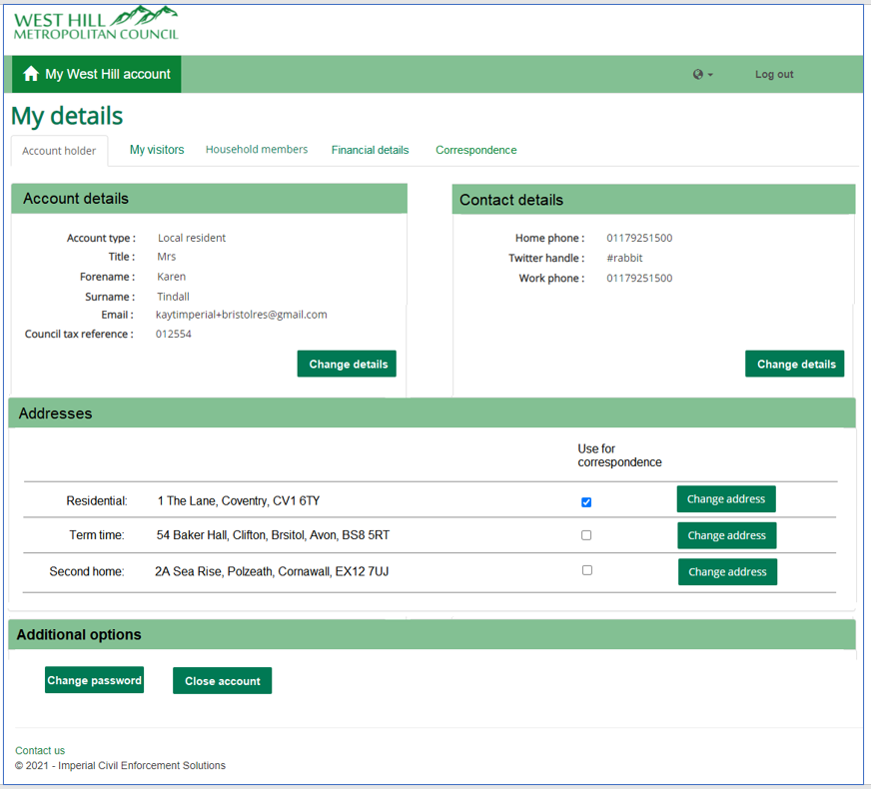
My details (Account holder)

Slide 31
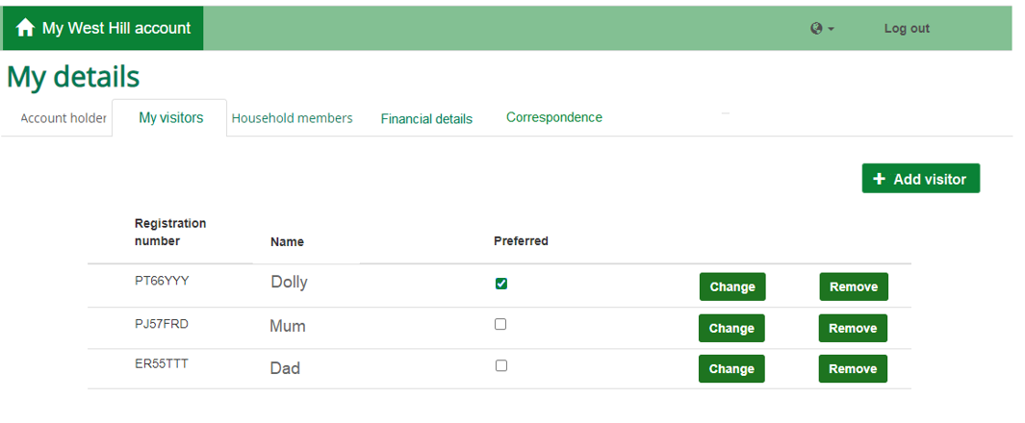
My details (My visitors)

Slide 32
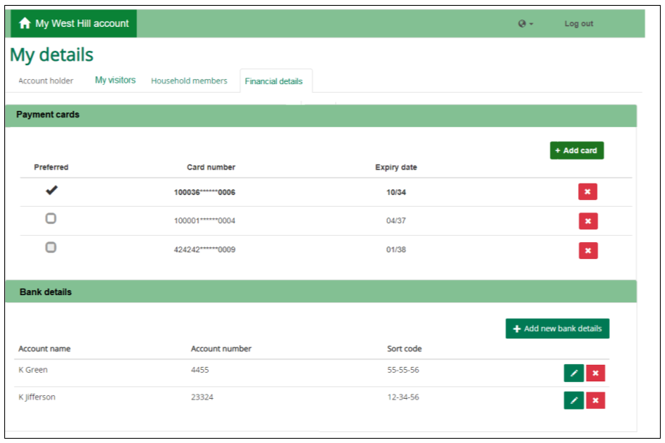
My details (Financial details)

Slide 33
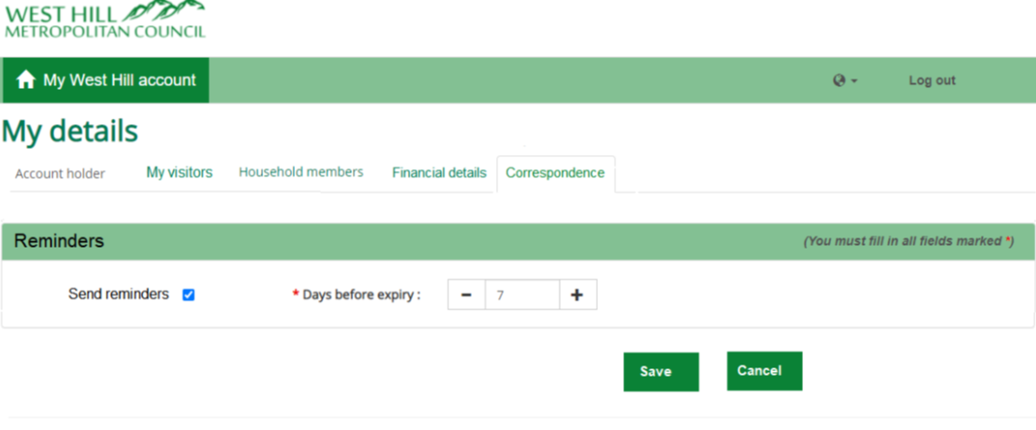
My details (Correspondence)

Slide 34
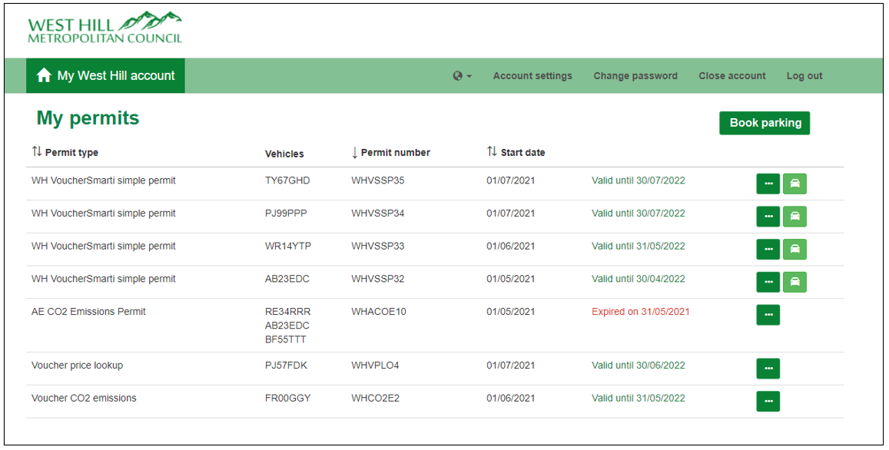
Combined Permit/Booking

Slide 35
Roadmap – Key Items
Hotelier Portal/Kiosk for Vouchers
(pre cursor) Integration of Vouchers into PermitSmarti
Facility to purchase vouchers without creating an account
Hotelier/Organisation will hold underlying permit
Notes:
Hotelier Portal/Kiosk for Vouchers – Expansion where applicable on the points above

Slide 36
Roadmap – Key Items
LLPG/Property Cluster Updates
Analysis to identify an improved method
Implement improved process for consuming LLPG/Property Clusters from Operators
Consider referencing the NLPG directly
Notes:
LLPG/Property Cluster Updates – Expansion where applicable on the points above

Slide 37
Roadmap – Key Items
PermitSmarti App
(pre cursor) Integration of Vouchers into PermitSmarti
Provision of MyAccount via an iOS/Android app
Consider log in using mobile phone number (rather than email address)
Notes:
PermitSmarti App - Expansion where applicable on the points above

Slide 38
Roadmap – Key Items
PermitSmarti Workflow/Task Lists
(pre cursor) Integration of Vouchers into PermitSmarti
PermitSmarti’s workflow is currently driven through emails
Not efficient if Operator has high/peaks in volume
Introduction of workflow/task lists, consolidating workloads to specific users
Notes:
PermitSmarti Workflow/Task Lists - Expansion where applicable on the points above

Slide 39
Thank you

