Slide 1
Your Association, working for you Stacey Chaplin (Cofely/North East Lincolnshire Council), BPA Yorkshire and Humber Regional Chair
ICES User Group
Harrogate, Thursday 26th March 2015
Notes:
The British Parking Association (BPA) is the largest professional association in Europe, with over 700 members, representing organisations in the parking and traffic management profession.
The BPA aims to actively represent and promote the sector by advancing knowledge, raising standards and professionalism, and using its influence to deliver excellence for the benefit of all.

Slide 2
BPA governance
Notes:
The association has developed a new governance structure (based on the structure of the parliamentary model) composed of:
30 Council of Representatives (“MPs”)– represents, debates, scrutinises, informs, influences and questions
9 Directors / BPA Board (“Cabinet”)– Consults on and develops strategy, oversees the Management of the business, budgets, business plan and maintains legal responsibilities
Staff Executive (“Civil Servants”) – manages day to day business and progresses policy, strategy and reporting/communicating to members
Note: All those in red writing are also electoral colleges (special interest and regional groups)
The adopted structure seeks to empower members in directing the association and ensures that the association represents members and best practice across the different sectors of the profession.

Slide 3
5 year strategy
5 Year Strategy
Our core Business Plan objectives:
Putting the consumer at the heart of our thinking
Developing membership and delivering better value
Informing and influencing Government
Building a consensus with all stakeholders
Promoting innovation, technology and sustainability
Making parking a recognised profession
Notes:
To achieve excellence in parking, the BPA has developed a 5 year strategy (2012 – 2017) targeting the following objectives-
Putting the consumer at the heart of our thinking
Developing our membership and delivering better value
Informing and influencing Government
Building a consensus with all stakeholders
Promoting innovation, technology and sustainability
Making parking a recognised profession

Slide 4
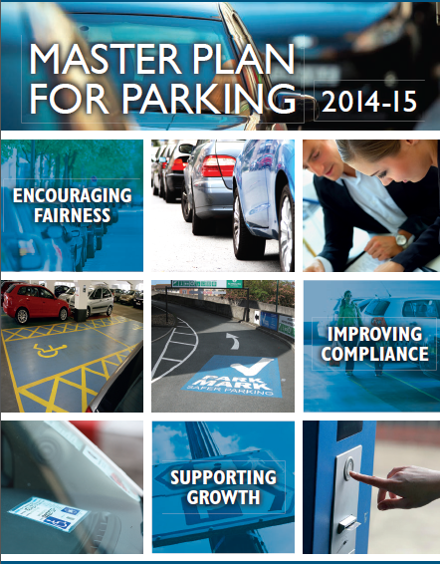
5 year strategy
Master Plan for Parking
2014/15
Rights and Responsibilities
Encouraging Fairness
Improving Compliance
Supporting Growth
2015/16
Keeping Society Mobile
Enabling Sustainable Growth
Promoting Innovation and Investment
Delivering Fairness in Parking
Notes:
The BPA’s Master Plans for Parking are launched at the President’s Reception each year. Master Plans have become an established part of BPA work to inform and influence Government. They set out the Association’s view on how governments can assist in improving parking related legislation for the benefit of members and motorists.
Plans exist for the UK, Scotland and Wales and a similar plan has been developed for Ireland in partnership with the Irish Parking Association.
The BPA is currently developing the 2015/16 Master Plan which will aim to:
Promote Professionalism and raise standards
Encourage responsible collection, recording and use of personal data
Improve accessibility for people with additional mobility needs
Improve Road Safety through better management of parking and traffic
Deliver fair and transparent adjudication for everyone
Encourage effective management of car park operations including structural safety and promotion of best practice
The BPA would like to receive members’ thoughts on what should be included in the 2015/16 Master Plan
Please send feedback to media@britishparking.co.uk by the end of March.

Slide 5
BPA Brands: Products and services
Notes:
Approved Operator Scheme
The first and largest Accredited Trade Association for parking on private and unregulated land
POPLA – The Independent Appeals Service
Since inception, over 50,000 appeals have been assessed by POPLA – 49% have been found in favour of the motorist and 51% for the operator. The contract between the BPA and London Councils for the provision of POPLA ends on 30th September 2015. The BPA has appointed the Ombudsman Services to provide dispute resolution services for POPLA from October 2015.
Park Mark - Safer Parking Scheme
Aims to reduce crime and improve sense of security in car parks. 1 in 4 of all UK car parks (almost 5000) have the Park Mark. The BPA is also launching new brand guidelines and running a workshop on 29th April in London to assist award holders to promote the scheme. For more details contact media@britishparking.co.uk
Model Contract
Designed for organisations that appoint service providers to manage their parking and associated services. The Model Contract is endorsed by the Transport Select Committee and included in the Statutory Guidance.
Know Your Parking Rights
The campaign was launched by Ashley Bijster on 25th November and aims to help motorists by providing a comprehensive and trusted resource so they can better understand parking restrictions as well as clear advice about what do to do if receiving a parking ticket, signs to look out for and other useful facts about the appeals processes available, helping them to save time and money. The new website has now been launched and can be found at www.knowyourparkingrights.org. We would encourage you to publicise the website using the logo. Feedback on the content is also encouraged and should be sent to media@britishparking.co.uk.
Charters
The are currently two charters (one for Healthcare and one for Higher education). The charters aim to strike the right balance between being fair to patients / students, staff and visitors, ensuring facilities are managed effectively for the good of everyone. The BPA are keen for facilities managers and car park operators to recognise the importance of car parking policy in terms of the wider transport strategy and the need to manage traffic and parking in line with demand and environmental needs. The BPA will review and improve Charters in 2015 as they become part of the criteria for organisations to achieve the Professionalism in Parking Award (PiPA)

Slide 6
Public Affairs and Research Update
Influencing government on your behalf
Influencing government on your behalf
Recent responses:
We are responding to:
Royal Mint -Technical specification of the £1 coin
Healthcare Travel Costs Scheme (Wales)
Welsh Transport Plan
Identifying Best Practice in NHS Car Parks
DfT rail penalty fares
The TfL Streetscape design
Notes:
Over the last year the BPA secured important concessions in proposals to ban local authority camera enforcement in England, assisted the Ministry of Justice to develop fairer rules and fees for bailiffs in England and Wales and collaborated with the Department for Transport on the UK traffic signs review and the emerging draft Traffic Signs Regulations and General Directions 2015.
The BPA have recently responded to the Royal Mint Technical consultation for the specification of the £1 coin, as well as the Healthcare Travel costs Scheme (Wales), Welsh Transport Plan 2015, and the Department of Health Transport management and car parking - Identifying best practise in NHS car parks.
Currently the BPA is drafting responses for The TfL Streetscape design, and DfT’s consultation on rail penalty fares.
The governments local authority parking reforms – Deregulation Bill The BPA lobbied government on members behalf, strongly opposing the complete ban of CCTV. The BPA collaborated with London Councils and LGA, campaigning strongly for exemptions at school clearways, bus stops and stands, bus lanes and red routes, which are now embedded into regulations.
Private Parking legislation changes/lobbying
The result of the forthcoming High Court of Appeal case – Parking Eye .v. Beavis – should bring much needed clarity to the sector on the subject of Genuine Pre-Estimate of Loss. The BPA continue to lobby for legislation to introduce Keeper Liability and an Independent Appeals Service to Scotland and Northern Ireland. The newly announced EU requirements for Alternative Dispute Resolution may accelerate this.
These activities help the BPA raise the profile and reputation of its members, continuously communicating the views of the profession.

Slide 7
Fighting you corner on TV, Radio and in the press
A media session at Parkex will encourage members to participate
We are liaising with Century Films over the new series of Parking Mad
Patrick Troy interviewed for Channel 4 dispatches
We have appeared on National TV/radio slots in response to RAC Foundation report
Notes:
Parking in the media
The BPA have responded in the media to a number of recent issues: Chief Executive, Patrick Troy has been interviewed on the recent ‘Dispatches’ Channel 4 programme and both Patrick and Kelvin Reynolds, have appeared on radio and TV in response to the RAC Foundation’s report on private parking charges.
A new series of Parking Mad has recently been commissioned and will be aired by ITV. Producers aim to create a balanced series, showcasing life in the UK and the impact of parking and traffic management in different locations. Filming will take place between February and May with the series due to air around the end of the year.
Producers have already started to contact people with a view to gathering information and content for the programme and have met with the BPA to discuss further.
The BPA website blog has proved successful in generating page views and links to the site with on average 500 – 1000 views per post. In August, 2 posts in response to Daily Mail articles together gained over 7000 views. The ‘Monday Musing’ theme continues by focusing on a current topic intended to stimulate debate. Guest blogging has been introduced and we have received a number of enquiries and submissions from members.
The BPA will continue to aim to change the public perception of parking, by commenting on current affairs and communicating messages to a wider audience.

Slide 8
Publishing cutting edge research, news and intelligence
Parking Practice notes
Information notes
Research reports
Infographics and insight in Parking News
Monday Musing Blog posts
LinkedIn discussion group
Research the Research project – collating Academic Research
Supporting Universities with
funding via John Heasman Bursary
Notes:
The BPA is keen to better understand our profession and aims to utilise any current research that exists whilst encouraging further study and research to develop a comprehensive picture of this diverse and challenging sector.
In 2005 we set up the John Heasman Bursary, created in order to encourage research in the parking and traffic management profession.
The Ernest Davies Award for Advancing Parking Knowledge was set up in 1994 with the aim of "encouraging younger members to communicate both verbally and in writing on matters relating to any aspect of parking in its broadest sense".
Researching the Research
Adam Snow, a final year PhD student at Keele University, has been appointed to undertake a project to Research academic research and will submit his final report by 1st April. Adam’s brief is to provide a report which will identify gaps in knowledge and where further research would benefit the profession. He will also offer suggestions for potential funding sources so that we might approach other research organisations with a view to working with them collaboratively on projects.

Slide 9
Working hard to make parking a recognised profession
Professional Parking Qualifications in partnership with WAMITAB:
• Level 2 Award for Parking Enforcement Officers
• Level 3 Award for Notice Processors
Development of the Professionalism in Parking Award
Conducting audits and guides members’ compliance with the Associations codes of practice, codes of conduct and developing charters
Notes:
As the recognised authority within the parking profession, the BPA represents, promotes and influences the best interests of the parking and traffic management sectors throughout the UK and Europe.
The BPA promotes and encourages professionalism within the membership to encourage awareness and uptake of organisational and individual professional development and increasing legitimacy within the profession.
Currently there are over 700 members, equally split between the public and private sectors, 140 of these are members of the Approved Operator Scheme. There are also 99 individual members – individual membership recognizes individual's commitment to the parking profession and your continuous professional development
WAMITAB The BPA has launched flexible, up-to-date parking qualifications for both regulated and unregulated environments in partnership with WAMITAB, the new awarding organisation for parking qualifications, which include:
• Level 2 Award for Parking Enforcement Officers
• Level 3 Award for Notice Processors
PiPA PiPA is envisaged as a universal accreditation for all sectors of the parking profession. It will feature high-level principles known as the PiPA criteria, which will be applicable to all sectors. This new form of accreditation will serve as the benchmark for professional excellence in parking, helping to promote parking as a recognised profession.

Slide 10
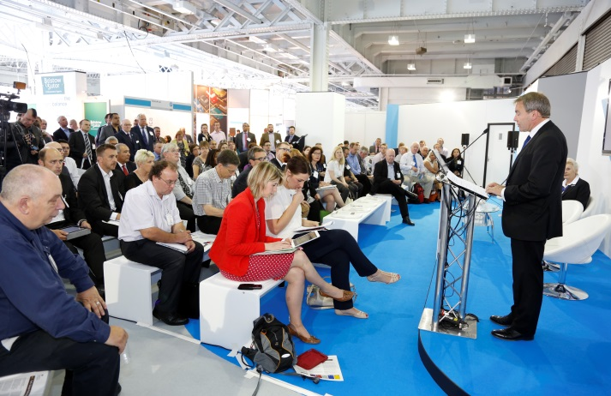
How we communicate
Notes:
The BPA aims to keep members informed about current developments in the profession via a number of different channels.
e-communications
Parking News
Websites, online forums and social media
Regional meetings and special interest groups
Conferences and events

Slide 11
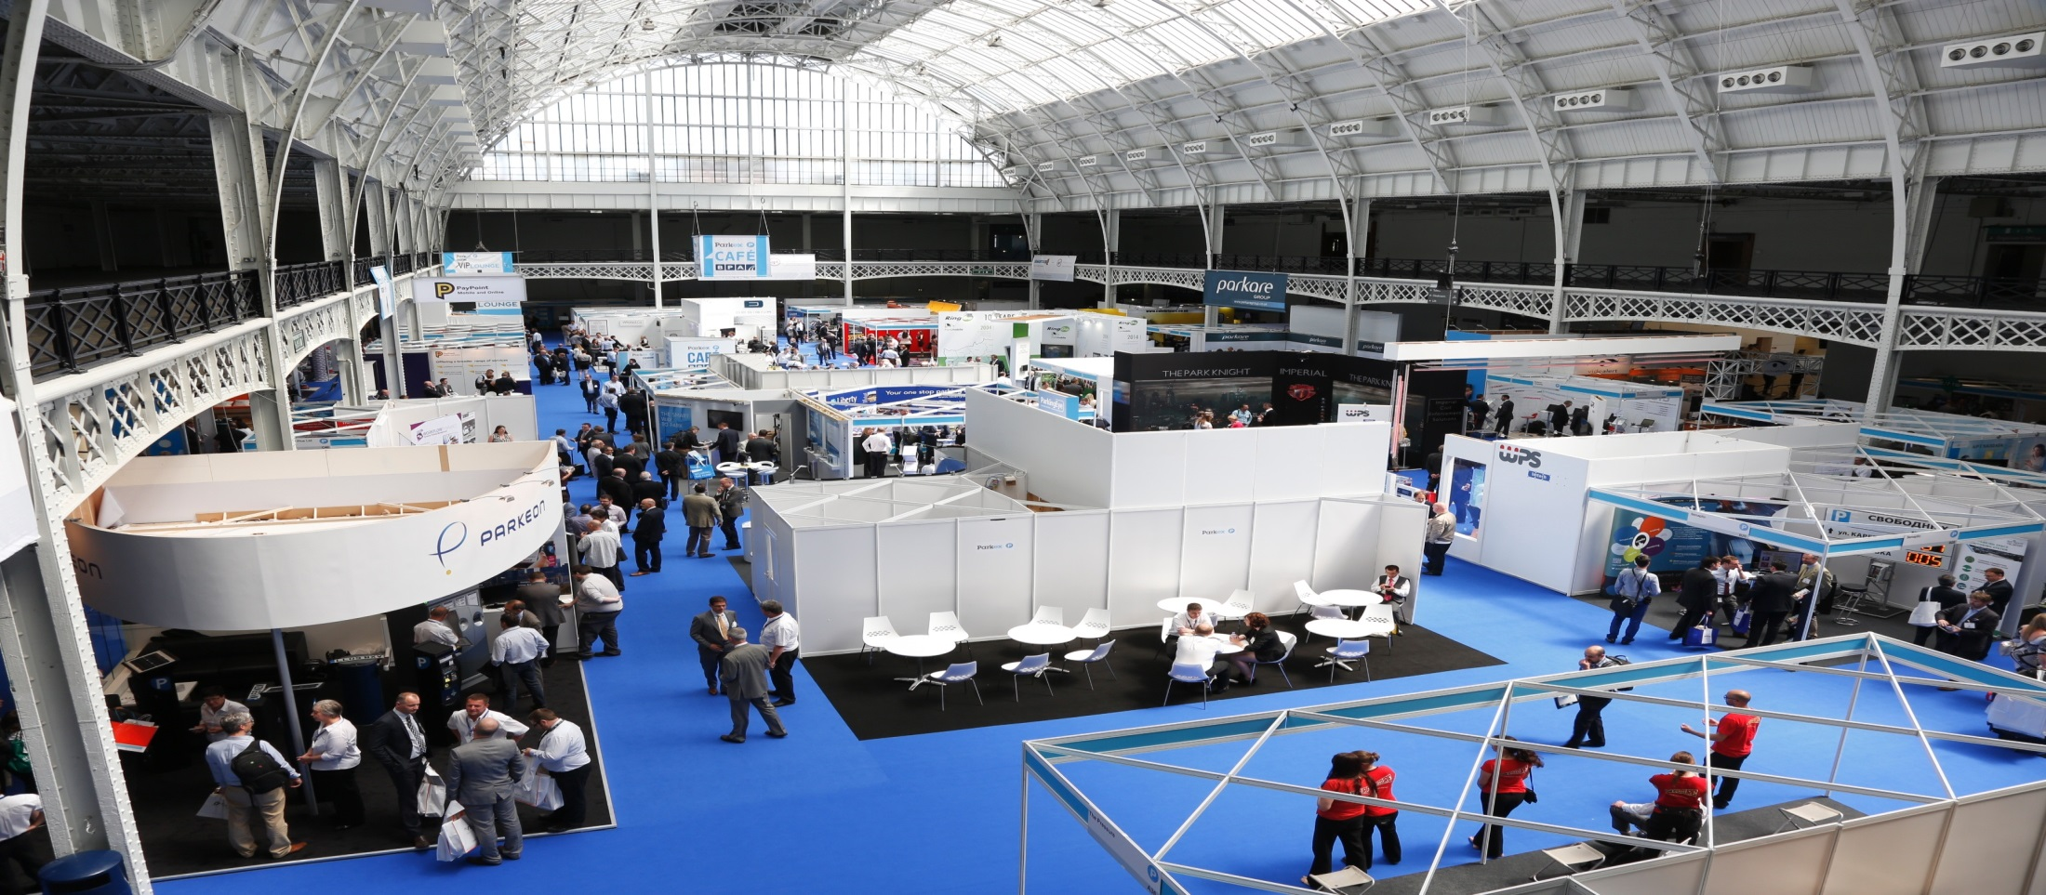
Building a parking community for you
Parkex/Traffex at Birmingham NEC 21st – 23rd April
AGM and President’s Reception 29th June
Annual Conference Central Hall Westminster
6th October
Regional and Country Group meetings
Focus groups
Online discussion forums
Notes:
The BPA provides its members with a number of networking opportunities, knowledge sharing sessions at regular meetings and major events throughout the UK.
In the last year event success grew with…
Over 480 Members attending regional and special interest group meetings. The first round of regional and country meetings for 2015 are currently underway.
The successful launch of the Parkex Hub. A full seminar programme is being developed for this year’s event at NEC.
The highest turnout yet at the BPA Annual Conference. The 2015 conference is scheduled to take place on 6th October, again at Central Hall Westminster
Another sold out Members’ Dinner event at Draper’s Hall. Save the date on 2nd December for 2015 event.
Richard Burden MP is the host sponsor for the 2015 President’s Reception and a date has been secured – Monday 29th June.
A number of dedicated Focus Groups
For a full list of meetings and events, go to the website at www.britishparking.co.uk/Events.
Online discussion forums on the BPA website
BPA events provide an opportunity to network, meet colleagues and make new connections as well as keeping up to date with all the very latest from professionals in the sector.
Online discussion Forums such as LinkedIn and the BPA’s dedicated website Forums allow communication to continue outside of events and at a time to suit you.
Visit www.britishparking.co.uk for more details.

Slide 12
Thank you

