Slide 1
3sixty Functionality
“Version 5 is a thing of great beauty.”
Stuart McGregor
Parking Ticket Office Manager City of London
6th June 2015
Notes:
Had to show this as it’s the nicest thing that anyone has ever said about 3sixty. Does anyone ever ring support to say ‘I like this….’? Now, wait till you see what’s in V5.1

Slide 2
3sixty V5.1
Available now
New release of Rialto as well
18 items (40%) were requested by the Steering Group
Integration with LetterSmarti
Some features to assist those upgrading from Parking Gateway
Notes:
Contact support to book the upgrade or of you haven’t received the release notes. Full details of everything I mention in the release notes.

Slide 3
Features to assist PGW users
View of permits from Main Case Screen
User migration report
Photos embedded in letter
Notes:
BG03HXW. We’ll see photos in a minute.
Status of each permit associated with the VRM as at the date of contravention.

Slide 4
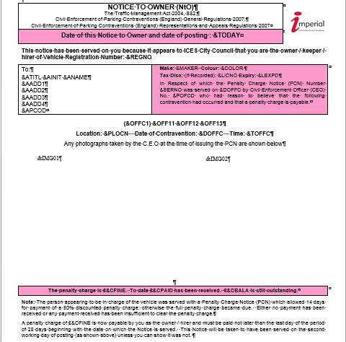

Slide 6
New features in V5.1
No longer need a cashless parking cross reference file
Schedule calculation and extract of persistent evaders
Enforcement agency returns in a single file
Notes:
Configure the Ringgo/ Bemrose/ whatever against the location in 3sixty
Schedule after Rialto import and overnight but before Rialto extract

Slide 7
Other cool features
Search for cases by state code
Export of case results
Export of reports to Excel
Batch progression file import
Schedule import of VQ5, payment file
E-mail – attaches letter as a pdf
Much harder to do the wrong thing!
Notes:
STAT state code, export of results to csv. If you can search for it, you can report on it.
Data from every report can be exported into a variety of formats. Can import a file containing case numbers so they can be progressed all at once. Real example using a new feature which can handle white list vehicles.

Slide 8
Data migration to 3sixty
Data created in 3sixty to match data in PGW. Data is not removed from PGW.
Must be on PGW V8.4
Must run a purge first to remove closed cases issued before 31/03/2012
Will migrate all open TMA cases
Two other utilities must also be run
Letter extraction
UAT file snapshot
Notes:
Please check if purge is running and if so, if it’s working. If not running please place a call with support to get it going.
Must be at V8.4 to step across to 3sixty.

Slide 9
Data migration to 3sixty
Your data gets a health check
Good opportunity to leave behind old stuff
PGW database retained if you use Permit Gateway
Access to parking data will be removed
Notes:
For example we found many hundreds of cases at one council which had effectively become lost, some of them had been in these states for two years or more. Not systems fault but just in states that no=one was checking. We brought these to council’s attention and they are now reviewing them.
RTA91 config and cases, cancellation reasons used once in five years. Get a good tidy-up.

