Slide 1
Introduction to the
User Group
November 7th 2019
© 2019 Volaris Group Inc., its subsidiaries and affiliates. All rights reserved.

Slide 2
$3.0B total revenues
c10% employee ownership
15,000+ employees across the globe
140,000+ customers in over 100 countries
450+ acquired businesses
© 2019 Volaris Group Inc., its subsidiaries and affiliates. All rights reserved.

Slide 3
The Volaris Family
AGRIFOOD
ASSET MANAGEMENT
BIO SCIENCES
COMMUNICATIONS
CULTURAL COLLECTION MANAGEMENT
DRINKS
EDUCATION
FINANCIAL SERVICES
JUSTICE
LIBRARY MANAGEMENT
MARINE
NON PROFIT
PEOPLE TRANSPORT
RENTAL MANAGEMENT
RETAIL
© 2019 Volaris Group Inc., its subsidiaries and affiliates. All rights reserved.

Slide 4
The Volaris Difference
Unlike most Private Equity or Venture Capital Funds, we hold onto our acquisitions indeﬁnitely. With nearly 20 years’ experience and hundreds of closed transactions to date, we are proud to say that we have never sold a core business.
We encourage sharing best practices across our entire organization, and regularly bring our people together for functional summits across the world.
As part of Volaris, our companies have the autonomy to continue running their business while gaining the benefits of belonging to a larger organization.
We enable our companies to lead their respective industries by providing them with the capital necessary to make sustainable improvements to their business.
© 2019 Volaris Group Inc., its subsidiaries and affiliates. All rights reserved.

Slide 5
What it means for clients
A safe, long-term home for your supplier of a mission-critical system .
Increased innovation and client collaboration, with access to extensive and diverse knowledge and experience of technology and service development
The team, including the management team stays the same. You can continue to rely on the experts that provide your current service. The team will benefit from the Volaris emphasis on talent management
Volaris will acquire the shares of Imperial Business Systems. Contract terms and conditions remain exactly the same, and no novation of contracts is necessary
© 2019 Volaris Group Inc., its subsidiaries and affiliates. All rights reserved.

Slide 6
Transport Solutions
© 2019 Volaris Group Inc., its subsidiaries and affiliates. All rights reserved.

Slide 7
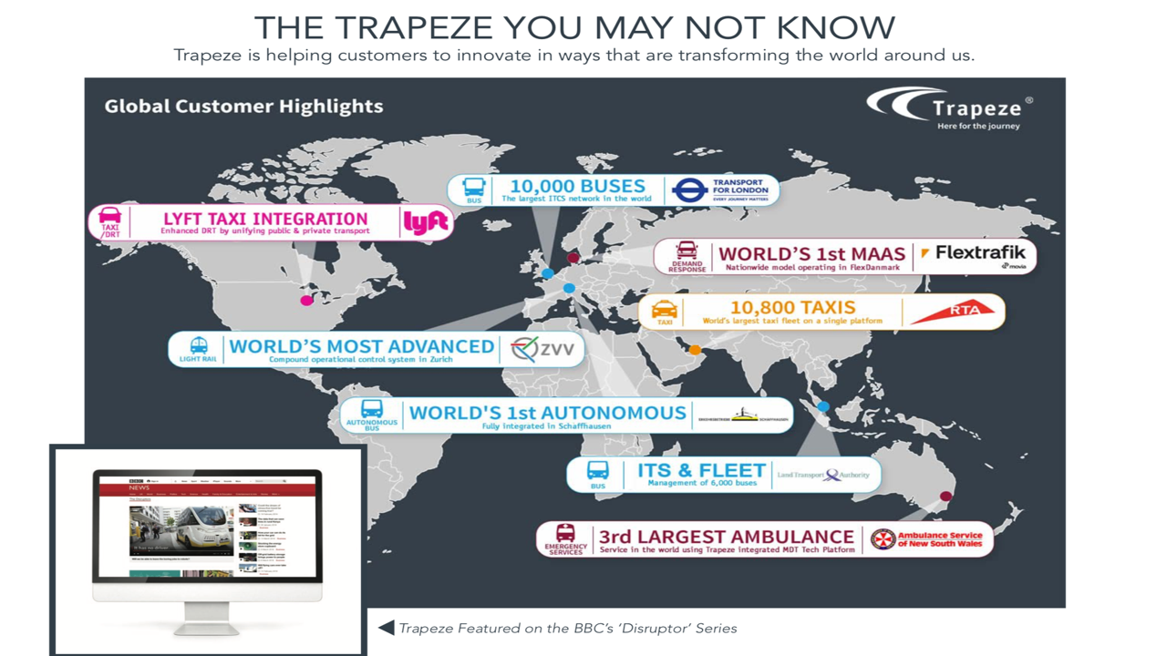
© 2019 Volaris Group Inc., its subsidiaries and affiliates. All rights reserved.

Slide 8
Questions?
© 2019 Volaris Group Inc., its subsidiaries and affiliates. All rights reserved.

