Slide 1
ICES User Group 30th March 2017

Slide 2
Application Support Update

Slide 3
Support Desk Staff
New on the Support Desk
Robert Williams joined the company on the 20th March.
Notes:
Robert will be working with Support for a month or two to pick up experience with our products and customers.

Slide 4
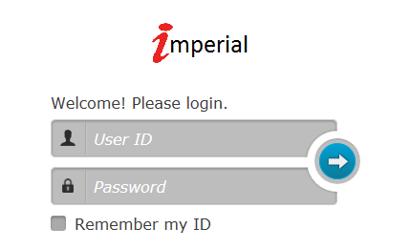
Support Desk Web Portal
All Customers should have a logon to the Support Desk Portal.
If you do not have your account details please contact the Support Desk.
Notes:
The Web Portal will allow customers to update their calls, and download training manuals.

Slide 5
Product Update Mandy Watson

Slide 6
PermitSmarti
Key new functionality:
‘Custom’, ‘first’ and ‘final’ permit expiry reminder emails.
Enhanced search for list and view email correspondence and permit payments.
Postcode ‘exclusion’ areas. Where a resident is not entitled to a permit of a certain type
Permit account can be set up so that the holder can apply on behalf of another person from a list of names associated with the account (‘business accounts’).
Cancellation refund calculation rules can be defined and applied.
The facility to configure and process printed correspondence

Slide 7
PermitSmarti
A permit holder can be prompted to upload supporting documentation at:
Permit renewal
Against an application where more information has been requested.
If key information entered by the applicant cannot be verified automatically e.g. Blue Badge holder.
Proof documents can be uploaded against a permit application or permit in the operation (front office) web site.
Applications for a permit type can ‘open’ and ‘close’ on the public site on specific dates.
A permit account holder can request cancellation of one of their permits.
‘External references’ such as scratch card serial numbers can be recorded against a permit.

Slide 8
Project Geneva
Helen Clements

Slide 9
Citizen Challenge
Extension to LetterSmarti
Serves you right Smarti?!
Reduces Appeals
Increases back office efficiency
Requests specific evidence upload

Slide 10
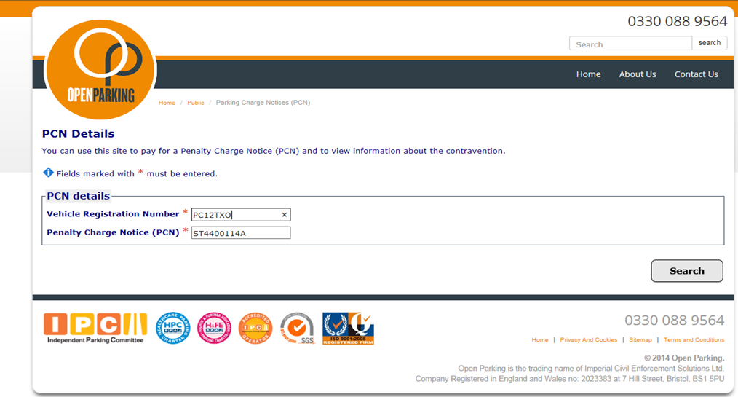
Enter PCN details on 3SC website

Slide 11
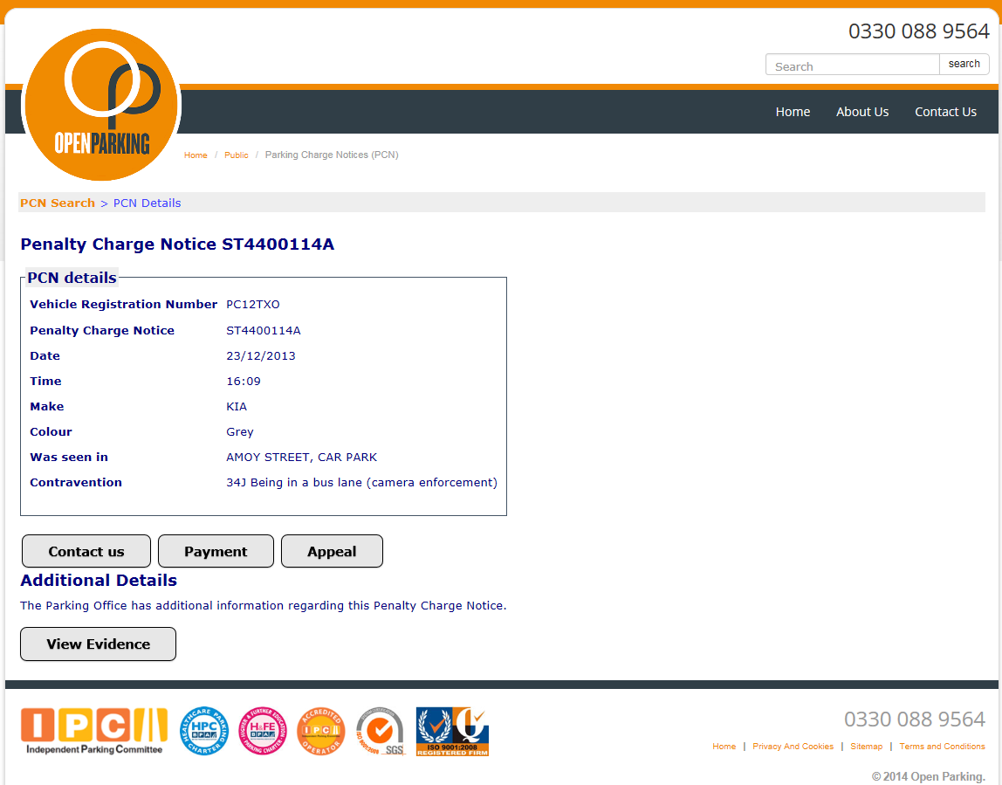
PCN details confirmed
Click on ‘Appeal’

Slide 12
Vehicle broken down - Appeal entry screen
Select ‘My vehicle was broken down’

Slide 13
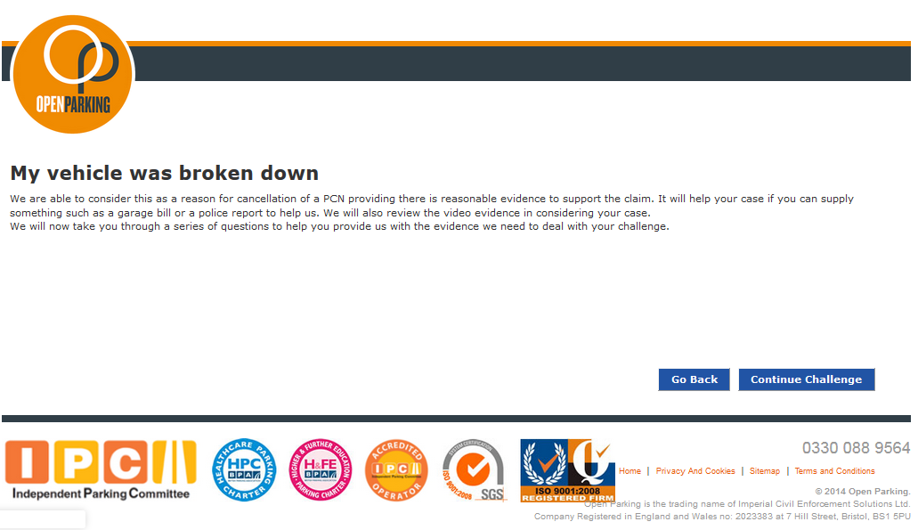
Citizen has selected ‘My vehicle was broken down’
Continue challenge

Slide 14
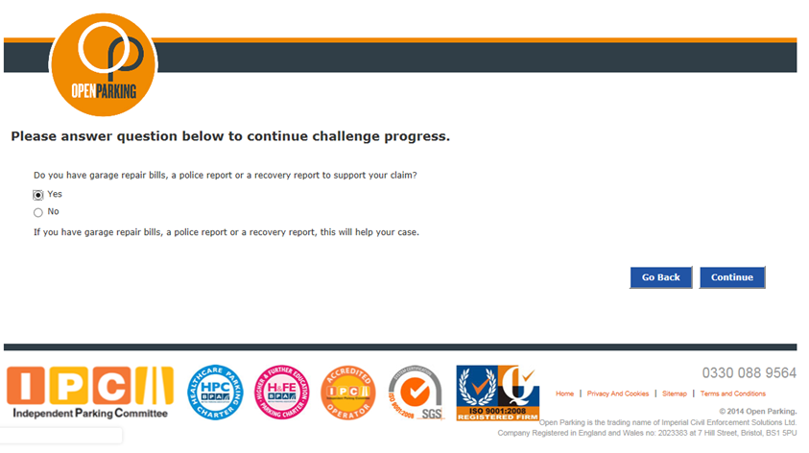
Question: Do you have repair bills…..?
Yes

Slide 15
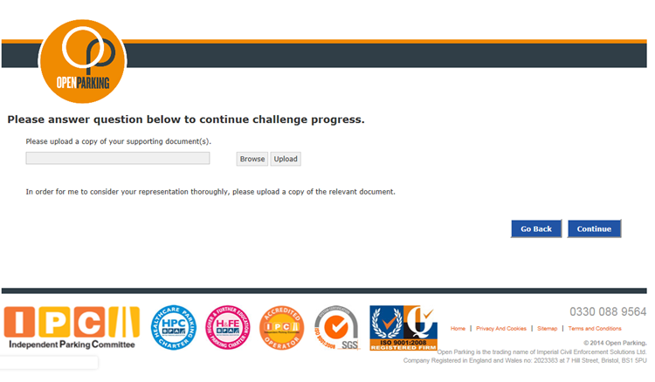
Request upload of supporting documents
Browse

Slide 16
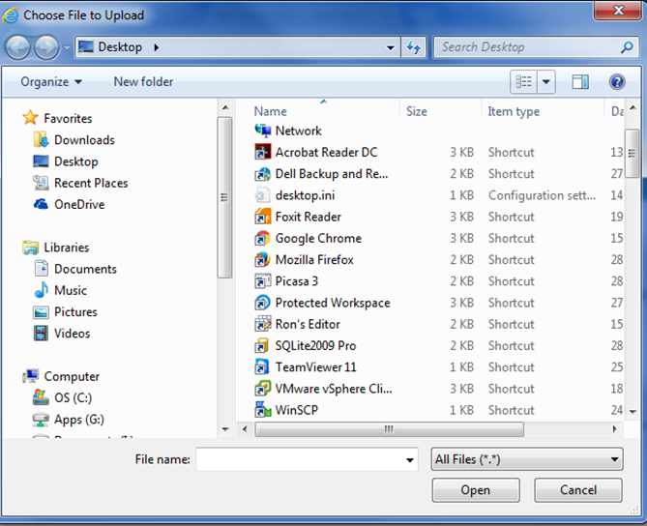
Select file to upload
2 files selected and uploaded

Slide 17
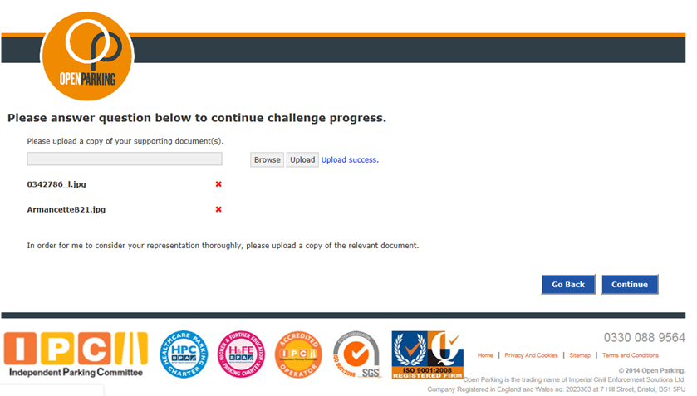
Select file to upload
2 files selected and uploaded

Slide 18
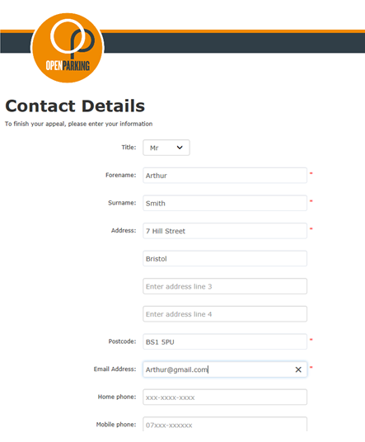
Enter contact details
2 files selected and uploaded

Slide 19
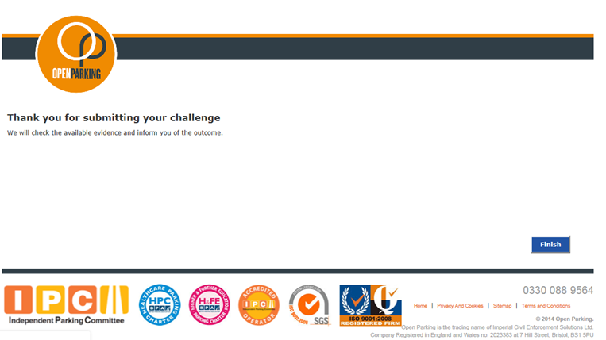
Thank you and goodbye

Slide 20
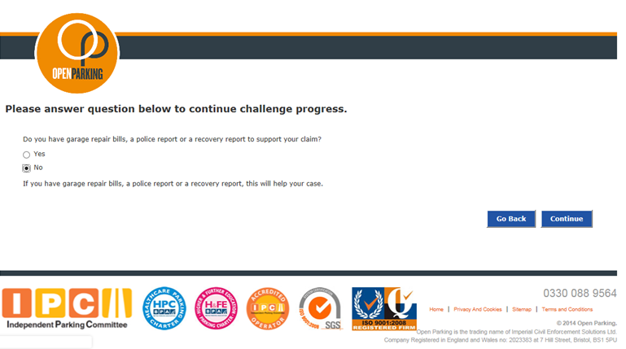
Broken down, no supporting docs
No

Slide 21
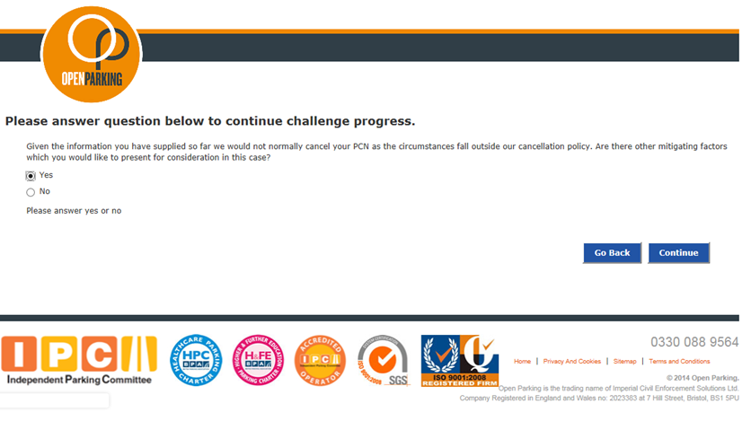
Ask for further information
Yes

Slide 22
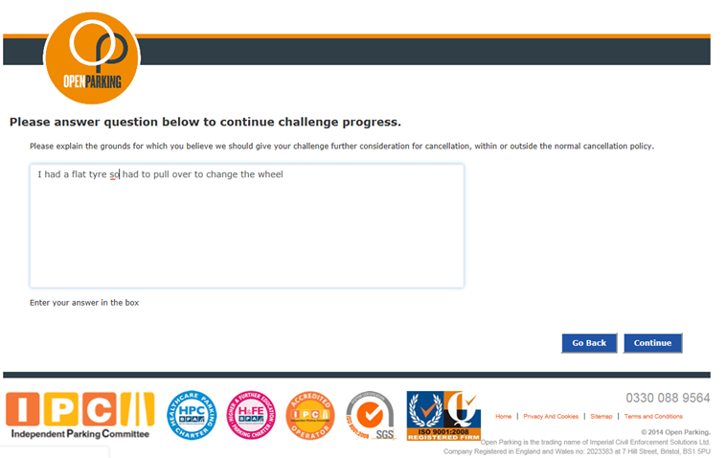
Enter further information
Continue

Slide 23
Enter contact details
Contact details entered

Slide 24
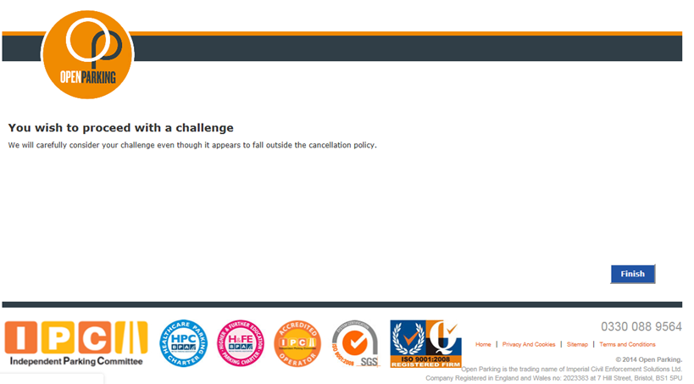
Thank you and goodbye
End

Slide 25
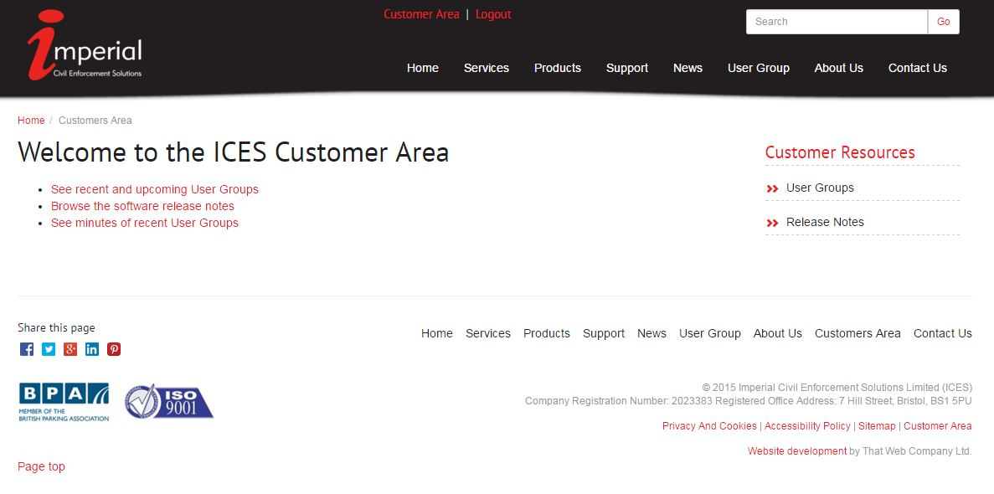
ICES Website
User Group Area
http://www.imperial.co.uk/user-group/

Slide 26
New Staff
Leadley Wilson – Software Trainer
Starts 3rd April
Just in time for Parkex!

Slide 27
Parkex 2017
4th – 6th April NEC Birmingham
Stand P235
Theme
“It’s a stand Jim but not as we know it”

Slide 28
Any Questions?

