Slide 1
ICES User Group 14th April 2016

Slide 2
Application Support Update Kevin Johnston

Slide 3
Support Staff
New Starters
Ben Stollar joined Imperial as a Support Desk Engineer in March. Ben has previous experience working on a support desk, and software support.
Ben Harrington also Joined us in March as a Support Desk Engineer. Ben Has just finished an IT apprenticeship.

Slide 4
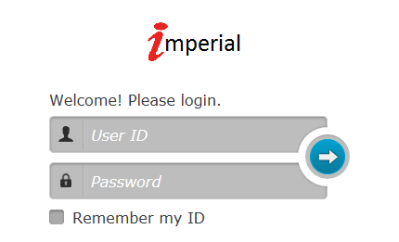
Support Desk Portal
All customers should now have a logon to the Support Desk Portal.
If you do not have your account details Please contact Support.

Slide 5
ICES Update Mandy Watson

Slide 6
New Faces
Welcome
Liverpool City Council
Luton Borough Council
New to Bristol Office
Mark Sandor
Bid Manager
Joined 19th Oct 2015

Slide 7
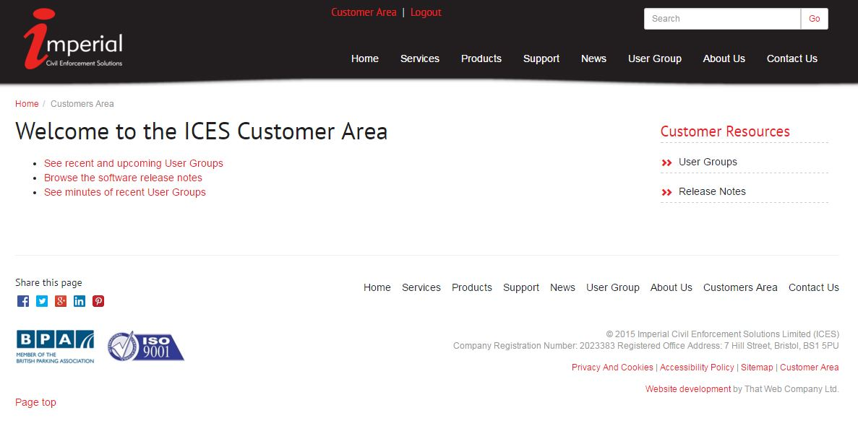
ICES Website
User Group Area
http://www.imperial.co.uk/user-group/

Slide 8
ICES on Social Media :
Twitter and LinkedIn
For the latest parking news, product updates and Q&A sessions, please follow us on social media.
media
https://twitter.com/imperial_soluti
https://www.linkedin.com/company/imperial-civil-enforcement-solutions-limited?trk=biz-companies-cym

Slide 9
Parkex 2016
15th – 16th June Ricoh Arena, Coventry
ICES – Stand B14
Theme

Slide 10
Product Update
Why only 3sixty?
Frees up development resource
Agile development
Work smarter and not harder!
Look what we’ve done:
LetterSmarti
GeoSmarti
ScanSmarti
VoucherSmarti
PermitSmarti

Slide 11
Any Questions?

