Slide 1
A Digital Journey...

Slide 2
Roll Out Complete
307 Local Authorities trained and using FOAM
Dartford Crossing
Mersey Gateway (September 2017)
Clean Air Zones (2020)

Slide 3
Evidence Provision for FOAM
Adjudicator’s requested a move away from the “jumble bundle”
Requirement for FOAM evidence provision is separate PDF’s
PDF’s are difficult to alter/change
Improves the navigation of evidence in the hearing setting for all parties
PDF’s can be downloaded from FOAM along with a summary PDF with page numbers for the “offline” appellant (this now comes off in order)
Concise Summary – add one if necessary, hightlight to the adjudictaor additional information

Slide 4
ICES Imperial Evidence (reg 9 PCN)
Copy PCN
Case File and History DVLA Return CEO Notes (if not included with Audit)
Incoming Correspondence - Informal & Formal
Challenge Rejection
Copy NtO
Notice of Rejection of Representation
Charge Certificate (if any)
Additional Correspondence (if any)
TEC Documents (if any)
Photographs (collated into one .PDF)
Map to show approx. location of vehicle
TRO link
Standard Documents Link
Please add any Transfer of Liability documents in chronological order under Additional Correspondence.

Slide 5
ICES Imperial Evidence (reg 10/Bus Lane)
CEO Witness Statement
Copy PCN/Nto Bus Lane or Reg 10
Case File and History DVLA Return CEO Notes (if not included with Audit)
Incoming Correspondence - Informal & Formal
Notice of Rejection of Representation
Charge Certificate (if aby)
Additional Correspondence (if any)
TEC Documents (if any)
Photographs (collated into one .PDF)
Link to Moving Image File
Map to show approx. location of vehicle
TRO link
Standard Documents Link
Add any TOL documents as Additional Evidence in Chronological order

Slide 6
How do I do this in 3sixty?
Must be on 3sixty V5.4 or later
Need to buy utility pdf995 (third party product)
Access via Word to a PDF printer. May need help from your IT provider.
Find a directory you can write to from 3sixty AND access from FOAM. May need help from your IT provider.
Follow the easy instructions
At no point will you need to print documents and rescan them, nor will your hands leave your arms

Slide 7
Witness Statement Process
Currently an Interim process for most users
New process in Beta Testing phase with 4 authorities using the new self referral screens
Continues to include the requirement to submit evidence with each referral
Evidence must be submitted in order for the Adjudicator to be able to issue Directions
Feedback on the 14 day payment letter positive with many appellants understanding and paying
Refer WS against boxes 2, 3 & 4 ONLY if you intend to continue to enforce

Slide 8
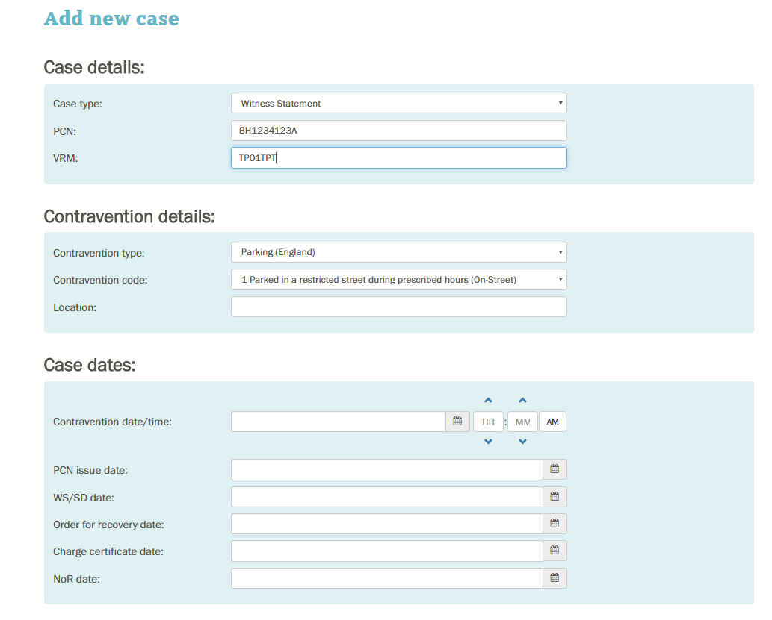
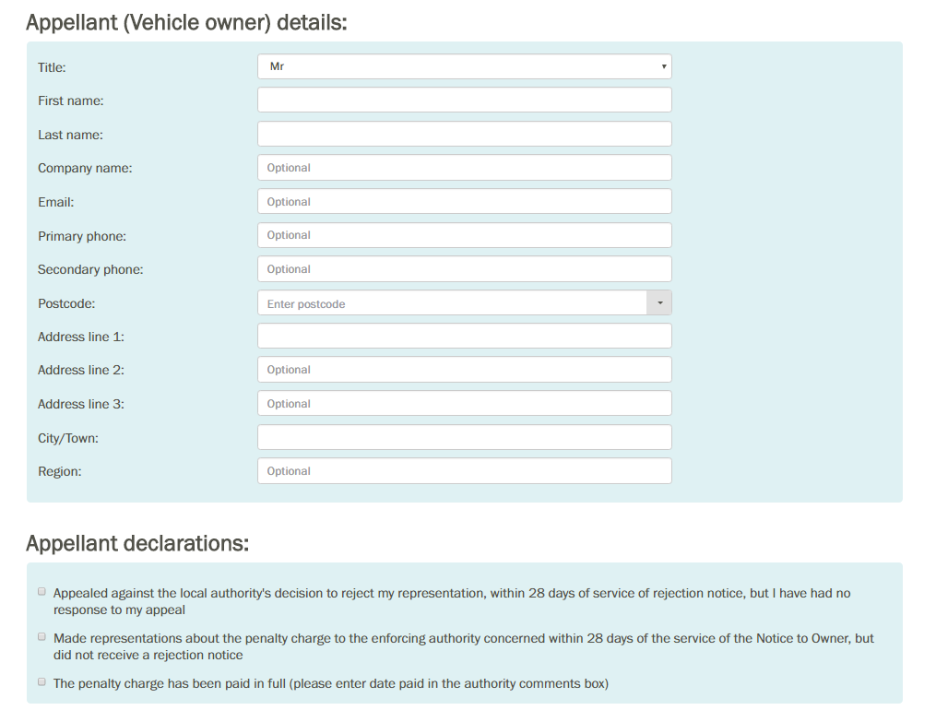
Witness Statement Referral through FOAM

Slide 9
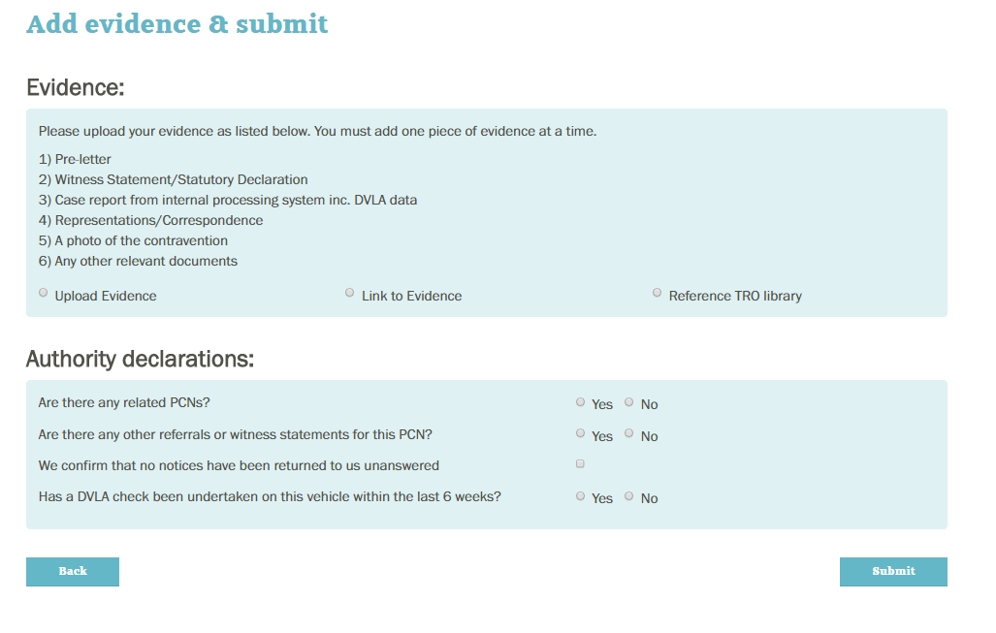
Witness Statement Referral through FOAM

Slide 10
Online Training Portal
Available to all users
Refresher course for new staff
New features
Advice on evidence creation

Slide 11
New Developments
Integration with Local PCN Management system
Tailoring of Notifications and Emails
Reviews and Costs module
Authorities to see chronological history tab
Audio Zoom Conferencing for Face to Face hearings, joining by telephone
Trial of Video Zoom Conferencing

Slide 12
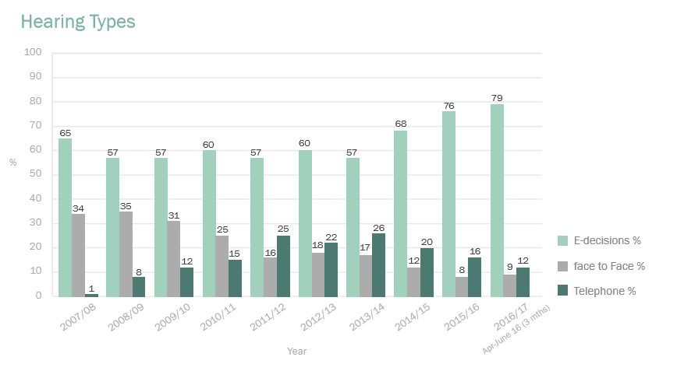
Hearing Type Changes

Slide 13
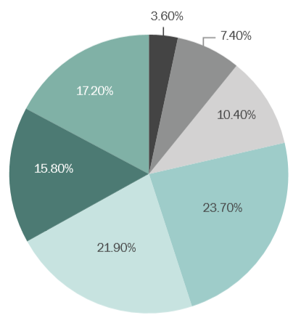
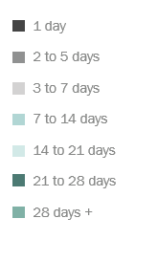
Impact of FOAM
Requests for hearings have reduced by 15%
3.6% of cases either not contested or closed on the same day of submission
45% of cases are closed within 14 days
87% of cases are concluded within 28 days

Slide 14
Questions?
Iain Worrall – Authority Engagement Manager, Traffic Penalty Tribunal
Louise Hutchinson – Director, Patrol

