Slide 1
Can we reduce congestion?
Sir Nic Cary
@geektwogeek waysphere.com

Slide 2
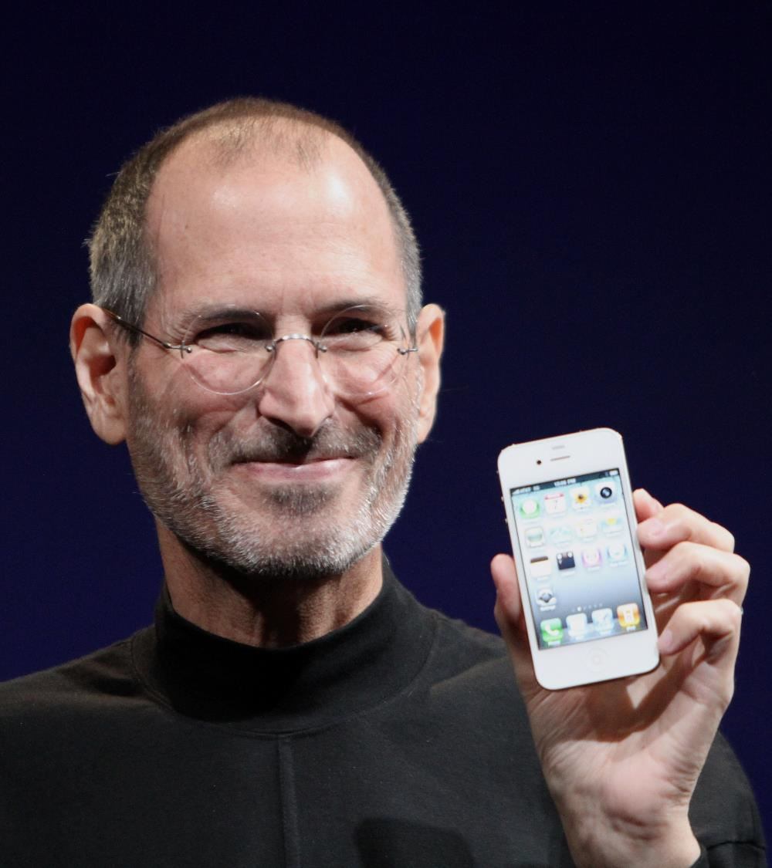
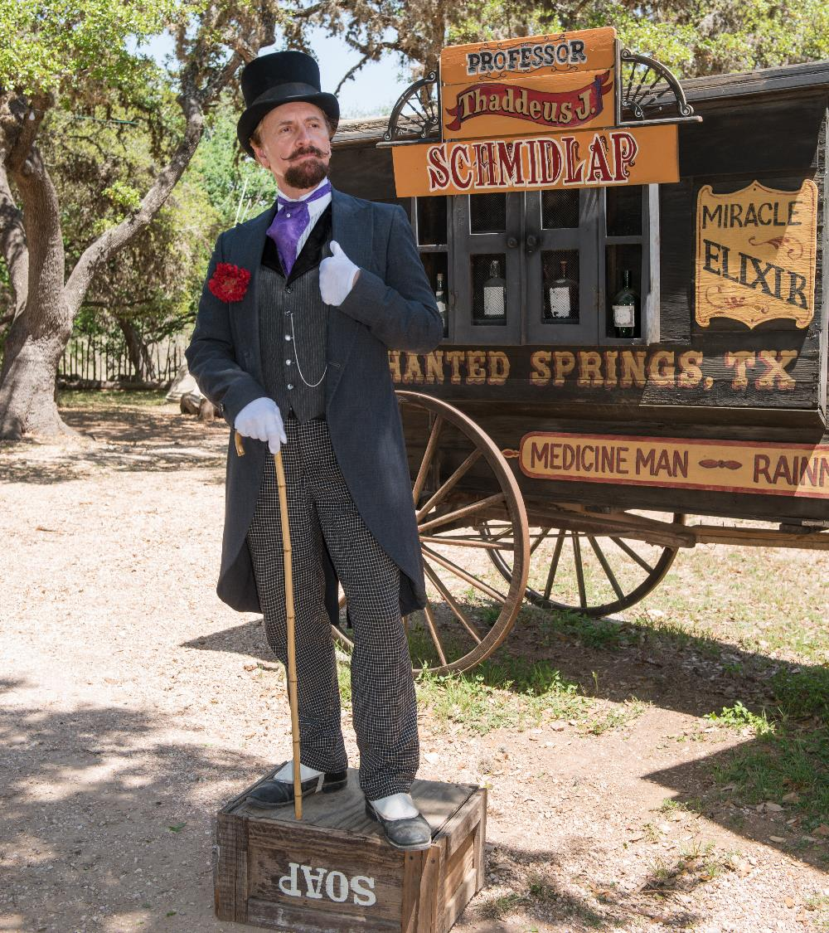
You decide if I’m a technology evangelist or just another snake oil merchant…

Slide 3
WHAT IS THE JAM
?
Poor air quality
Excess emissions
Vehicle congestion
Overcrowded trains
Overall
a poor user experience
Insufficient parking
Stressed infrastructure
£307bn projected cost to the economy 2013-2030¹
¹Source: INRIX
Notes:
Increasing congestion – on our roads, railways and at our airports
Excess emissions – transport accounted for 40% of UK energy consumption and 24% of UK domestic greenhouse gas emissions in 2015
Poor air quality – transport significant contributor to air quality reduction: NOx, and Particulate Matter (PM₃ and PM₁₀) particularly serious
Insufficient parking – blocked streets, circling cars
Overcrowded trains at peak times that run half empty for the rest of the day
Stressed, poorly maintained infrastructure – potholes, signal and points failures
£307bn 2013-2030 projected economic cost¹

Slide 4
WHY ARE WE IN THIS JAM?
1994-2017¹
UK population +14%
Total spending +188%
Vehicles on UK roads +49%
Rail passengers +150%
Planning focused on demand
Obsession with infrastructure
Polarised funding
¹Sources: DfT/ONS
Notes:
WHY ARE WE IN THIS JAM?
Between 1994-2017
UK population increased by 14%
Total spending in the economy increased by 188%
Vehicles on UK roads increased by 49% – roads account for 89% of all journeys
Rail passengers increased by 150% – but still under 10% of all journeys
Transport planning aims to meet projected demand – BUT is based on classical modelling, not agent-based and unreformed scheme approval methodology
Obsession with ribbon-cutting
Twin obsessions with:
Building new infrastructure – building bypasses and widening roads
Decreasing journey times
Polarised funding between railways vs roads and national vs local roads

Slide 5
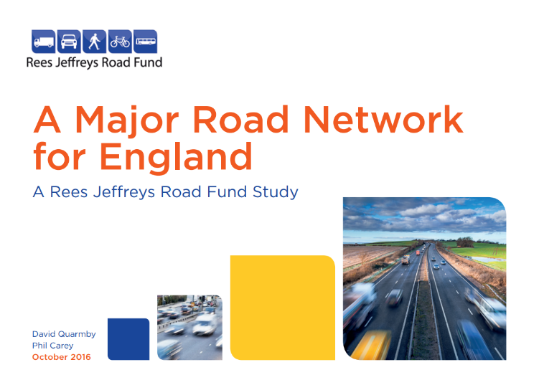
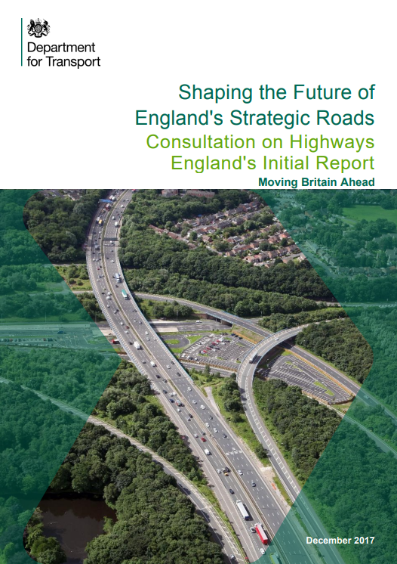
URGENT NEED FOR REFORM
New thinking being squandered
No Big Picture view
Not joined up
Technophobia at the top
Myopia about future transport
THIS MATTERS
Notes:
New thinking being squandered:
Rees Jeffreys Study mentions ‘scheme’ 9x and ‘technology’ 36x in 64pp
Major Road Network Consultation mentions of ‘scheme’ 55x and ‘technology’ 2x in 42pp
Lack of Big Picture and joined up thinking
Technophobic fear of investing properly in Intelligent Transport Systems and data sharing
Myopia about future transport – ‘driverless’ vehicles, MaaS, shift in car use
THIS MATTERS
Decisions now will lock us in for many years to come.

Slide 6
The future of transport looks nothing like where we are targeting our efforts
Notes:
Built around user needs
Journey supermarket at the top – much as we have heard about in the West
Supermarket sources journeys from wide range of modes
Infrastructure layer

Slide 7
SO WE HAVE TO DO SOMETHING NOW…
BUT WHAT?

Slide 8
HERE’s WHAT WE NEED TO STOP DOING…

Slide 9
STOP PANDERING TO
Viewing more infrastructure as a universal panacea
Reducing journey times
WHY?
Notes:
We can’t keep adding more concrete and steel
Bypasses and road-widening induce traffic
Infrastructure costs £Billions for an uncertain return

Slide 10
Most new roads and road widening schemes induce traffic
Ref: campaign for Better Transport

Slide 11
Stop relying on approaches to transport modelling and planning that have not changed since the ‘50s

Slide 12
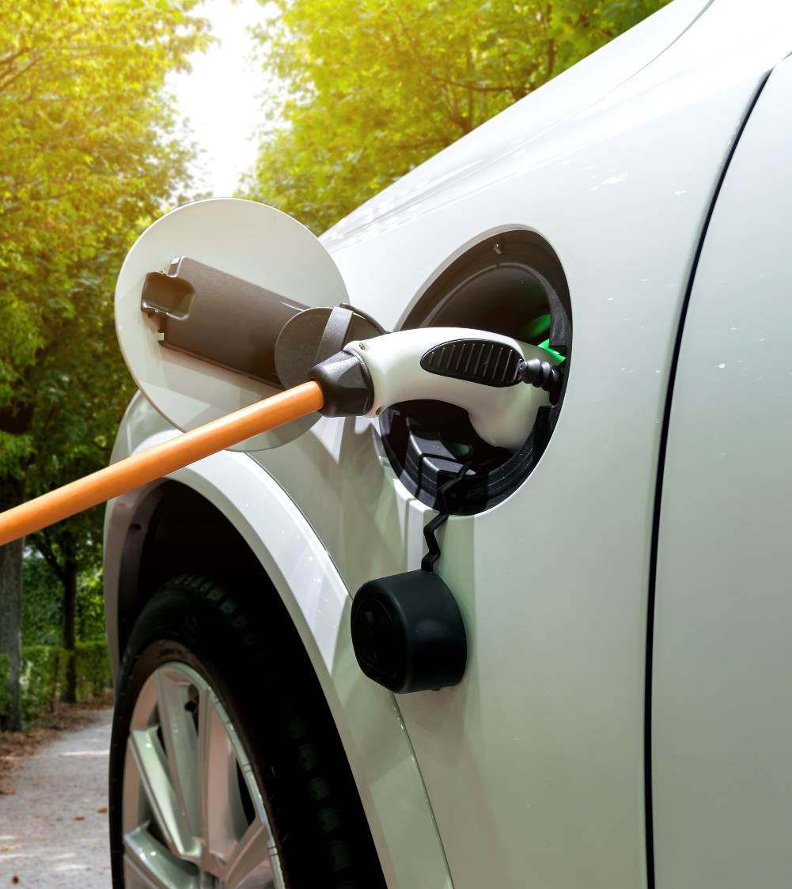
STOP WAITING FOR EVs
Minimal 0.4% penetration
Unused funding of charge points
25-35% new sales electric by 2040
11 year waste out rate
Source: DfT Statistics
Notes:
Minimal penetration $–$ EVs under 0.4% of UK vehicles and 14,250 charge points
Funding for 1,000s of car charge points unused by councils
Projections suggest 25-35% of new vehicle sales electric by 2040
Average vehicle waste out rate is 11 years

Slide 13
HERE’s WHAT WE NEED TO START DOING…

Slide 14
INVEST IN DATA SHARING
Data sharing is chronically underfunded
Currently state of transport data:
Complex (=interwoven) and complicated (=large scale).
Huge incompatibility between assets, services and costs.
Comprises three weakly coupled tiers: data collectors / aggregators / apps.
Vague and incomplete asset registers.
Medium-sized, incoherent data, not big structured data.
Legacy systems based on underspecified data models.
Data feeds are not discoverable automatically and are often hidden.
No data quality indicators for feeds: no agreement on truth.
Low interoperability between platforms.
Low level of security among parties.
Fragility of Infrastructure as a Service

Slide 15
Invest in intelligent transport systems

Slide 16
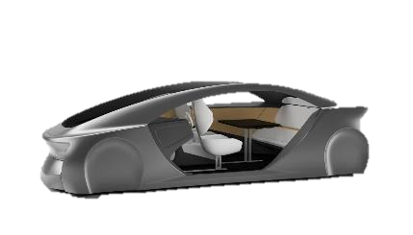
Rehabilitate the road vehicle
NOW
Inefficient
Expensive
Mainly uses fossil fuels
Unused +95% of the time
‘Kept’ by driver
FUTURE
Efficient
Pay what you use
Electric
Used 60-80% of the time
‘Kept’ by service provider
Dangerous
Adds to congestion
Clogs up valuable parking
Stand-alone
Limited MaaS support
Long distance
Safe
Minimises congestion
Parks minimally
Supports integration
Supports MaaS
Last mile

Slide 17
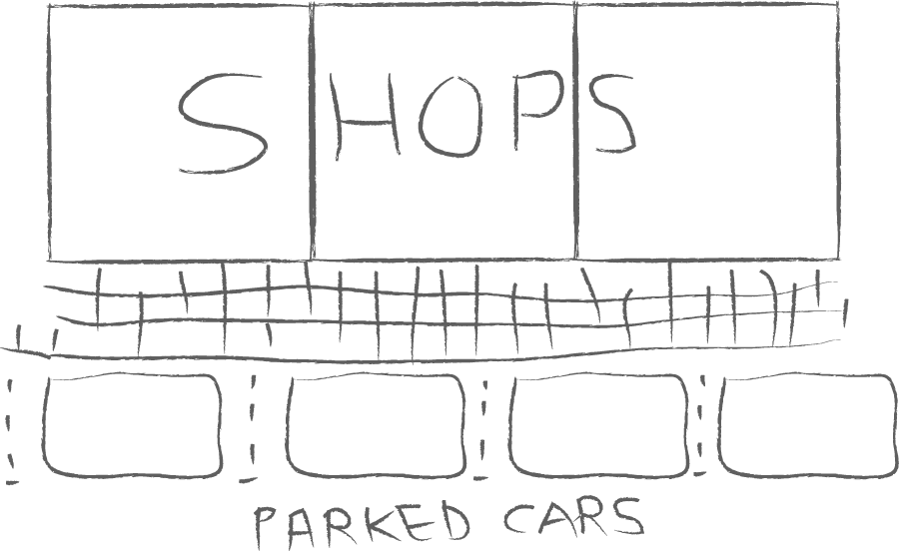
A simple lesson in the arithmetic of
on-street parking…
Parking duration: 30 mins to 2 hours
Vehicle occupancy: 1.6 people
Pedestrian walkway capacity: 100s
Source: DfT
“Retailers have been shown to over-estimate the importance of the car for customer
travel. In these studies, more people actually walked, cycled or came by bus.”
‘The pedestrian pound
The business case for better streets and places’
Livingstreets.org.uk

Slide 18
Therefore we should reclaim our high streets

Slide 19
Invest in user research and behavioural economics to flatten the peaks
Picture: Rory Sutherland
Global Creative Director of Ogilvy Insight

Slide 20
Intelligent transport systems built on good data-sharing cost way less than infrastructure.
Together they enable us to make better use of what we’ve already got.

Slide 21
DEVELOP AND IMPLEMENT AN INTEGRATED TRANSPORT STRATEGY

Slide 22
Design and roll out a new integrated transport governance model for national and local government
POLITICAL OVERSIGHT
Parliament and ministers Council and members
USER EXPERIENCE GOVERNANCE
User needs
Behavioural economics
Regulation and supervision
Tax collection
Subsidy provision
OPERATOR GOVERNANCE
Vehicle providers
Train providers
Airlines
INFRASTRUCTURE GOVERNANCE Planning, building, operation and maintenance for roads, railways and airports
Notes:
Design and roll out a new governance model for local and national government that matches the way we consume transport

Slide 23
Thank you!

