Slide 1

Local Authorities and Devolved Powers
Bethan Beasley bethan.beasley@dvla.gsi.gov.uk

Slide 2
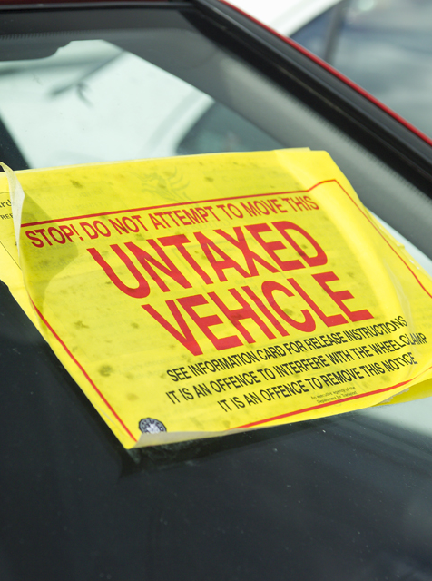


The DVLA is an executive agency of the Department for Transport.
It is responsible for maintaining over 48 million driver records and almost 40 million vehicle records.
It collects around £6 billion a year in Vehicle Excise Duty (VED).

Slide 3






Background
VED evasion has risen from 0.6% to 1.8% over a six year period
1.8% equates to a potential loss of £107million to the Exchequer
New national wheel-clamping contract began in February 2019
But DVLA also needs
help from Local Authorities and Police Forces

Slide 4





Current Devolved Power Partners
48 Local Authorities
30 Police Forces
Over 35,000 vehicles were enforced in the last 12 months by Devolved Power Partners

Slide 5
Local Authorities
1. Barking and Dagenham | 12. Darlington | 23. Lewisham
2. Barnet | 13. Doncaster | 24. Liverpool
3. Basildon | 14. Dudley | 25. Luton
4. Basingstoke & Deane | 15. Ealing | 26. Manchester
5. Blaby | 16. Enfield | 27. Middlesbrough
6. Bournemouth | 17. Greenwich | 28. Newcastle
7. Brent | 18. Hackney | 29. Newham
8. Bromley | 19. Hartlepool | 30. Northampton
9. Broxbourne | 20. Havering | 31. Nottingham
10. Camden | 21. Hinckley & Bosworth | 32. Oxford
11. Cardiff | 22. Hull | 33. Portsmouth

Slide 6
Local Authorities
34. Redbridge | 45. Uttlesford
35. Redcar & Cleveland | 46. Waltham Forest
36. Rochford | 47. Warwickshire
37. Rotherham | 48. York
38. Sandwell
39. Southend - on - Sea
40. Southwark
41. Stockton - on - Tees
42. Stoke - on - Trent
43. Swansea
44. Thurrock

Slide 7
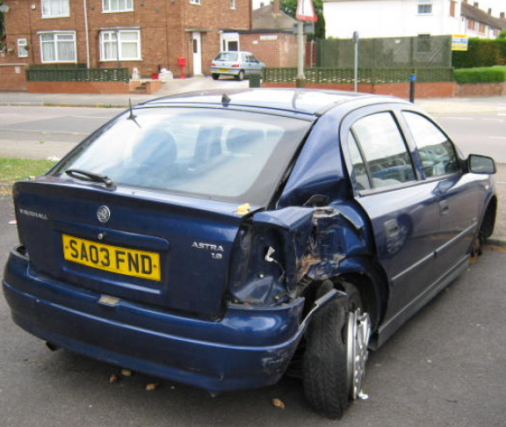
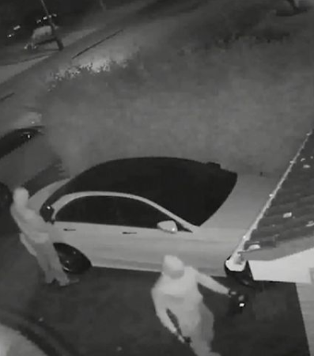
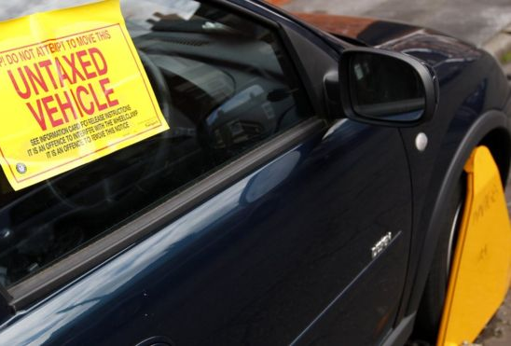
Nuisance Vehicles
AB49DON
Nuisance vehicles include those that are untaxed and abandoned
They degrade the quality of our local environments but also attract acts of vandalism and criminal damage, including vehicle arson, and diverts money from local services.
Some of these vehicles have been involved in serious crimes and can signal wider problems in communities, others have simply reached the end of their life.

Slide 8













Benefits of taking on Devolved Powers
Improves the quality of local environments for the people who live there
Reduce incidents of vehicle arson
Disrupts criminality associated with the use of untaxed vehicles
Reduces the opportunity for anti-social behaviour
Encourages motorists to re-license their vehicles
Helps to maintain accuracy of DVLA’s records – vital for DVLA and Local Authorities

Slide 9



Benefits of taking on Devolved Powers
(continued)
Any income from vehicle disposal
£21 per day storage fee
Only Local Authorities with devolved powers can remove foreign registered vehicles
Surety fee of
£160 if not claimed within 15 days
Local Authorities keep:
Release fee of £100. Increasing to £200 if not claimed within 24 hours.

Slide 10
How it works
If required, we can send you the unlicensed database for ANPR use
although you can use gov.uk (up to date) or WEE
Untaxed vehicle identified
Dedicated DVLA phone line during office hours will give you authorisation to enforce, plus any support you may need
Clamp, remove or sticker
Enforcement Office completes offence report (CLE2/6) which is sent to DVLA (prosecution is then used to pursue cases in Magistrate’s court)
When impounded, vehicle is valued by local authority contractor.

Slide 11
How it works (continued)
DVLA sent daily list of all impounded vehicles
DVLA issues letter to registered keeper informing them of where the vehicle is being held and when it will be disposed of if not claimed.
If not claimed within specified period (7 days for vehicles under
£1,000, 14 days for vehicles over £1,000) DVLA authorises contractor to dispose of vehicle
Local Authority/Contractor to decide on method of disposal
All fees and income from disposal retained by Local Authority
No cost to Local Authority

Slide 12

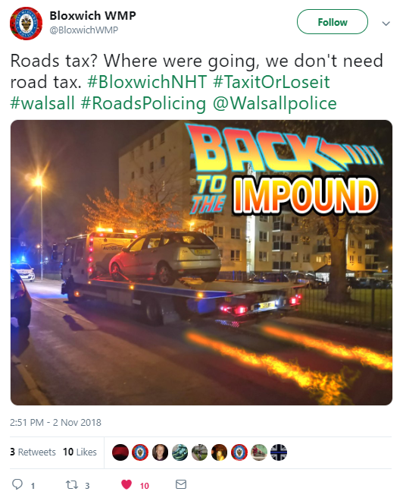
Devolved Power Partners at work
Some of our partners who have already accepted Devolved powers have begun using social media to document the impact it is having…

Slide 13
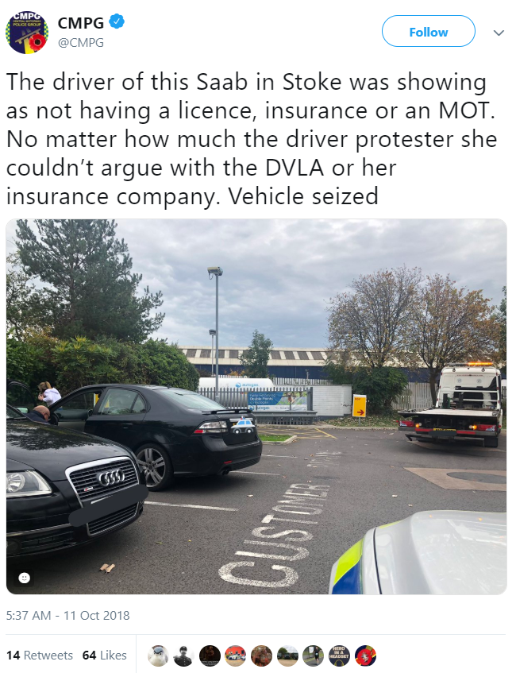
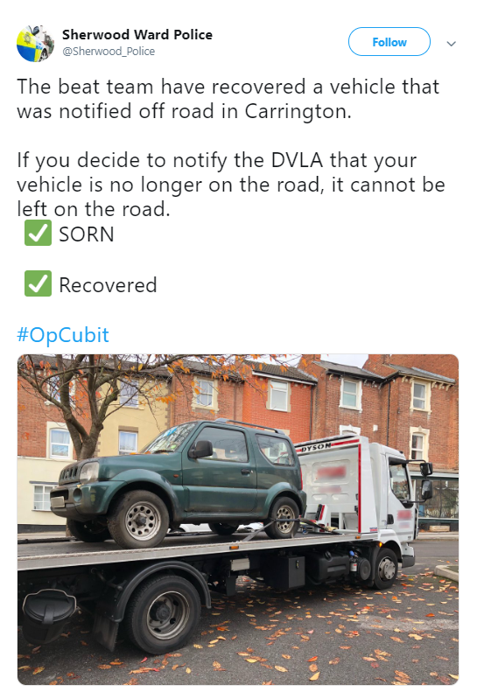
Devolved Power Partners at work

Slide 14







Next Steps
Letter of Agreement issued
All stationery provided free of charge
DVLA staff support if required
Training dates agreed
Agree start date

