Slide 1

ICES User Group
12 October 2017

Slide 2
Identifying the Problem
With an ever increasing awareness and pressure on councils to address air quality issues in general, there is a significant need to address the management of the kerb-space at a micro-level; encouraging haulier behavioural change through incentivisation and intelligent kerbside management.
Premature deaths as a result of diesel fumes from heavy goods vehicles are estimated at 40,000 per annum in the UK and 9,500 per annum. (King’s College Report 2015).

Slide 3
#1
London Ranked
For congestion
250
Hours Spent
idling in traffic in a year
per vehicle.

Slide 4
£15bn
Societal Health Costs
from impact of Air Pollution

Slide 5
What is ?
Kerb is a Virtual Loading Booking System (VLBS) which makes more effective use of the kerbside for freight through allowing dynamic booking of spaces and thereby speeding up deliveries.
This is a real-time Dynamic, Intelligent Kerbside Management solution for cities. It is patent protected and ready for market, with global potential.

Slide 6
How does Kerb work?
Kerb is a web-based scalable application which allows commercial vehicle operators to opt to pay and park / load unload on previously unavailable kerb space in high density, urban areas that are typically subject to traffic congestion.
The application is available on Android and IOS Smartphones or via web-based management portal.

Slide 7
How does Kerb work?
Local Authorities
Engineers identify locations where loading restrictions apply, that can be lifted for specified periods.
Charges are set to take account of congestion and emissions.
The space is made available for dynamic Dispensations, there is no need to change the Traffic Orders or signs.
Notes:
ADD SCREENS

Slide 8
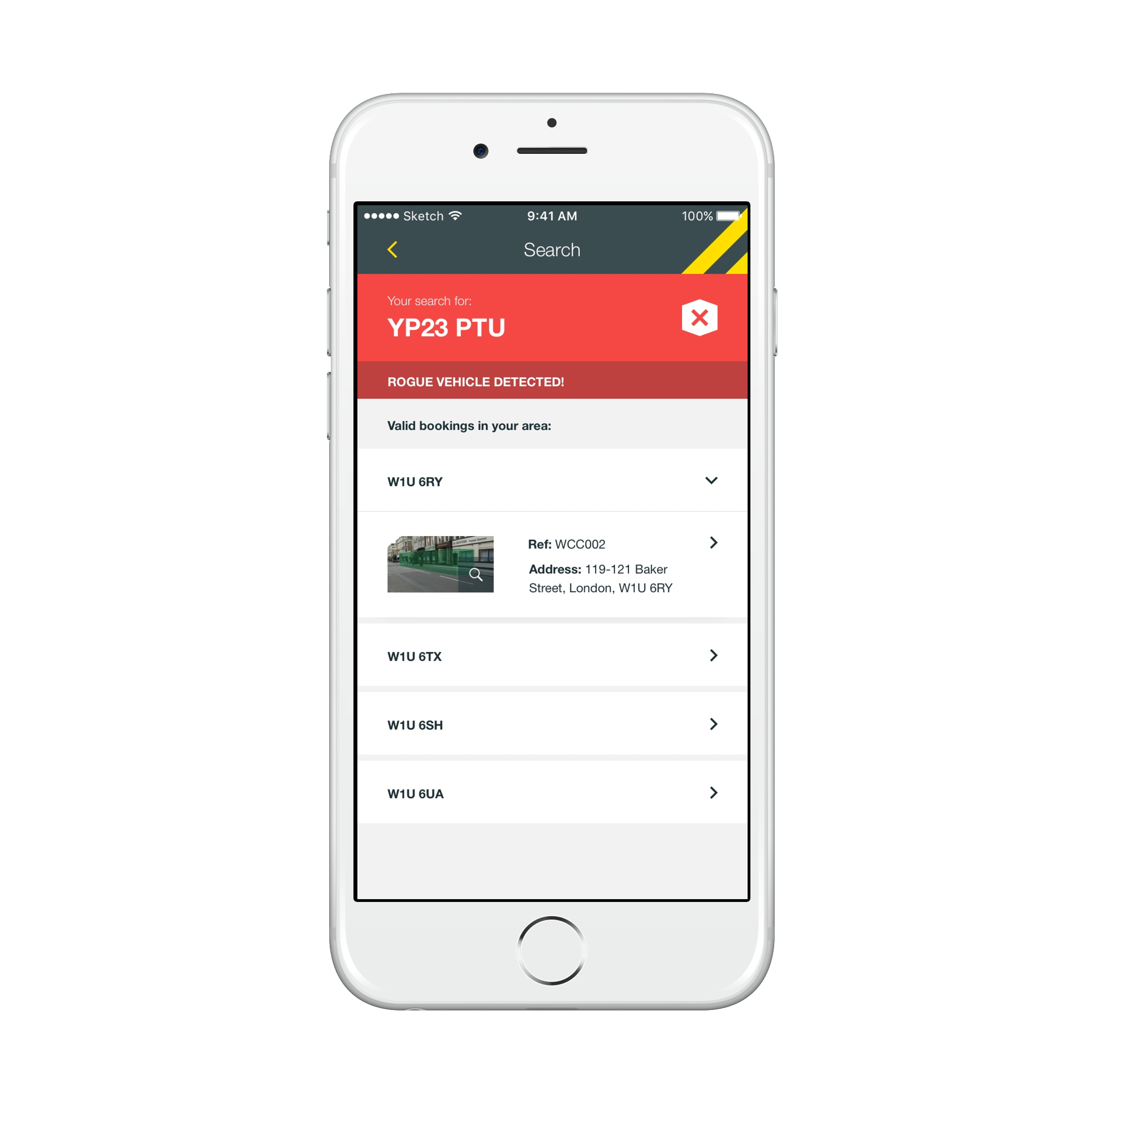
How does Kerb work?
Enforcement
Civil Enforcement Officer arrives and finds a vehicle in ra estricted loading space.
Officer checks to see if the vehicle has booked a Kerb VLB. If the vehicle hasn’t booked, enforcement takes place.
LA receives consolidated payment for use of Kerb VLBs.
Notes:
ADD SCREENS

Slide 9
How does Kerb work?
Hauliers
Reserve a loading bay at a defined location where loading is normally restricted.
Find the specific timeslot that you wish to book.
Turn up and use the bay for the allotted time.

Slide 10

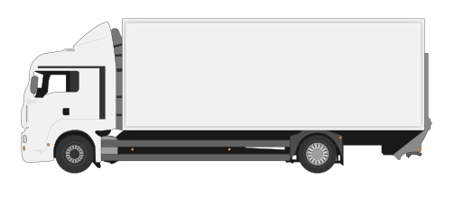
How does Kerb work?
Business alerted to arrival.
Depot
Mobile App
CEO HHC
Arrives in Virtual Loading Bay
Geo-Fence Breach
LA Back Office
Reconciliation
Book Bay
Time
Location
Vehicle Type

Slide 11
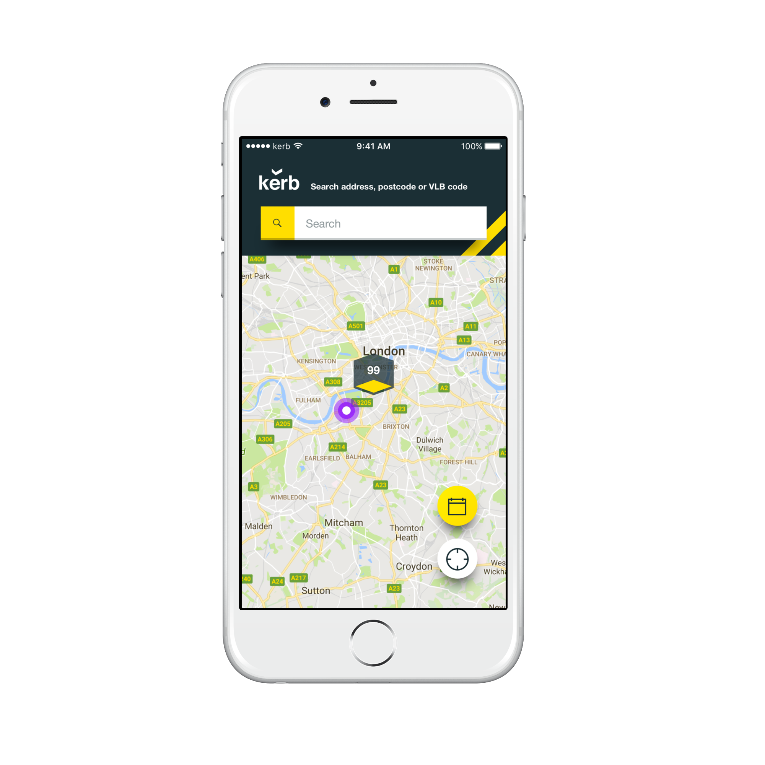
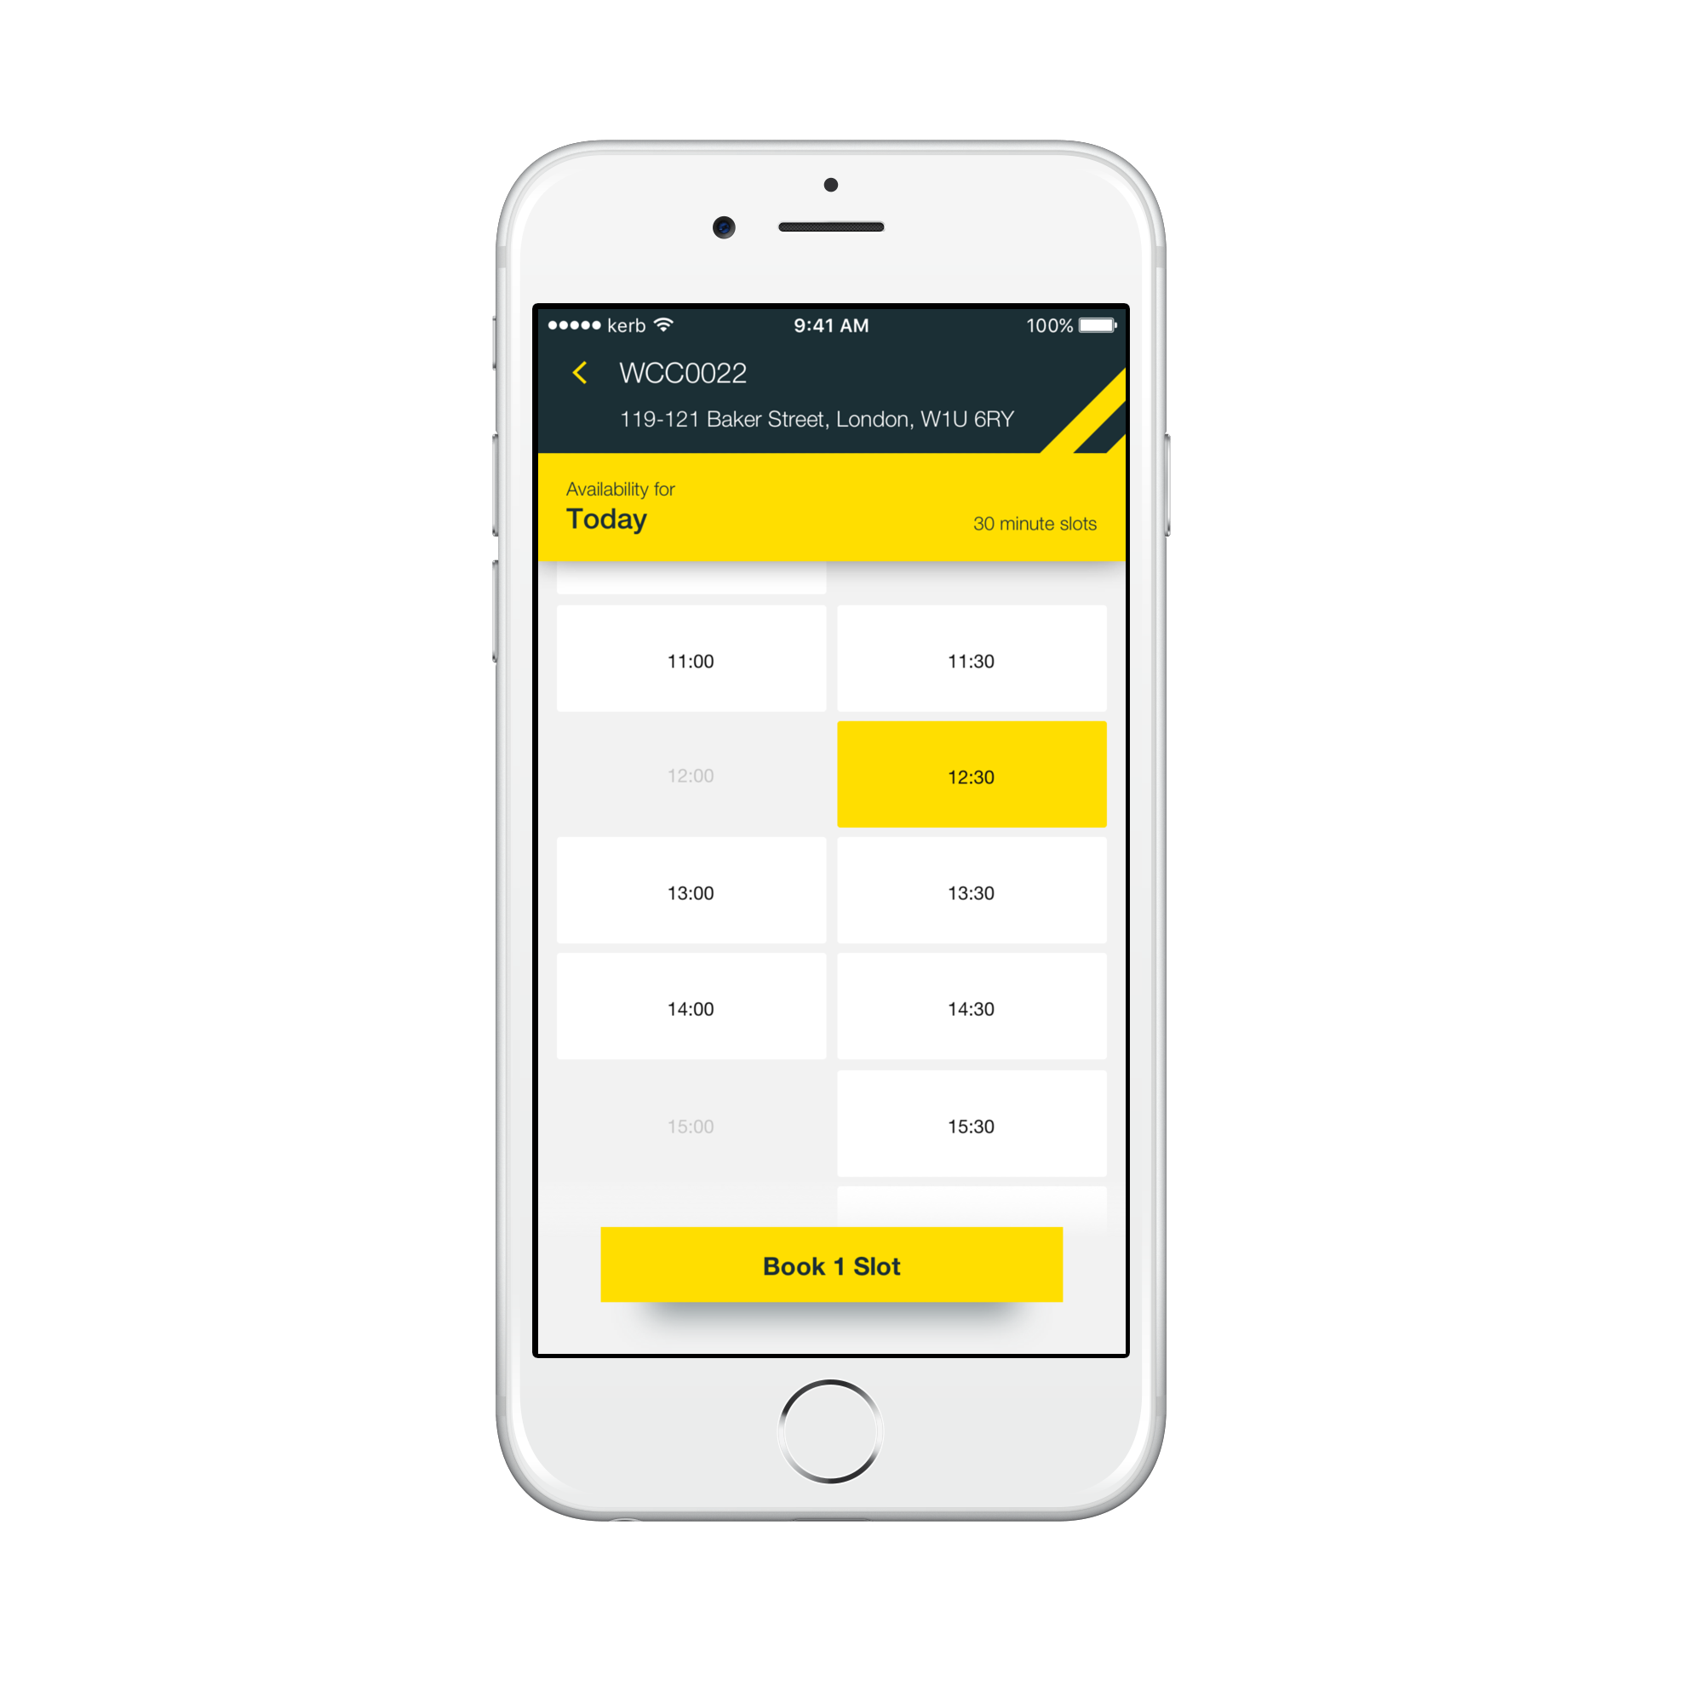
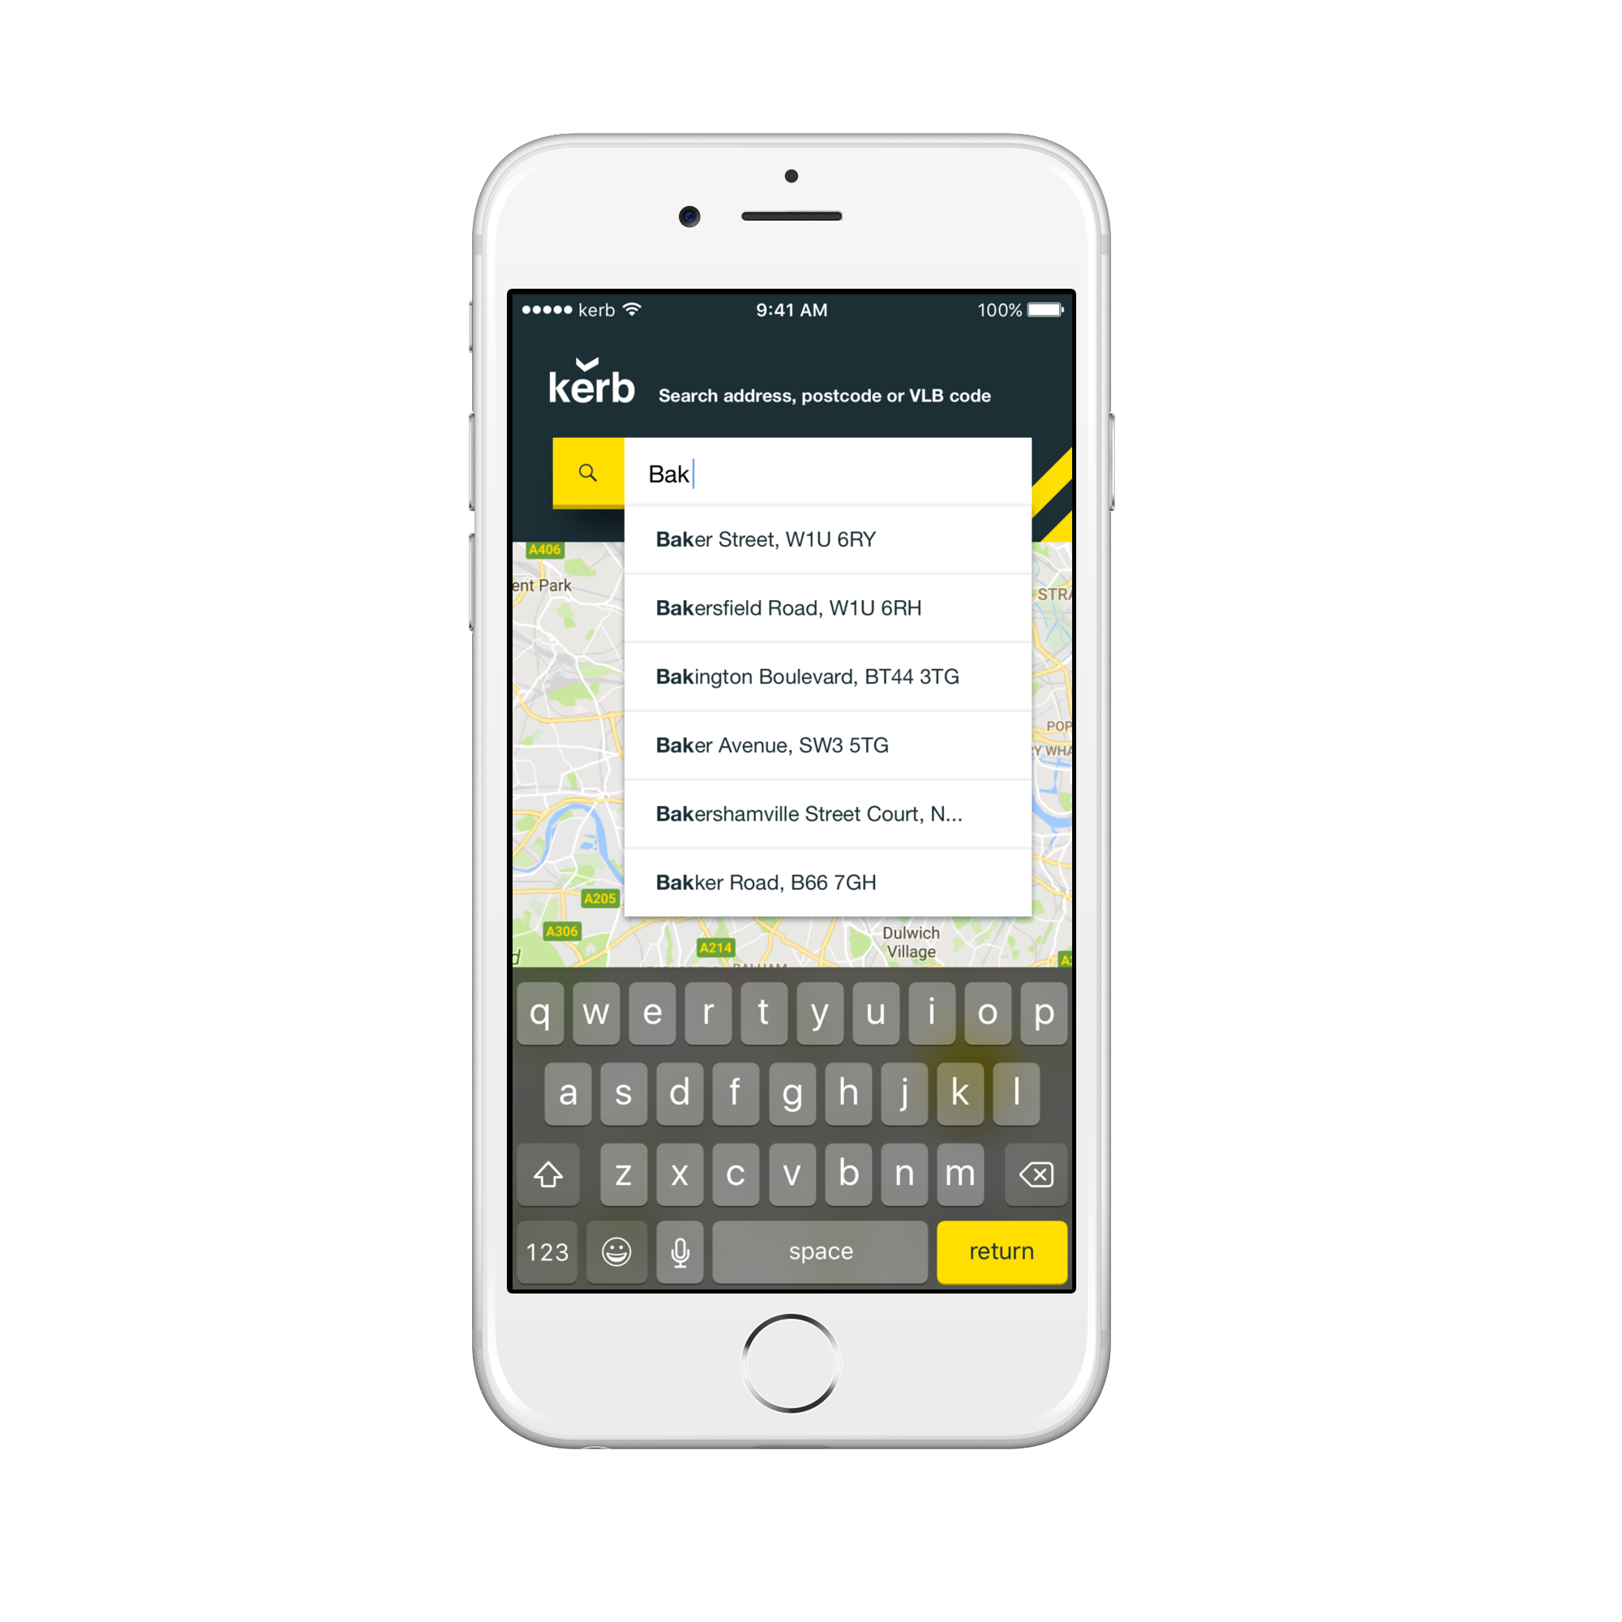
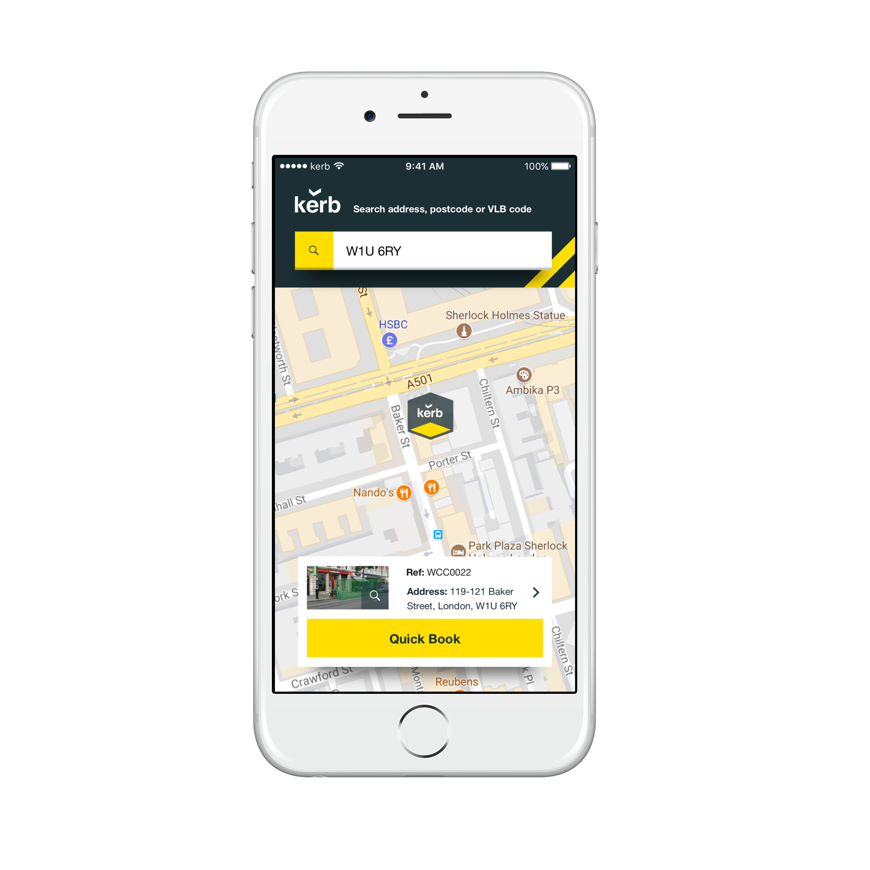
Searching and Quick Booking
With the Kerb app, drivers can conveniently search for a bay via postcode, address, area or bay number and quickly book a timeslot of their choosing in a few clicks.

Slide 12
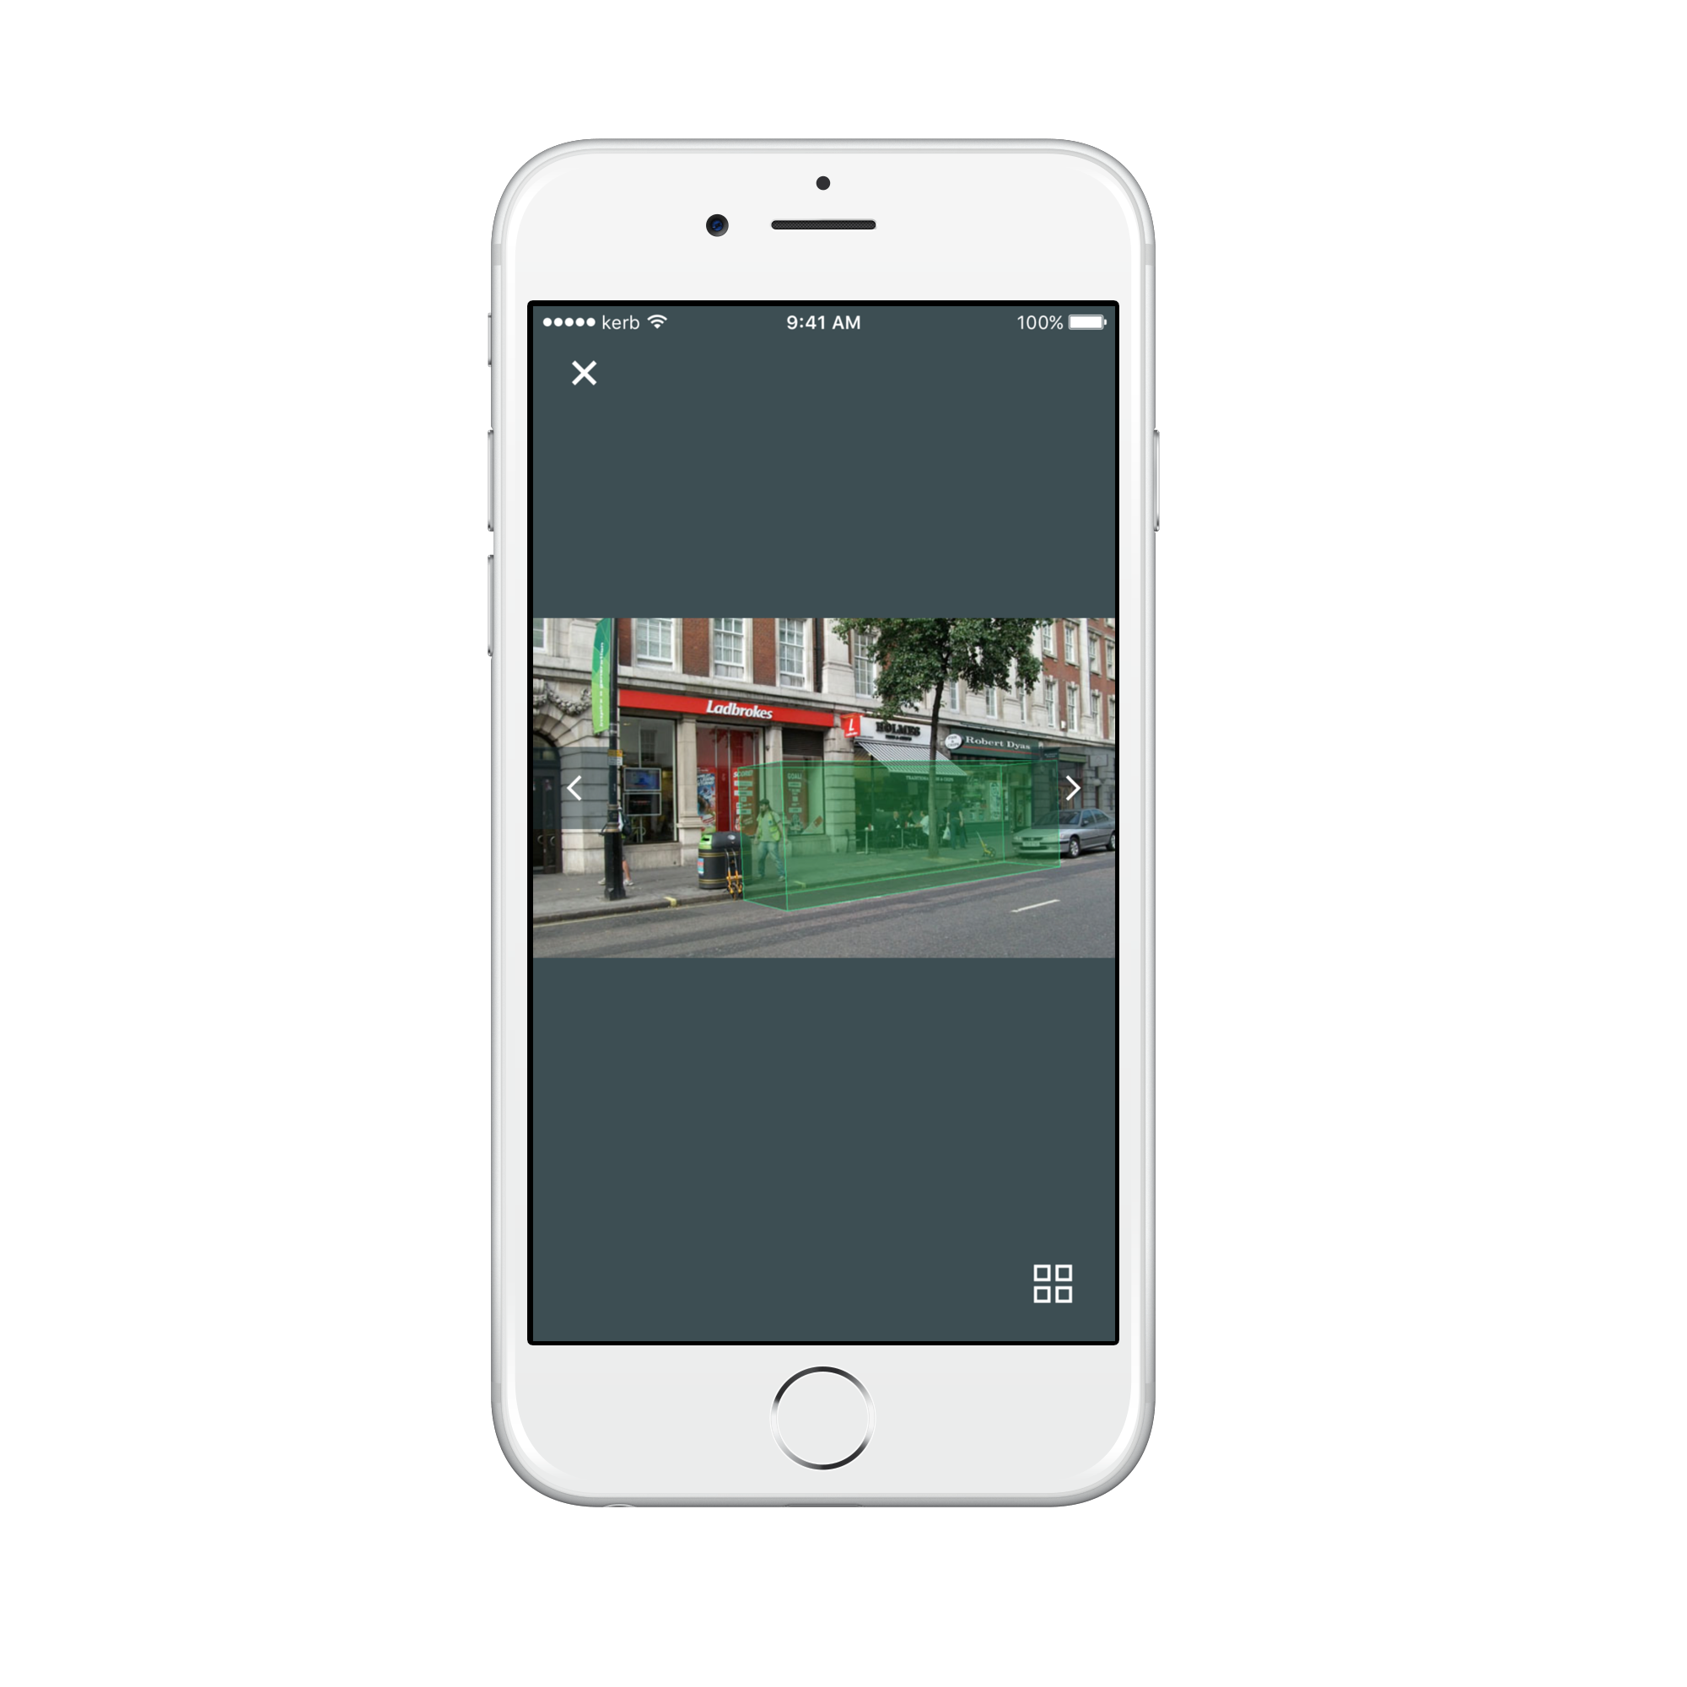
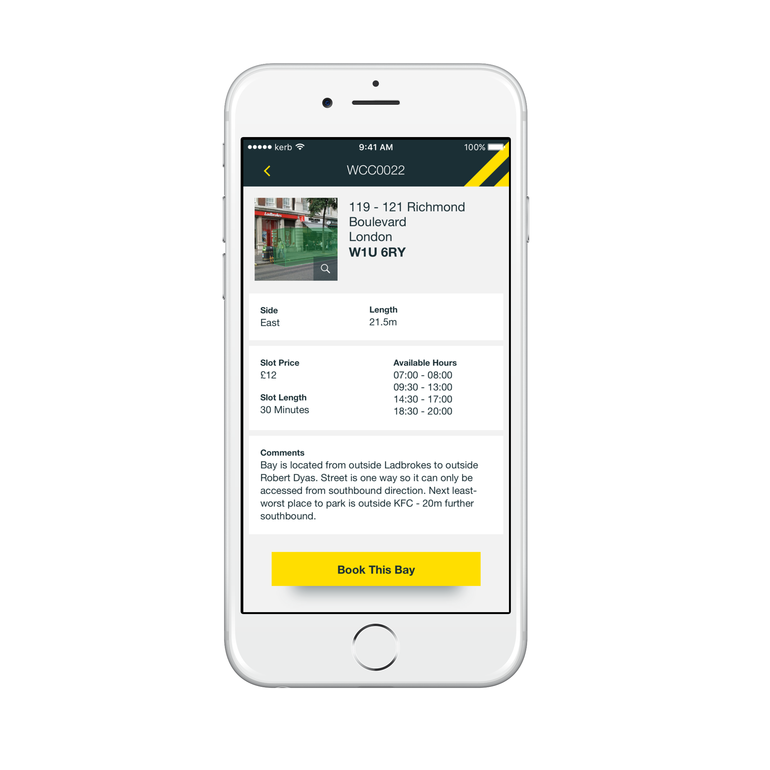
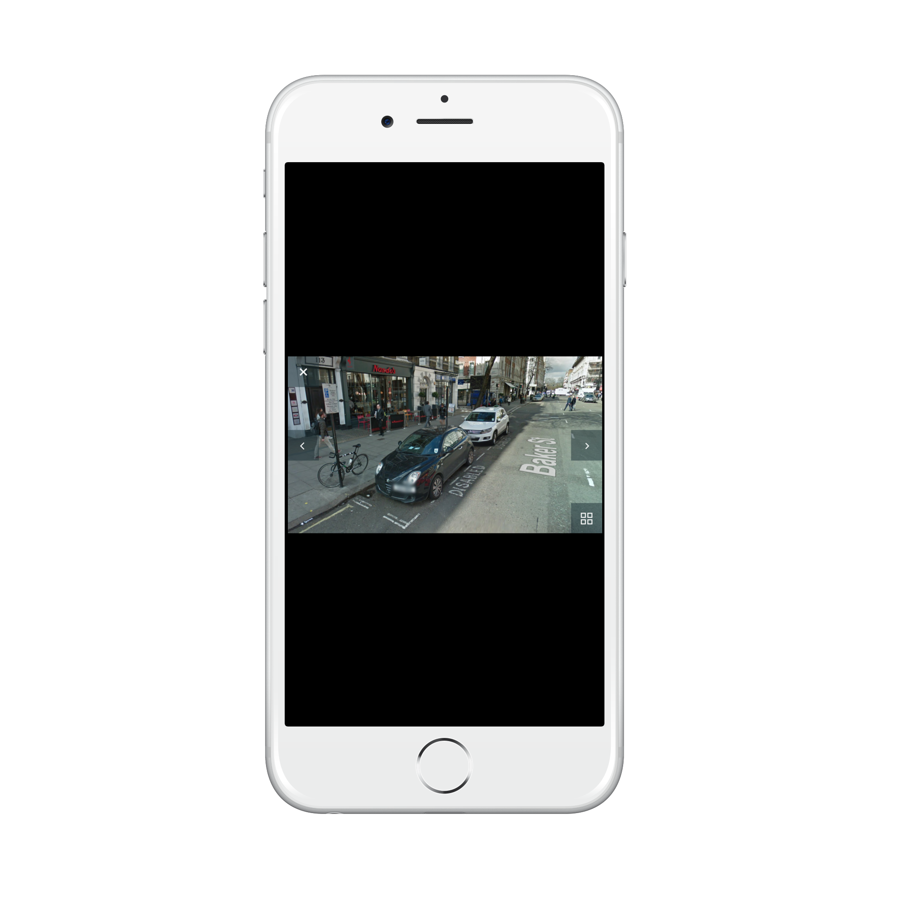
Bay Details
Drivers can click on a bay to find out more information including dimensions, restrictions and pricing, as well as detailed photographs of the location of the bay.

Slide 13
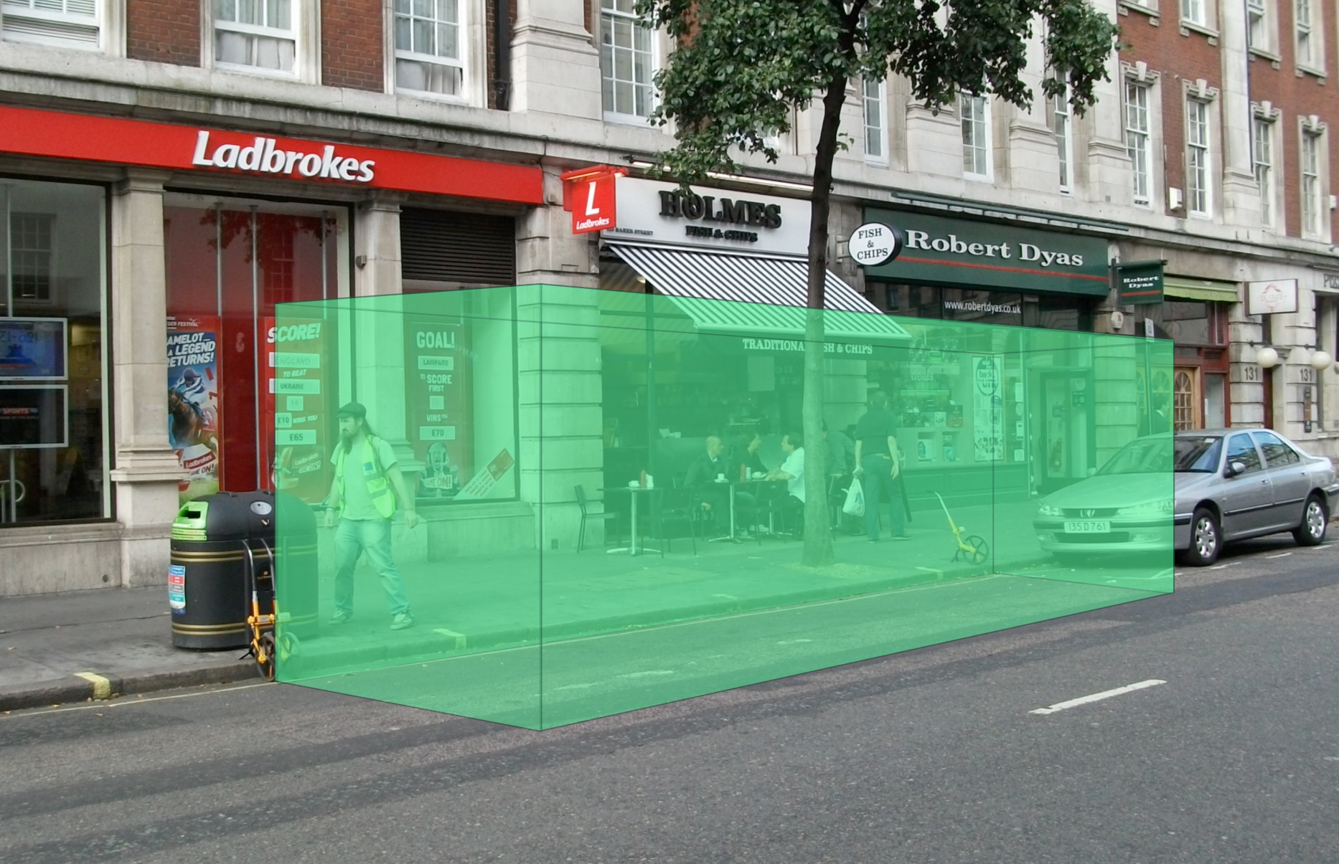

Slide 14
Benefits of Kerb?
Haulier
Local Authority
Optimises deliveries, with pre-booked space.
Brings previously restricted locations into use.
Reduces PCN and processing costs.
Provides cost certainty.
Provides a tool to reduce emissions and congestion.
Helps them encourage lower emission vehicles.
Reduces the cost associated with administering PCNs.
Creates certainty in the form of fixed booking revenue.
Notes:
DIVIDE INTO TWO

Slide 15
Benefits of Kerb?
Utilises kerb space on routes that traditionally prohibit loading and unloading – allowing deliveries at previously difficult to reach locations outside peak traffic hours.
Saves hauliers money by reducing the time and mileage spent searching for available kerb space.
Sending ‘real time’ updates to Civil Enforcement Officers (CEOs) about bookings made so they don’t issue a PCN to the vehicles that have bookings.

Slide 16
Benefits of Kerb?
Enables more deliveries per vehicle due to efficiency gains, leading to fewer vehicles entering the city centre.
Reduced particulate matter, Nitrogen Oxide and CO2 emissions in keeping with the London Mayor’s action plan on emissions, business “Corporate Social Responsibility” policies and international air quality standards.
Encourages take-up of electric vehicles (EVs) by the delivery industry, by providing bookable EV bays which could be served by 'at location' rapid chargers.

Slide 17
The Kerb Solutions
Virtual Loading Bays
(VLBs)
Virtual Loading Extensions
(VLEs)
Virtual Holding Bays
(VHBs)
Used in areas where loading is prohibited to create extra loading opportunity windows.
Used in areas where loading is allowed but time-limited – ensuring longer loading for consolidated deliveries does not lead to the operator being penalised.
Area of kerbspace in the proximity of construction sites – could be built into / costed as a planning requirement S.106.

Slide 18
The Kerb Solutions
Virtual Electric Bays
(VEBs)
Virtual Disabled Bays
(VDBs)
Virtual Coach &
Rest Bays
(VCBs / VRBs)
Charging of EVs is likely to place considerable demand on physical parking bays. Therefore creating an EV dispensation on SYLs / DYLs where street furniture can be adapted as charging infrastructure allows the restrictions to ‘go-live’ at permitted times.
Only relevant to the four core boroughs in London – Westminster / Kensington and Chelsea / City of London / Camden (part) where the national Blue Badge Rules do not apply.
Areas similar to virtual Loading Extensions where drivers are allowed to park but rewuire a greater amount of time. Appropriate in Tourist Areas & Sports events.

Slide 19
Support for the Solution
Air quality is now the big UK driver, now that the detrimental effects of poor air quality caused by congestion and vehicle emissions have been identified and qualified by institutions including Kings College.
The need for Virtual Loading Bays and Intelligent Kerbside Management is included in the London Mayor’s Air Quality Strategy and is being adopted by boroughs across London.

Slide 20
Current Position
Innovate UK has engaged Grid Smarter Cities to undertake trials on-street under their First of a Kind (FOIK) programme.
The software is built and in testing.
The first VLBs will go live in Wandsworth this month, and in other boroughs before the end of the year.
Funding is available until March 2018 for other local authorities to join the trial.

Slide 21
Discussion

Slide 22
Contact
John McArdle
Stakeholder Manager
John.mcardle@gridsmartercities.com
Neil Herron
Founder - Grid Smarter Cities
neil.herron@gridsmartercities.com
hello@kerbuk.com
kerbuk.com

