Slide 1




User Group
19th April 2018
p
Notes:
So here we are, 5 weeks until the biggest change to data protection in 20 years, and I think it’s fair to say there will be some trepidation felt by most in this room.
Are we ready?
I must admit when I saw this agenda item, a little trepidation filled me at having to stand up here and answer that question.
What does that mean? are we ready for the new world after GDPR becomes enforceable? After all it will be a fresh page for data protection. No case law is in place to clarify the grey areas and no one knows how data protection will evolve over the next year.
And we all still wait with bated breath for the allusive Data Protection act 2018, due to be enacted into law before 25th May. At present the Bill has 3 more stages to pass before royal assent and becoming an Act. Will it be ready?
Then of course the Article 29 working party are still putting together guides on how to interpret the new legislation and this will go on past the 25th May. So, can we truly be ready?
But there is light at the end of the tunnel, even if very faint. last week I heard the Information commissioner Elizabeth Denham’s, speech from the Data Protection Practitioners Conference and although her words were much more eloquent than mine, they mimicked some of my sentiments today.

Slide 2
Application Support
19th April 2018 – Edward Davies
p

Slide 3

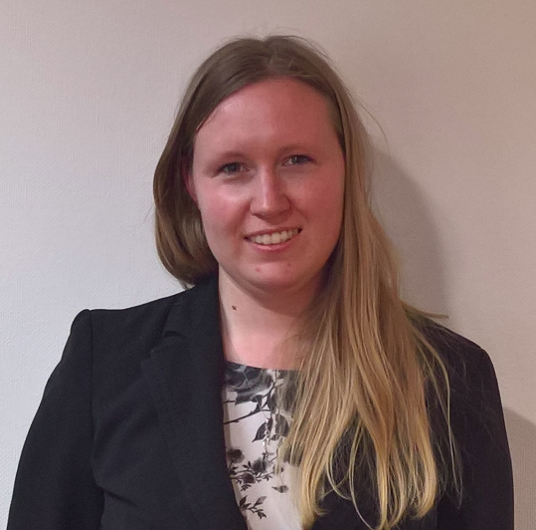
Application Support Team
New on the Support Desk
Emily Ives joined the Support Desk Team
as an Support Desk Engineer. 12th March 2018
Emily Ives

Slide 4
Application Support Team
Support Team Staff
Kevin Johnston – (Manager)
Edward Davies
Mike Barber
William McCombe
Kieran Walsh
Ben Stollar
Liz Taylor
Emily Ives
Phil Meredith

Slide 5
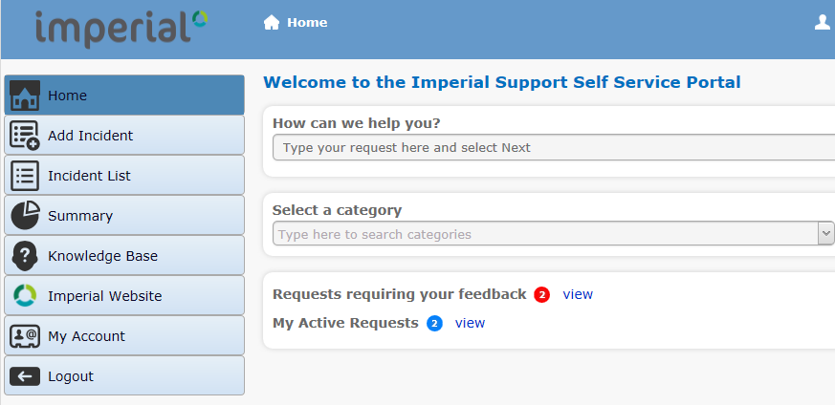
Richmond Portal - Update
New URL: https://support.imperial.co.uk/
One Location for all Support Calls
Support Document Library
If you don’t have a login, and would like one:
Please email: Support@imperial.co.uk

Slide 6
Application Support Team
Thank you for your time.
Any Questions?

Slide 7
Imperial Update
Mandy Watson
Sales Manager

Slide 8
New Customers
Dacorum Borough Council
Hertsmere Borough Council
Slough Borough Council
University of Glasgow
Watford Borough Council

Slide 9
New Staff
Imperial Development
Paul Stock - Software Development Manager
Open Parking – Specialist Private Land parking
Justin Ben-Nathan - Business Development Managers
Sharon Silcock - Business Development Managers

Slide 10
3sixty Citizen V3.7
Key features
  • Supports server to server communication via https using TLS 1.1 and 1.2 protocols (previously only up to TLS 1.0).
    Customers using DataCash payments require support for this feature by April 30th 2018 when DataCash will stop accepting connections via TLS 1.0.
  • Screens collecting contact details will now use a dropdown selection list of all titles as configured in 3sixty Notice Processing
  • ‘Send E-mail’ function captions and messages can now be reconfigured to be more specific to making a ‘challenge’ or ‘appeal’, and the caption on the button linking into this function is now also configurable.

Slide 11
Geneva
Continue to add functionality
Assign incoming email
Transaction entry and payment batches function
Additional reports
Case and record lock utility
Improvements to workflow
Ability to search SAFE report by description

Slide 12
Parking Gateway and
Permit Gateway
End of support date 31st October 2019
Permit Gateway not GDPR compliant

Slide 13
PermitSmarti
The following key new features are now available in V2.0
• Help text, terms and conditions, email templates, address/permit eligibility rules
  These can all be added or amended by the Front Office web site
• Conditional questions
  The permit application ‘questionnaire’ section is enhanced. It is possible to configure additional questions that may or may not be asked depending on the answer to an initial (‘primary’) question.
• Reuse proof documents
  In the permit application and renewal processes an account holder can choose, where appropriate, to refer to a copy of a proof document that has previously been uploaded.
• Data purge
  In preparation for the implementation of the General Data Protection Regulation (GDPR), a comprehensive set of data ‘purge’ facilities are provided.

Slide 14
PowerCube
A new version of PowerCube is now available
Key Features
• Web based
  Can login from any computer
• Dashboard
  Customers can easily see performance of enforcement and back office just by logging in
• Report Scheduling
  Once created reports can be scheduled to run automatically and emailed

