Slide 1




GDPR -
Are we ready?
p
Notes:
So here we are, 5 weeks until the biggest change to data protection in 20 years, and I think it’s fair to say there will be some trepidation felt by most in this room.
Are we ready?
I must admit when I saw this agenda item, a little trepidation filled me at having to stand up here and answer that question.
What does that mean? are we ready for the new world after GDPR becomes enforceable? After all it will be a fresh page for data protection. No case law is in place to clarify the grey areas and no one knows how data protection will evolve over the next year.
And we all still wait with bated breath for the allusive Data Protection act 2018, due to be enacted into law before 25th May. At present the Bill has 3 more stages to pass before royal assent and becoming an Act. Will it be ready?
Then of course the Article 29 working party are still putting together guides on how to interpret the new legislation and this will go on past the 25th May. So, can we truly be ready?
But there is light at the end of the tunnel, even if very faint. last week I heard the Information commissioner Elizabeth Denham’s, speech from the Data Protection Practitioners Conference and although her words were much more eloquent than mine, they mimicked some of my sentiments today.

Slide 2
“So here we are, days away from the first day of a new era for data protection. Does it feel like there’s a light at the end of the tunnel?
We want you to feel prepared, equipped and excited about the GDPR. I know many, many of you do. For those that still feel there is work to be done – and there are many of those too – I want to reassure you that there is no deadline.
In fact, it’s important that we all understand there is no deadline. 25 May is not the end. It is the beginning.”
Excerpt from Elizabeth Denham’s speech at the Data Protection Practitioners’ Conference on 9 April 2018.
Notes:
Despite my earlier ramblings I am convinced that on the 25th May Imperial will be one of the companies who feel prepared and equipped for GDPR and yes, I am excited I can’t speak for others in the company who are probably fed up of hearing me go on about GDPR but I am excited. We are ready or as ready as any company in the UK can be but at the same time there is work to be done.

Slide 3
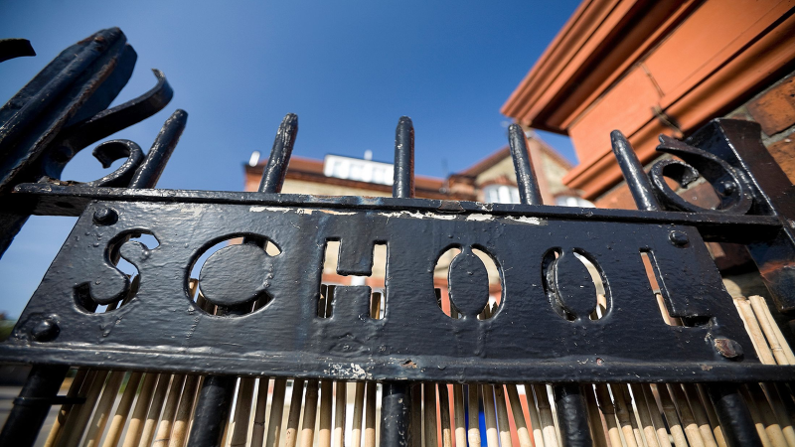
Notes:
Because ready in this case is like the first day of school, your parents have seen you off and your stood at the gates waiting to go in, with your tie all neat, your blazer probably a bit big, but you will grow into it, right? Clean new shoes and a bag full of new stationary and technology.
But in our case, we will be stood at the GDPR gates with a copy of “12 Steps to take now” stuffed under our arm all ticked off and completed and bundles of Article 29 working party guidance sticking out of our back pack.
And this is where our journey actually starts not two years ago this has just been the run up to the real show that is yet to come. But what did we do to get to these gates?

Slide 4
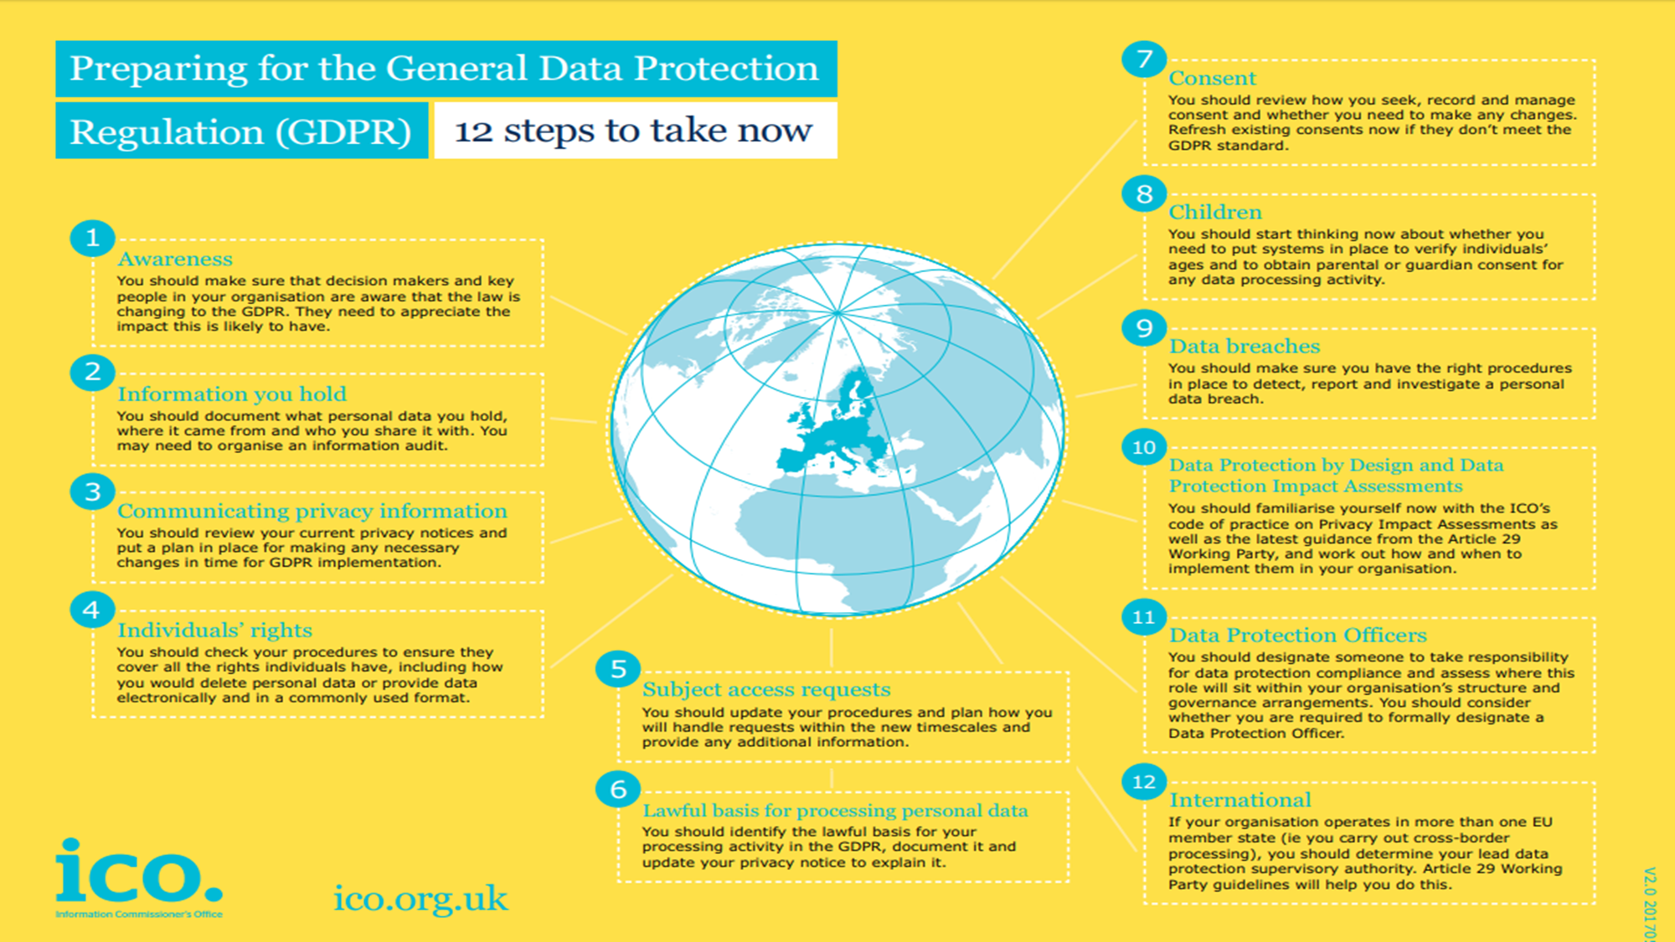



Notes:
Click Awareness, our employees have continued to be a credit to the company by embracing GDPR and their obligations, and I can honestly say I don’t think there is a single person in the company who has not been involved in the implementation of changes one way or another. Whether it’s been amending policies, changing software or simple giving feedback on process changes. We also ensured we put together awareness documents for our clients, if you have visited our webpage recently you may have seen our GDPR statement or maybe you have been working with our commercial team to help get your GDPR in place whether it be ticket rolls, letters or software.
To ensure all our employees are prepared we have put in place access to all policies, processes and training material and we will shortly be starting a programme aimed at making sure all employees are reminded of their obligations under GDPR regularly and can evidence their knowledge.
Click Information you hold, after an exhaustive audit of our products, policies, processes and procedures we were able to say exactly what personal data we held, processed or transferred in and out of the business. This fed into our Article 30 documentation and also lead to a number of discussions around personal data that was no longer needed to be kept. We have built a retention policy from this that is focused on the Principles of GDPR and the 8 rights of data subjects.
Click Communicating Privacy notice, we have amended all our privacy notices from across all areas of our business and added a new one specifically for our employees. In doing this we have ensured we have covered all data subjects that come into contact with the business whether they be potential or current customers, motorists, third parties or part of a marketing campaign. These policies have been tested under the ICO & BPA’s Law lines checklists and I am pleased to say have met the expectations.
Click Individuals rights, our processes and software have been checked to ensure we can accommodate the data subject’s 8 rights and this was key to get right as from the 25th May any one of those rights could be requested by a data subject which of course includes any of our employees at Imperial from our MD down. Let’s not forget that one of these rights is the Right of Access and that Subject access requests will be free of charge and provided within 30 days. We are continuing to review and improve our systems to ensure that they are able to meet the 6 principles of GDPR and allow for the 8 rights of data subjects. And even though this is possible now, we are still looking on how to improve this.
Click Lawful basis, Part of our audit was to identify, document and raise awareness of our lawful basis. It was ok me or Ashley knowing this but what about the employees who are on the front line dealing with data, they should know how and why they are handling this data as well as why we can process their data. And importantly what the data subject’s rights are under these lawful bases.
Click Children, although we aren’t a business who necessarily works with children’s data we were aware that we could come into contact with a child’s data inadvertently in our day to day work whether it was a parent delayed back to their car due to a child’s hospital appointment or an employee looking to join the childcare Vouchers scheme, the data was there and that was enough so it was important that our employees who were affected by this knew their obligations and that our privacy policies could cater for this.
Click Data Breaches, the first thing we did to ensure we could minimise Data breaches was to make sure there was no policy, process or system within Imperial that could lead to a data breach, this has led to a number of decisions on what changes would look like and what we can put in place in all areas to prevent breaches. A full risk assessment was run with input from all areas of the business. The outcome of this is that we now have new and updated policies and processes that are robust and promote transparency to all the data subjects we deal with and ensure our employees are within GDPR obligations. We have a new risk register which we will have ongoing work to see if we can reduce the risks and help prevent breaches in the future. All this helps but it doesn’t eradicate the chance of a breach and so we have also put together a new Breach reporting process to ensure if the worst should happen the Clients and the ICO can easily be notified within the 72 hours reporting deadline and imperial can be confident that we can identify what went wrong and how we can fix it.
Click Data Protection by Design & DPIA
I believe what we have done with the previous 9 steps already shows that from the ground up, we are ensuring that what we do has data protection by design at its core, employees who are processing or work in areas that see data are appropriately trained to do their jobs and how to handle the data in their control. Our policies & processes back the rights and principles of GDPR. Our systems and infrastructure are set up in such a way to ensure security for those of you who may not know, Imperial is now Cyber Essentials Certified and as a further measure to improve Cyber security, we are now registered with the Cyber Security Information Sharing Partnership (CISP) through the National Cyber Security Centre.
Click Data Protection Officer, very early on Imperial took the decision to designate a Data Protection Officer who could be dedicated to the company’s commitment to Data Protection and its journey to GDPR. And that person was me so it’s probably a good thing that I am the person in the room excited about GDPR. But I warn you if you get to close to me I can talk about GDPR all day.

Slide 5

Notes:
So, what’s next for Imperial and GDPR.
What we have done so far isn’t enough for us and in the days, weeks and months after the 25th May we will be continuing to monitor and review all areas of our business and as and when the case law comes through, and the clarification is received, we will be putting further measures in place to strength not only our data protection but yours as well.
The ICO recently released its “Your Data Matters Campaign” with the aim to increase the public's trust and confidence in how their data is used and made available. With the trust and confidence, will come knowledge, Knowledge of data subject’s rights and where their data is shared specifically. This will impact businesses, in particular industry’s such as ours for the better and worse.
Data subjects who genuinely didn’t know what to do regarding their data processing will be able to get advice through this campaign when previously they may have turned to the internet and forums. But of course, the person who deliberately looks for loop holes will remain and will interpret this information in such a way to further their cause.
Last but by no means least Brexit, we know GDPR is here to stay after Brexit but what that looks like is yet to be agreed.

Slide 6

Notes:
So, are we ready?
Yes, we are ready to cross through the GDPR gates and on to the new data protection world.

