Slide 1
Imperial AGM User Group Meeting
24th September 2020

Slide 2
Welcome
Cohort Plc Overview
SEA Overview
Geographic Overview
Industry Exposure
SEA Statistics
Traffic Enforcement
Product Details

Slide 3
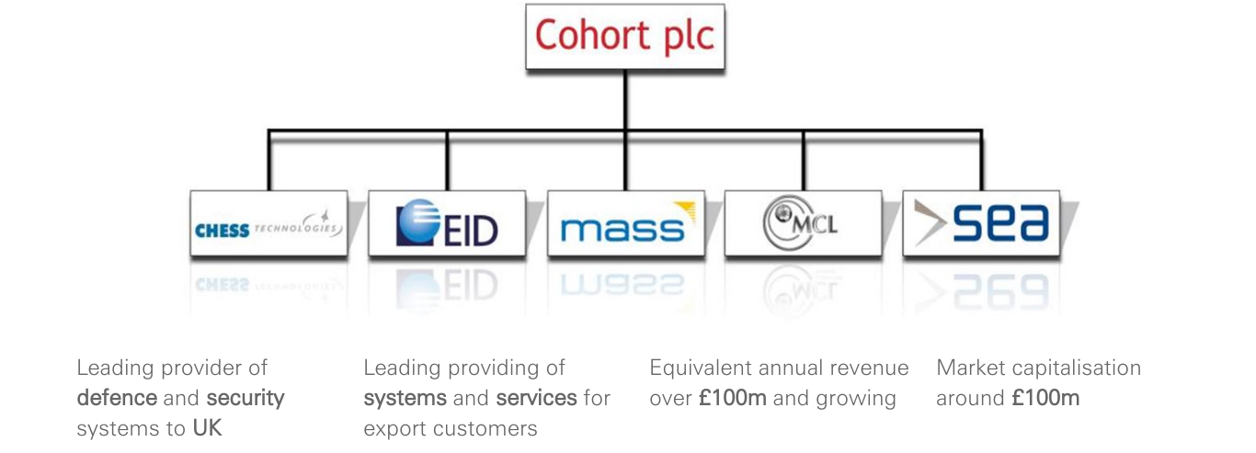
Cohort PLC - Overview

Slide 4

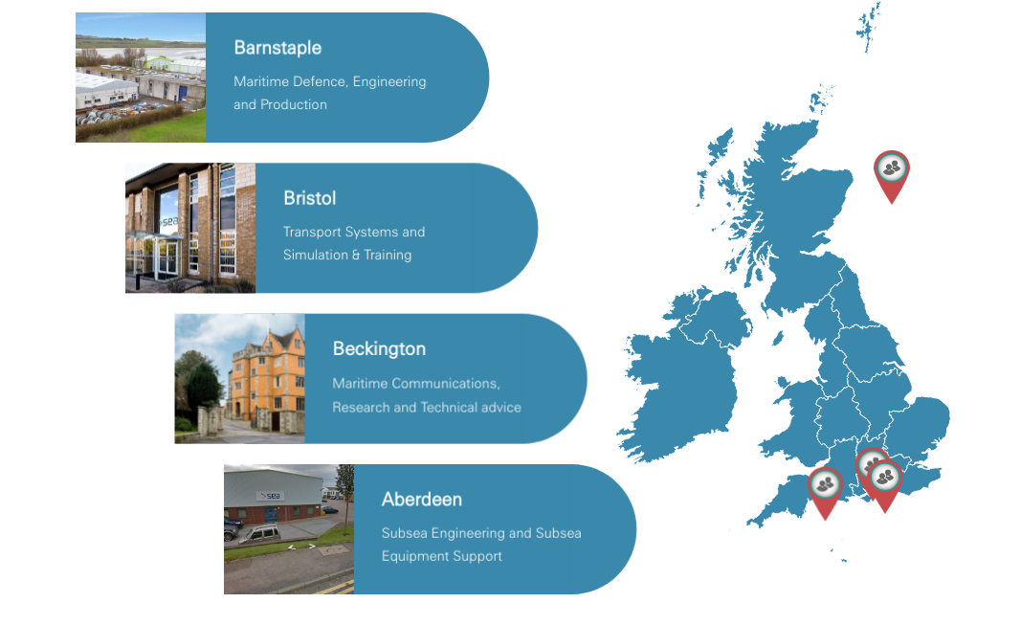
SEA UK Locations

Slide 5

Industry Exposure

Slide 6
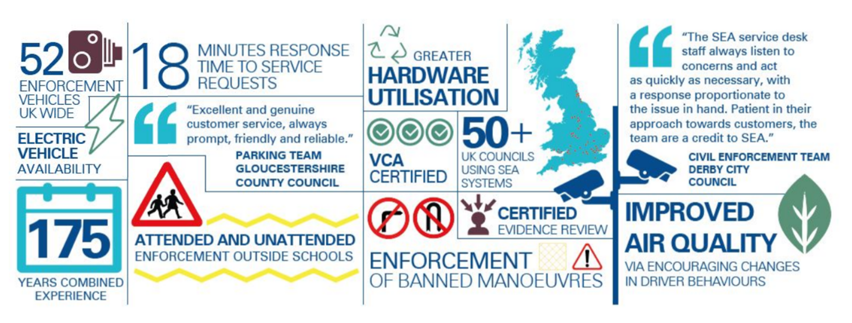
Statistics

Slide 7
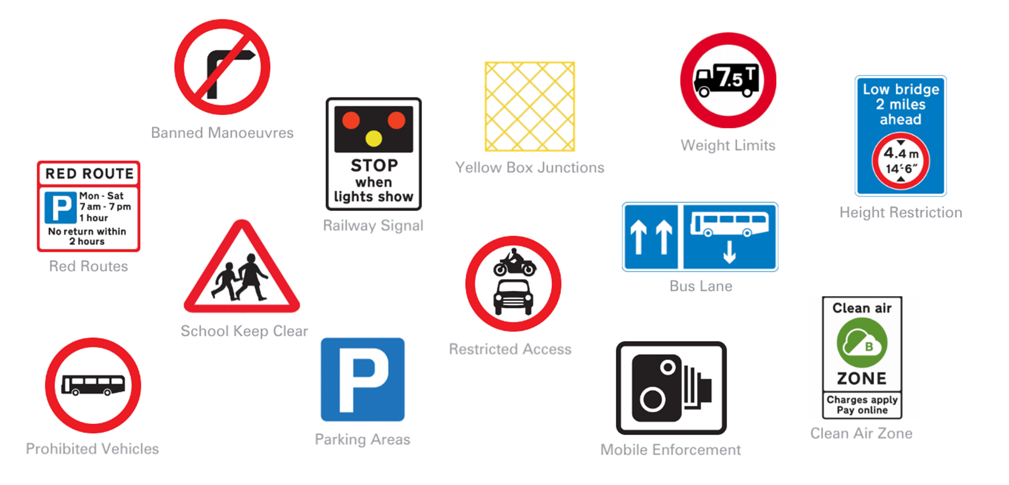
Traffic Enforcement

Slide 8
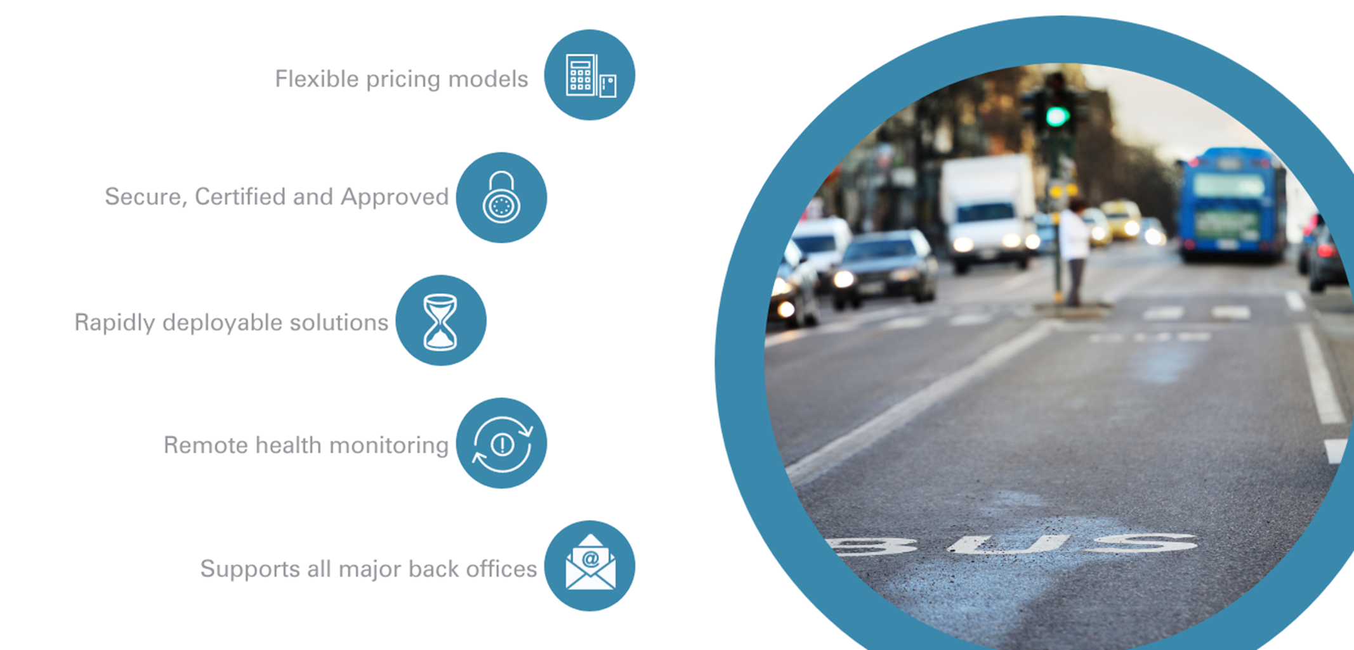
Traffic Enforcement Options

Slide 9
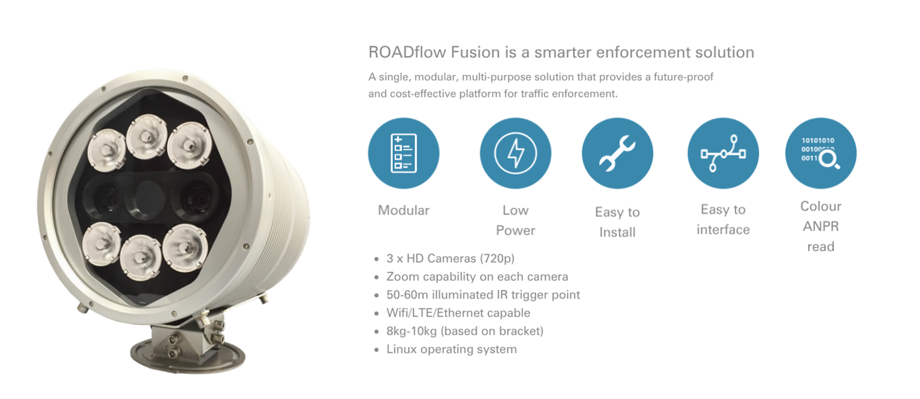
Roadflow Fusion

Slide 10
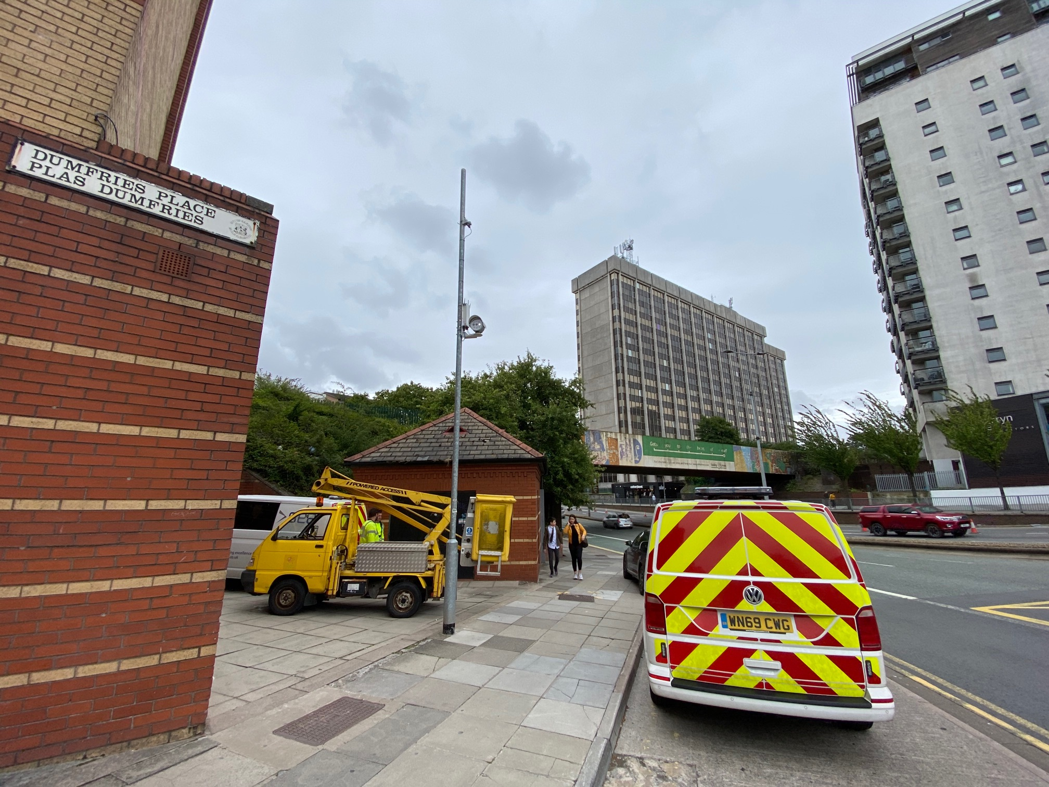
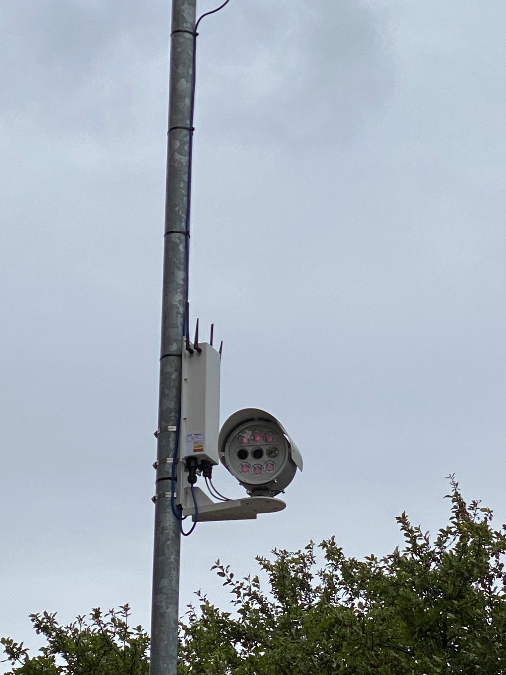
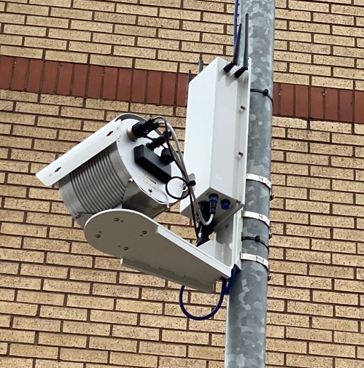
Fusion Update
Latest Fusion Update
SEA have received 5 pre production units
1 x unit is installed in Cardiff on test
Production unit:
  TBC
  TBC
All VCA documentation is ready to be submitted
Fusion is ready for:
  Yellow Boxes
  Banned Manoeuvres
  Bus lanes / bus gates
  School Keep clears
  Cycle lane enforcement
  Red routes

Slide 11
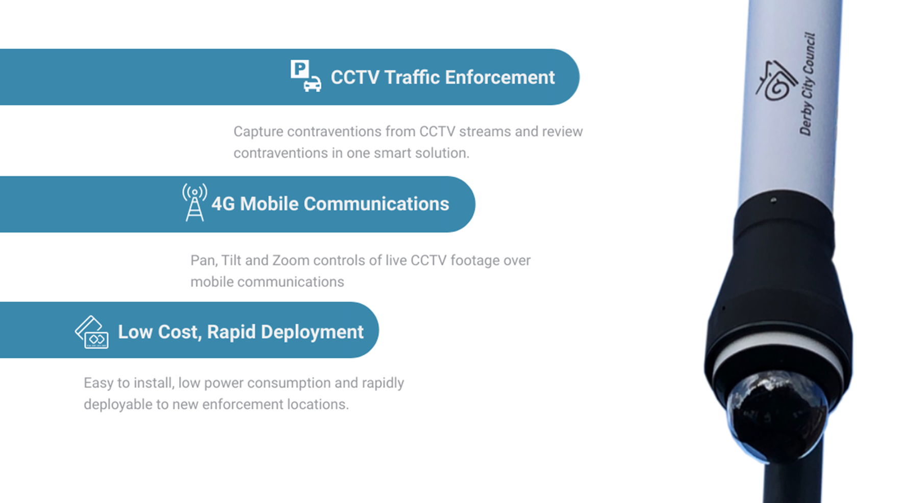
Attended Enforcement Solution

Slide 12
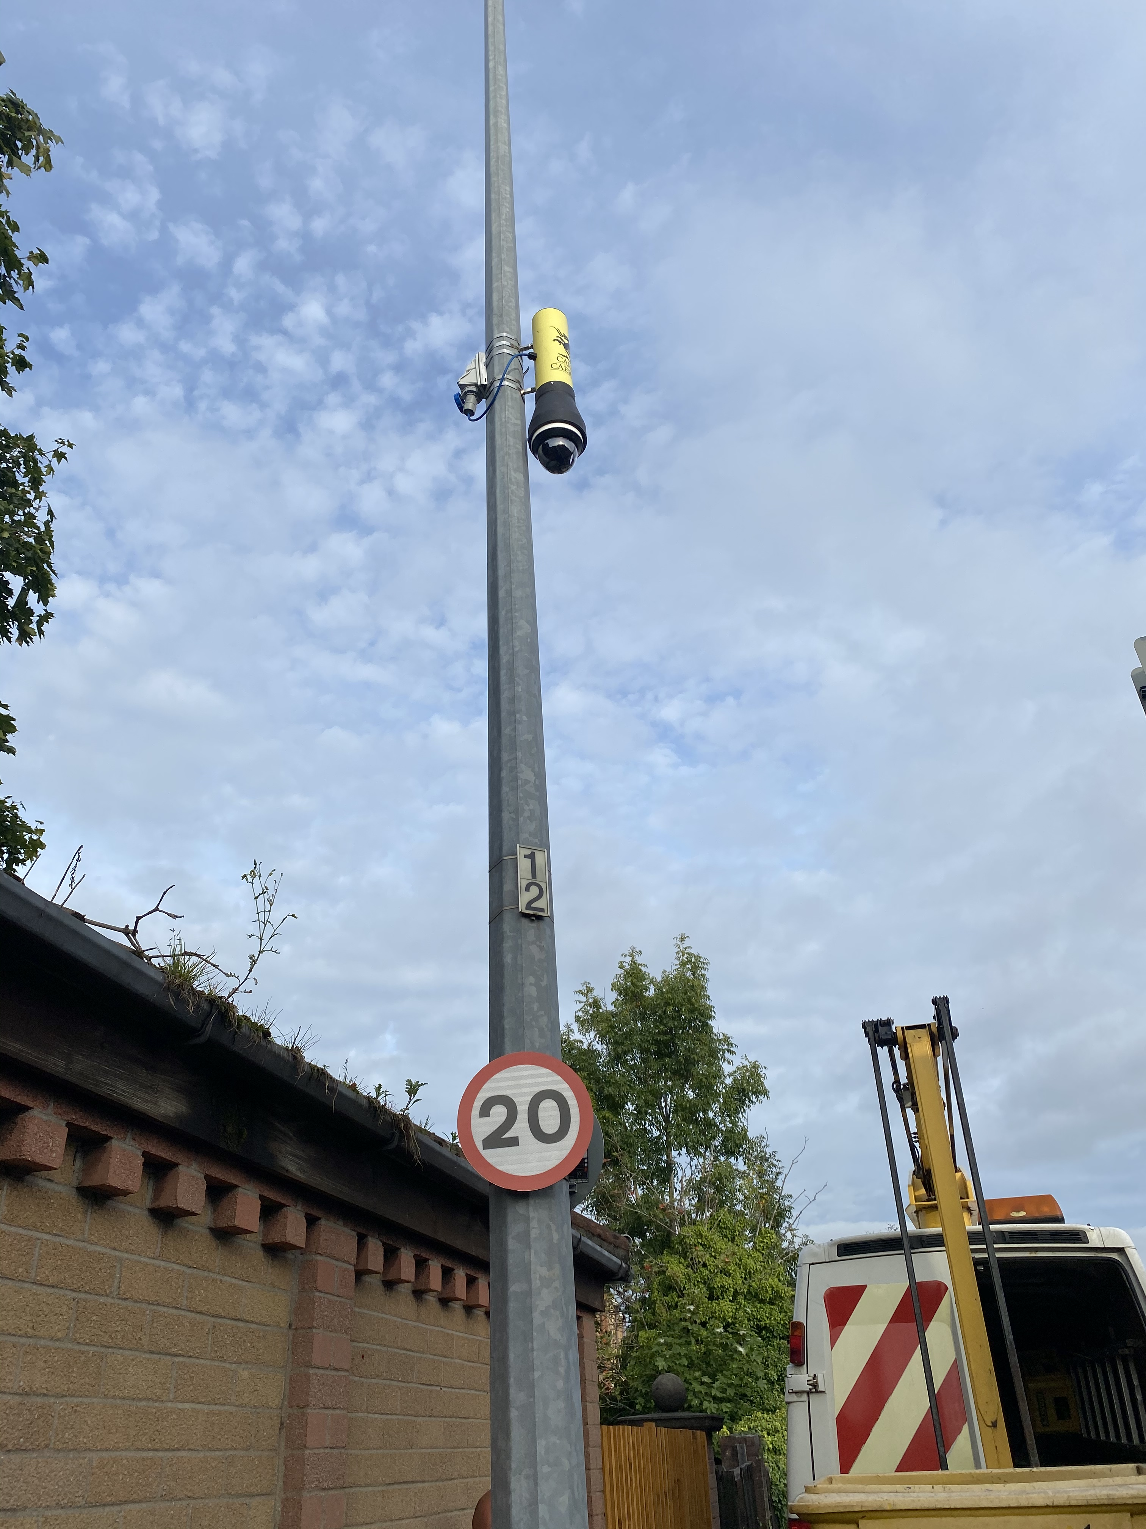
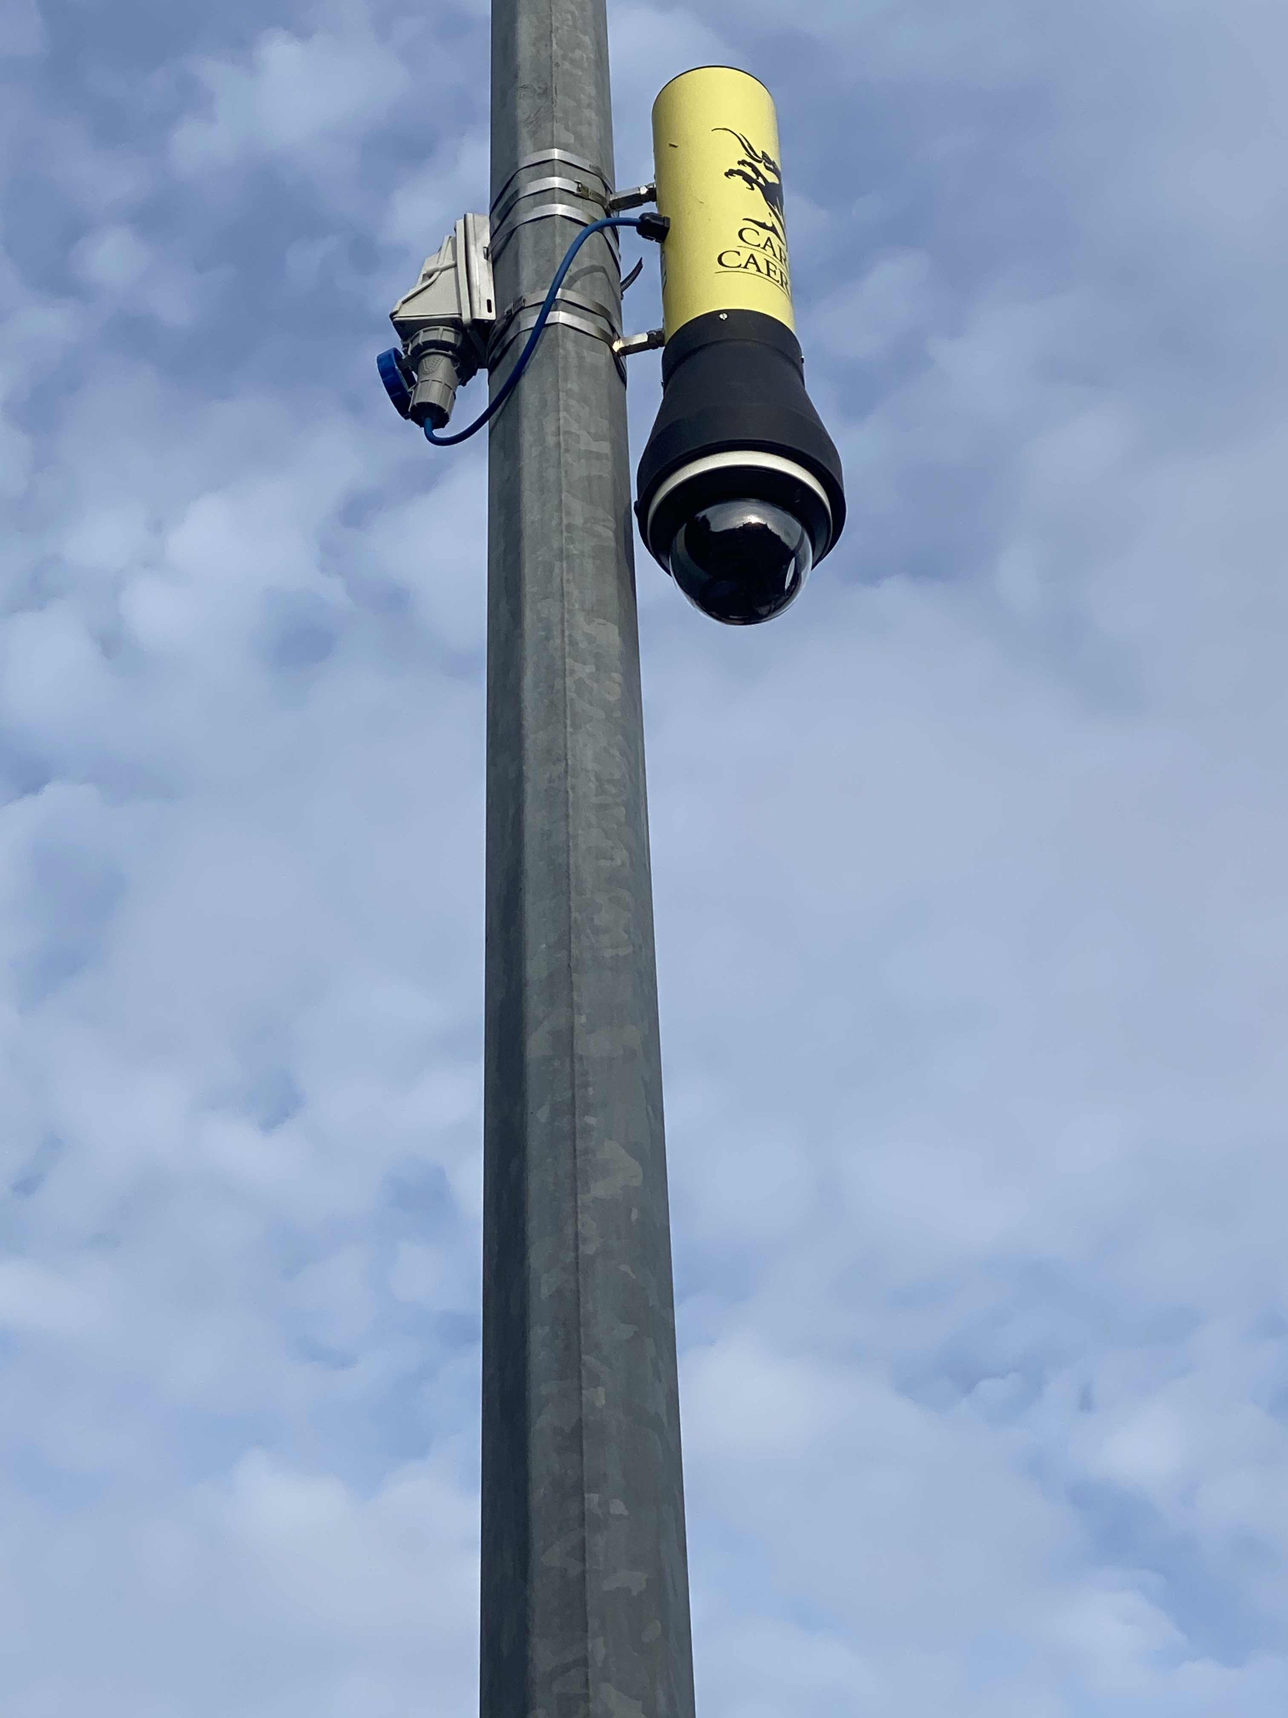
Attended Enforcement (cont)
Attended systems for Cardiff
SEA successful on TMT2 framework mini tender
Delivered 29 systems
4 x back office review suites
Cardiff were trained and carrying out own installations
Duration of contract 3 years

Slide 13

Parking Award 2020

Slide 14


Vision 2 Mobile Enforcement Solution
Enforcement vehicle for Newport
SEA supplied a vision enforcement system
Installed into the council supplied ‘hybrid’ vehicle
First system using Vision 2 hardware
Unattended operation
First vehicles for Newport & Vale of Glamorgan

Slide 15
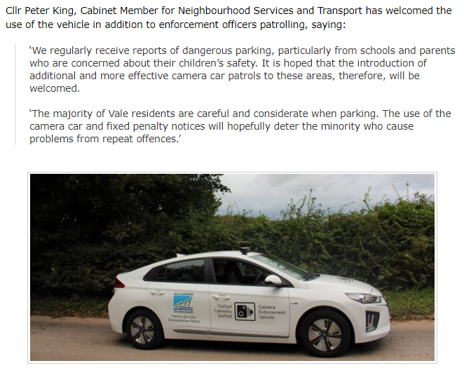
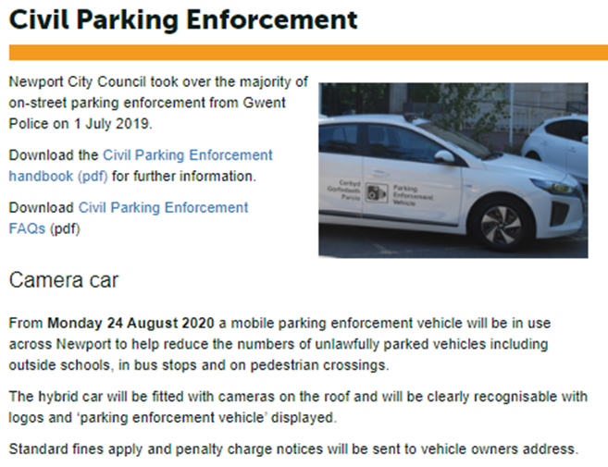
Vision 2 Mobile Enforcement Solution

Slide 16
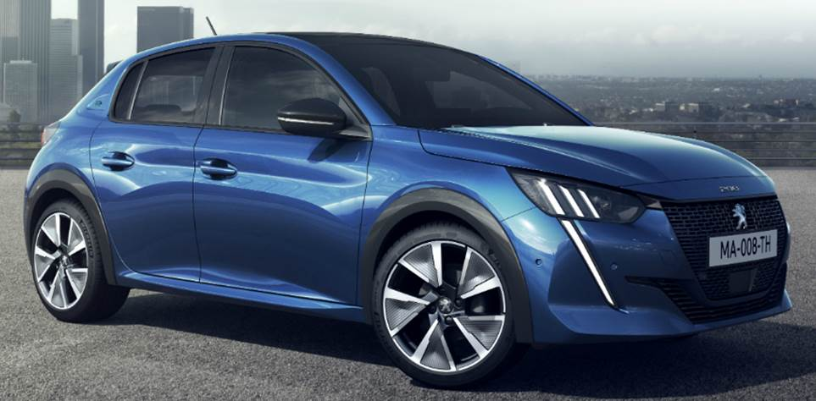
Development for 2020 - Vision 20 | 20
Latest hardware and software
Targeting minimum lifespan for the next 10 years
4 x High Definition cameras
Small form factor cameras
Minimum footprint for vehicle processor box
  Quicker and neater installation options
Exploring the integration options to use in car infotainment system (touchscreens)
Support future use cases
Vision 20 | 20 will provide support for legacy cameras (Analogue)
Low power for use in electric vehicle

Slide 17

Development for 2020 - Spot and Follow (spotting mode)
Integrated with Imperial – Permit Smarti
Live updates every 10 mins
Produces a popup on vehicle screen
  Shows vehicle when it has contravened permit/ parking restrictions
  Alerts Driver in vehicle
  Potential data from Phone parking etc

Slide 18

Development for 2020 - DVLA look up
SEA currently implementing a DVLA link into the ROADflow Replay review suite
New functions that will be available:
Make and Model populated for each Evidence Pack
Easier to find potentially cloned number plates
Vehicle weight and classification (for enforcement)
Emissions value (for Clean Air Zone)
MOT status
Tax status

Slide 19
Development for 2020 - Moving Traffic Contraventions – Part 6 TMA
Grant Schapps Announcement
Cycle Lane Enforcement
School Roads emphasis
Legislation – How far??

Slide 20
THANK YOU
Ian Gamble
E: ian.gamble@sea.co.uk
M: 07884 654175

