Slide 1




User Group
22nd April 2021

Slide 2
Application Support
Mandy Watson

Slide 3
Support Desk
Support Desk Team
Kevin Johnston - Support Desk Manager
Ben Stollar - Senior Support Desk Engineer
Chris Andrews - Support Desk Engineer
Mike Barber - Support Desk Engineer
Cameron Greenham - Support Desk Engineer
Phil Meredith - Support Desk Engineer
Liam Sinclair - Support Desk Engineer
Liz Taylor - Support Desk Engineer

Slide 4
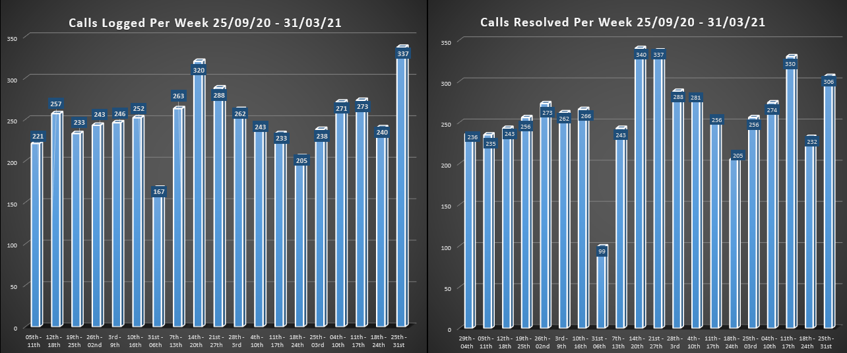
Support calls

Slide 5




Logging calls with The Support Desk
By Web
https://support.imperial.co.uk
By Email
Support@imperial.co.uk
By Phone
01173116688

Slide 6
Software Update

Slide 7
3sixty Web
V2.1 released Jan 21
Includes the following functions:
Generate correspondence either in 3SW or using LetterSmarti
DVLA Interface
Create TPT Case pack
Batch memos
Batch progression
Configuration functions for Address keywords, Break types, CEO maintenance, Contravention maintenance, Excluded postcodes, Issue events, legal codes, Letter definition, Litter types, MRR Codes, name sources, Name types, Payment methods, Progression maintenance, Progression sets, serial number formats, Settings, vehicle codes and Watch lists
Handheld configuration functions for Beats, CEO Comments and Driver’s Notes, Prompts, Special messages and User defined questions
Correspondence Awaiting print (similar to 3Sixty Print queue)
Create Enforcement Agency data
Enforcement Agency returns
Progress Foreign VRMs
Purge
Workflow
Security function – to manage Users and Roles
Transaction search and Entry
Payment Batches
Suspense
Batch Scanning
Dashboard, the SAFE report plus about 80 reports
Assign Incoming email

Slide 8

3sixty Web
First live site TMA 2004
V2.2 released Mar 21
Includes the following functions:
Amend case details
Support progressions which change Progression path (not req. in Batch progression)
V2.3 due end of May 21
Includes the following functions:
Improvements to TEC Interface and County Court returns
Save case details as pdf

Slide 9
Project Verona
(Call to action and response)
Manages incidents recorded in 3sixty
API for 3rd parties
  e.g. Smart Bay sensor overstay, CCTV spotter cars
Future releases:
Real time clamping/removals
Fault reporting

Slide 10
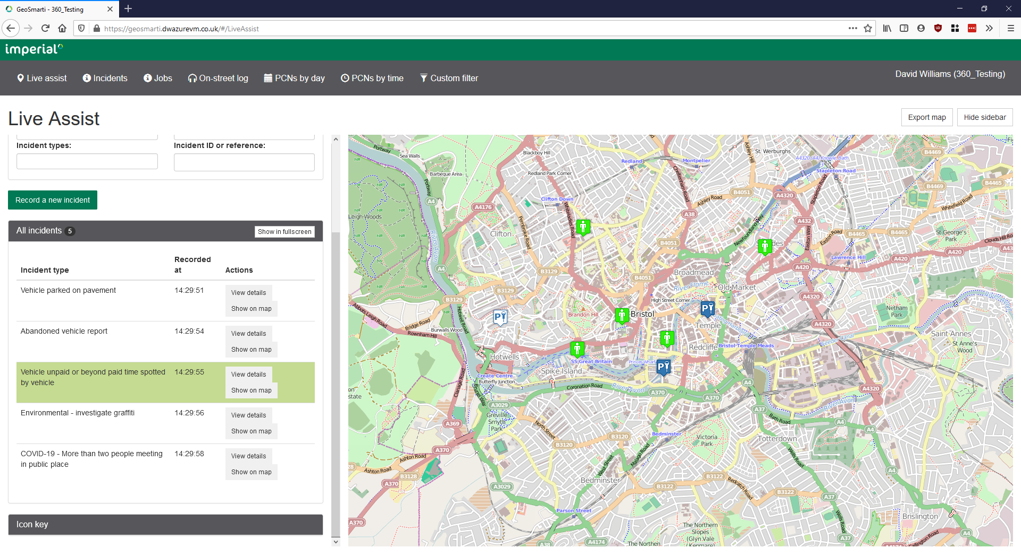

Slide 11
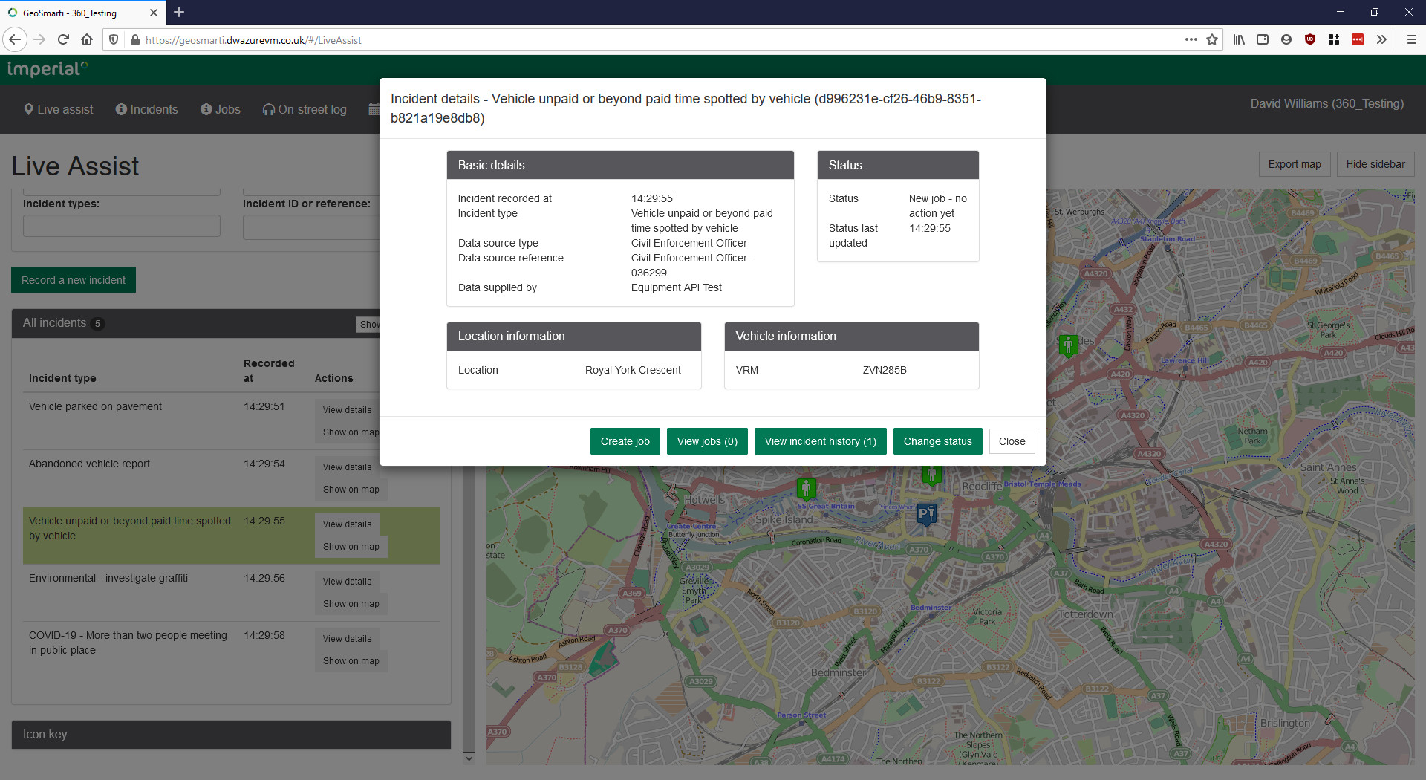

Slide 12
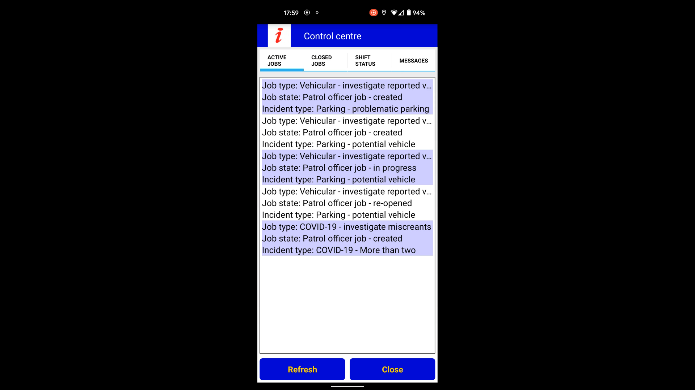
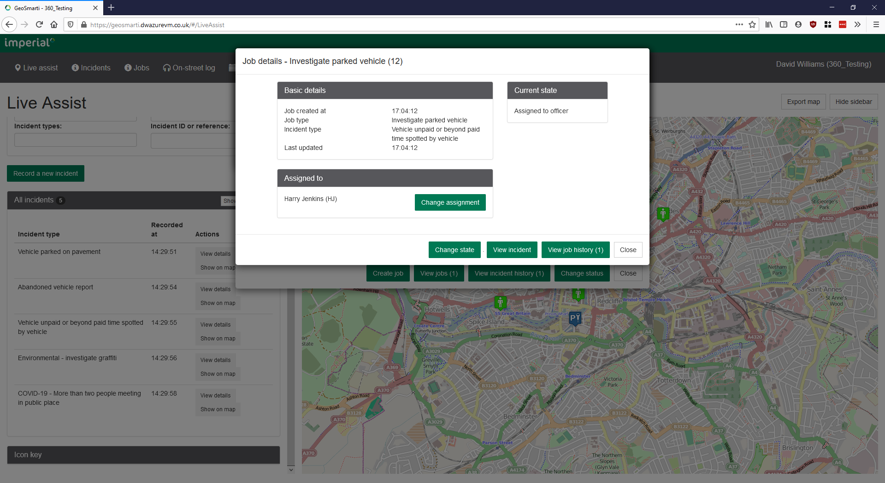


Slide 13
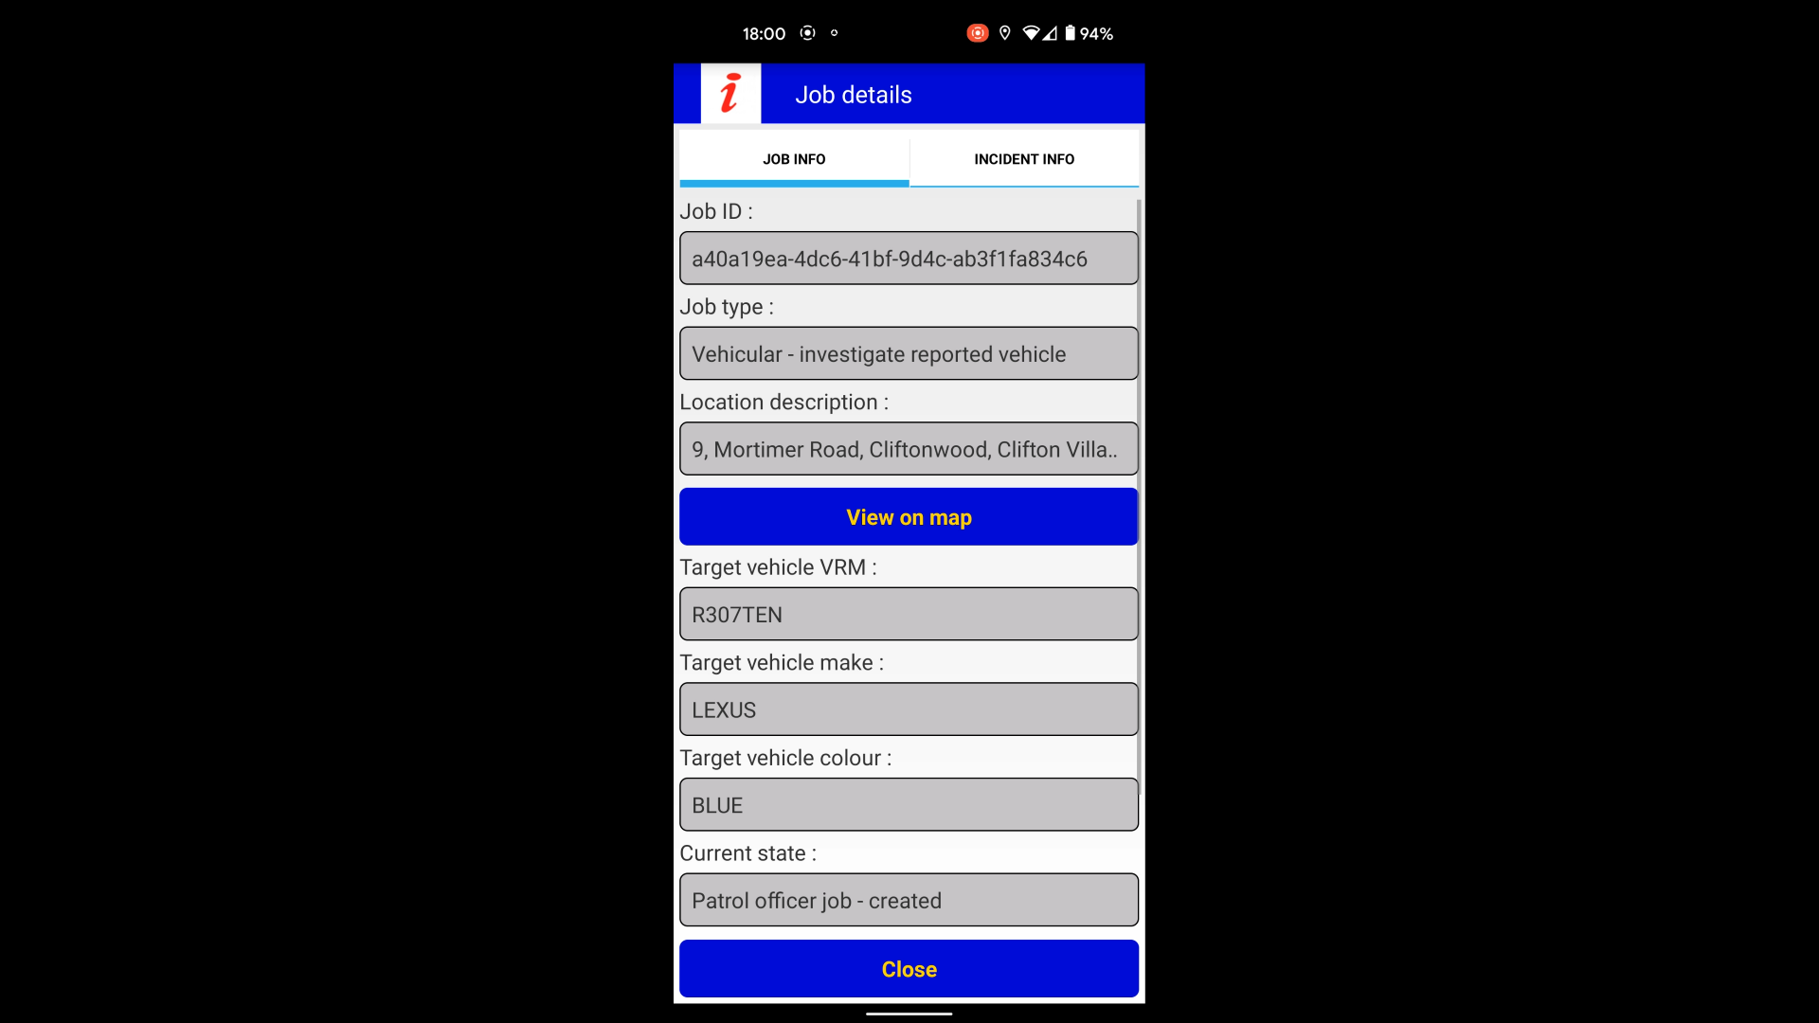

Slide 14
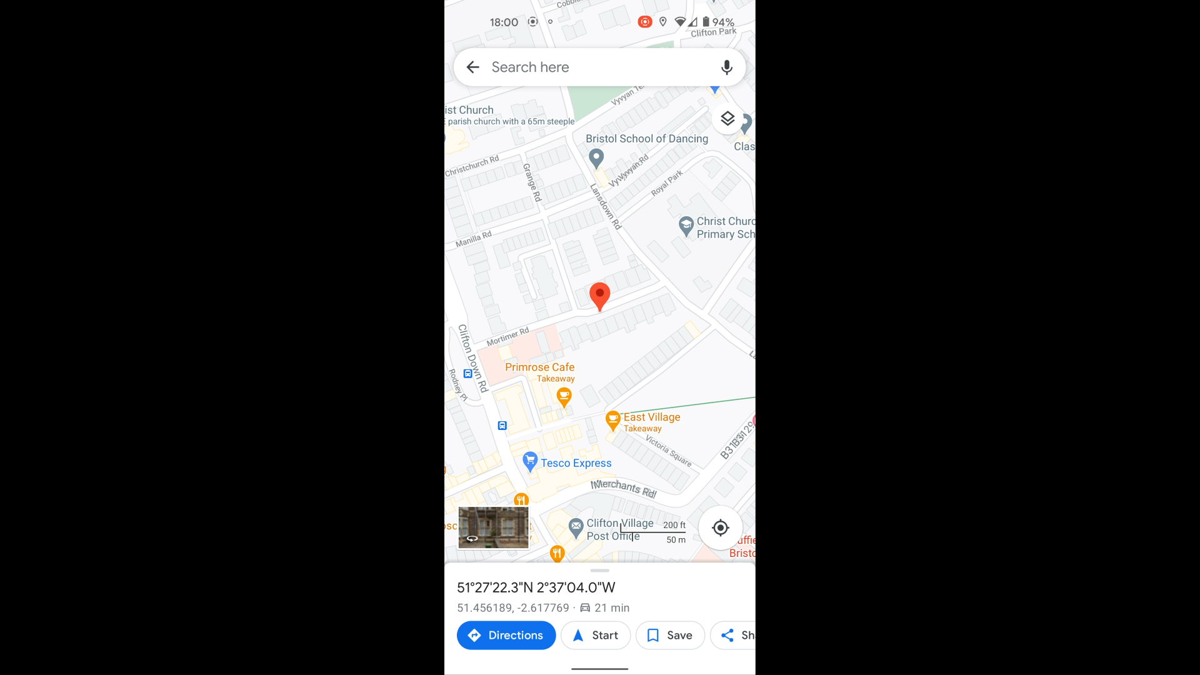

Slide 15
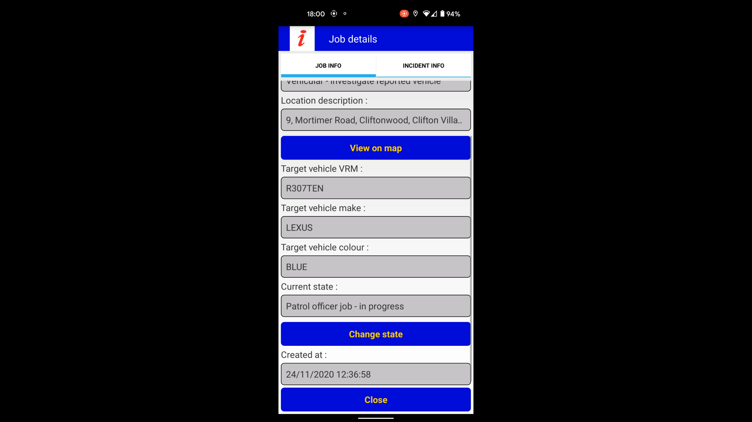

Slide 16
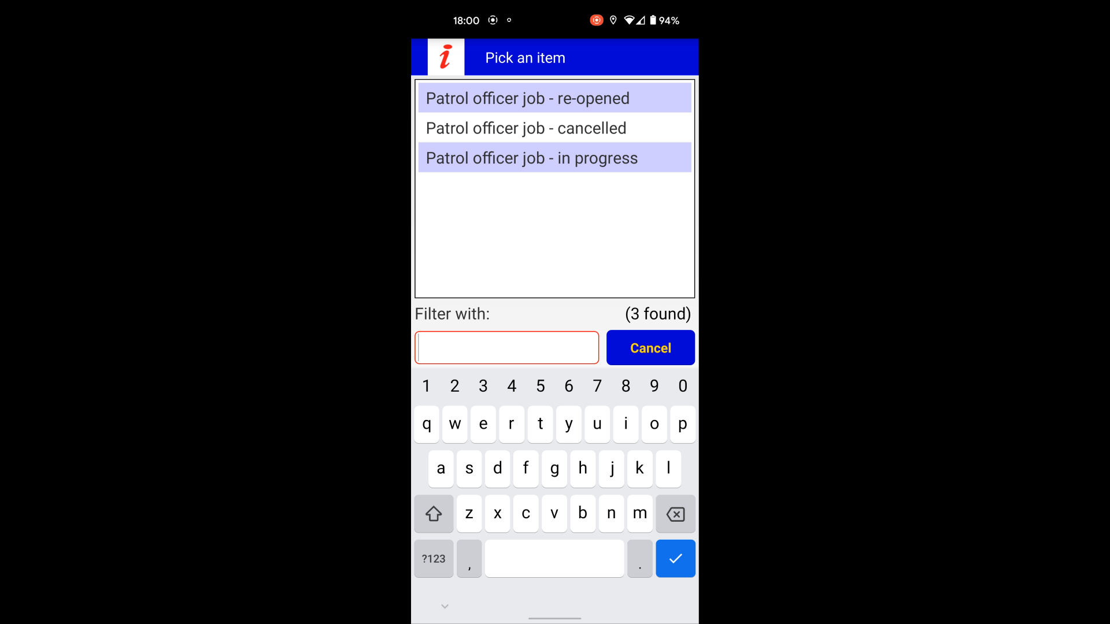

Slide 17
PermitSmarti
V2.9 released Feb 2021
Support for automatic permit renewal using Continuous Payment Authority (CPA) on a customer’s payment card.
New announcement function allowing the public login to show a message, for example regarding permit availability, or operational issues such as COVID.
V3.0 released Mar 2021
Changes to the tariff board permit type to allow sessions to use multiple top-ups.
Foundation work for improvements to address management.

Slide 18
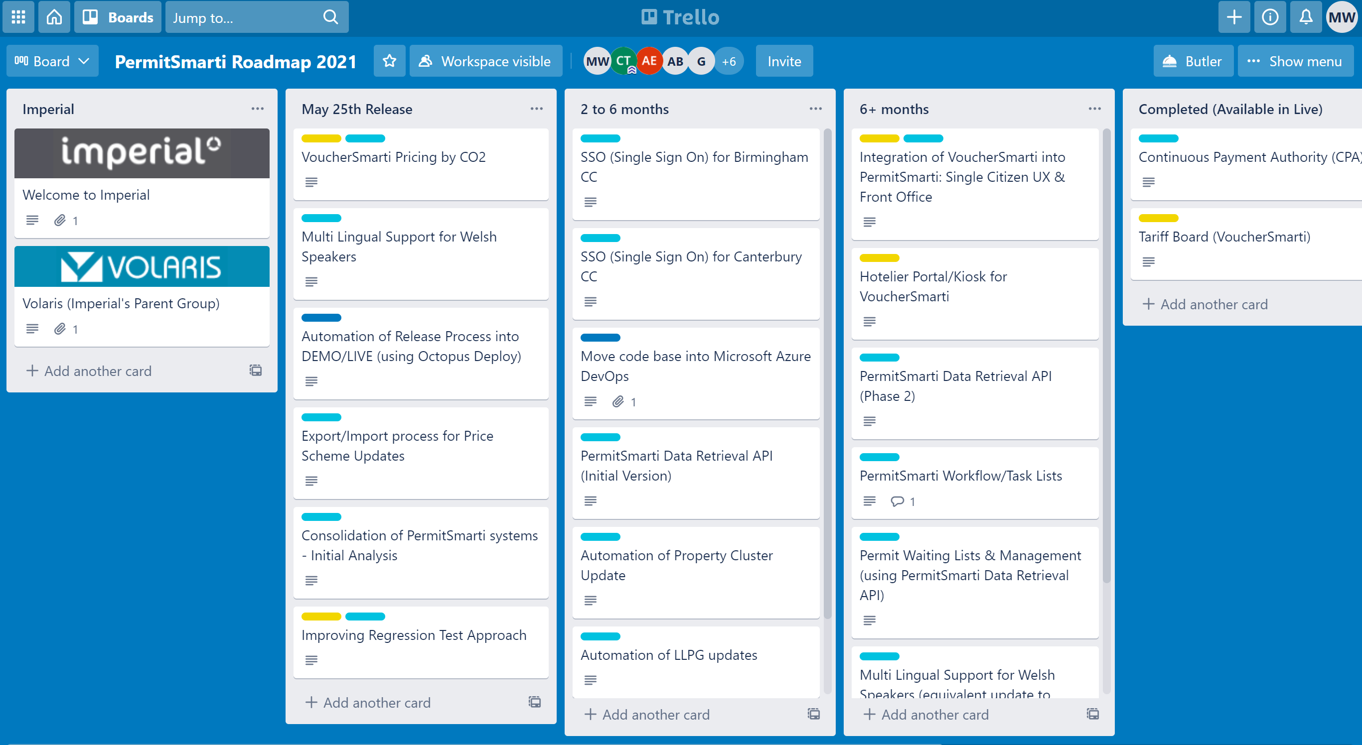
PermitSmarti Roadmap

Slide 19
Payment Services Directive 2
(PSD2)
With effect from 14th September 2021
All online payment card transactions will need to offer Strong Customer Authentication (SCA)
Imperial contacting all Mastercard (Datacash) customers for upgrade

Slide 20

Your thoughts on Moving Traffic Contraventions?

Slide 21
Business Update
Ashley Bijster

Slide 22
New contracts
Aberdeen – CCTV contract
Bury Council
G4S Jersey
Kent County Council – 24 hour Clamping
Lincolnshire County/South Holland District Council
South Lanarkshire Council
Tyne Tunnel

Slide 23
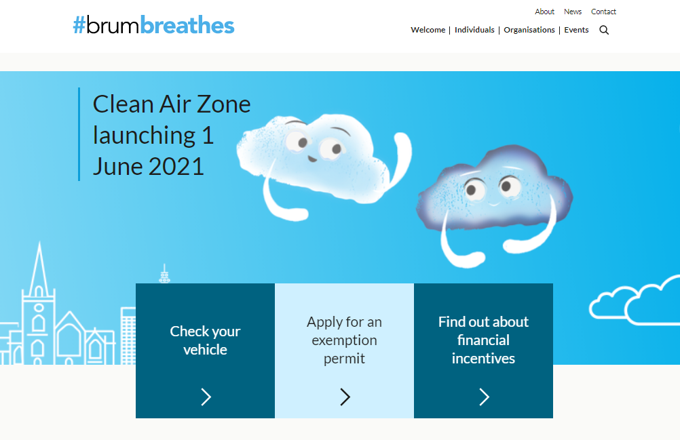
Clean Air Zones

Slide 24
Webinars
Upcoming 29th April – BPU and backlog processing
Previous webinars available on our website:
ChallengeSmarti
3sixty Refunds, Negative Transactions and Suspense
LetterSmarti

Slide 25
New Staff
Chris Tubby
  Product owner for PermitSmarti & VoucherSmarti

Slide 26
Restructure
More focus on the customer
Development and Infrastructure – DevOps

Slide 27
AB
Technical Consultants Martin Stocker
Project Management Jackie Dignam
Support
Kevin Johnston
Training
Software Development Manager
Paul Stock
BPU
Clive Hawthorn
Customer Success Manager
Mandy Watson
Sales & Marketing
Infrastructure
Dan Brereton
Finance
Helen Colbourne
HR
Dawn Landers

Slide 28
Any questions?
p

